Slide 1

Primary-Secondary-Resolvers Membership Proof Systems and their Applications to DNSSEC
Moni Naor
Weizmann Institute
Based on:
NSEC5: Provably Preventing DNSSEC Zone Enumeration Sharon Goldberg, Moni Naor, Dimitris Papadopoulos, Leonid Reyzin, Sachin Vasant, Asaf Ziv
PSR Membership Proof Systems, Moni Naor and Asaf Ziv

Slide 2
The (non) membership problem
Database R of n elements from universe U
  With object x∈R associated information y
Want to allow lookups in R such that
  If x∈R then answer is ‘yes’ and associated y retrieved
  If x∉R then answer is ‘no’
Don’t want to leak more information than this!
Entity providing answer: not trusted wrt to correctness.
Primary Secondary Resolver
Learns if
x is in R
Trusted,
Offline
Not trusted,
Online
Has x∈U
knows primary’s public key

Slide 3
Motivation: Secure DNS Lookups
Example.com: 172.16.254.1
DNS: Domain Name Server
  Allows the translation of names to IP Addresses
  Plain DNS does not guarantee authenticity to users
DNSSEC: Security extension of DNS
  Retrieved records are authenticated (signed)
  What about non-exiting records? Denial of existence
  Current methods leak information about the set
  Allow `zone enumeration’
Want to improve DNSSEC
Listing all names in a domain

Slide 4
How NSEC Works (Roughly)
The primary signs all existing records
  plus link to the next record in sorted order
  Gives all signatures to secondary
  Public key: signing key
Given query x
  If x∈R then secondary gives signature on record
  If x∉R then proof of non existence is:
  signed pair (x₁, x₂) such that x₁ < x < x₂
After a while: learn all of R
  Even with random queries
Unsuccessful
Binary search
Primary Secondary Resolver
Trusted,
Offline
Not trusted,
Online
Has x∈U
knows primary’s public key

Slide 5
Is Zone Enumeration a Real Problem?
Much debate in the networking world: After all this is public information?
There is a difference between willing to answer questions and revealing everything you know
Enumerating hostnames creates a toehold for more complex attacks
Legal reasons to protect host names
  e.g. EU Data Protection laws
IETF rewrote the DNSSEC standard to `deal' with this issue in 2008

Slide 6
How NSEC3 Works (Roughly)
May also add salt
Instead of storing x itself: store h(x)
  h is some one-way/random oracle function
The problem is now similar to the case where one is given oracle access to the membership function
  At best: this is an obfuscated membership program and allows the adversary ``unlimited” queries
Attacks:
    Bernstein’s NSEC3 walker
    GPU-based NSEC3 Hash Breaking
After a while: learn all of h(R)
Wander, Schwittmann, Boelmann, Weis

Slide 7
What Do We Have to Say
Model the problem
  Primary-Secondary-Resolvers Membership Proof Systems
Explain why current attempts have all failed
  Show that the secondary must be performing online public-key authentication per request
  Can convert to signatures in some circumstances
Suggest various constructions to PSRs
  Based on RSA plus random oracles
  Based on VRFs and VUFs
  Based on HIBEs Based on Cuckoo Hashing
Completeness, Soundness &
Privacy (Zero-Knowledge)
NSEC5
BLS

Slide 8
Primary-Secondary-Resolvers Membership Proof Systems
Primary public key PK_{P}, Secondary public key PK_{S}
Primary gets R and executes key generation:
PK_{P}, PK_{S} I_{S} =(SK_{S}, DS)
Secondary and Resolver get public keys PK_{P}, PK_{S}
Secondary gets I_{S} =(SK_{S}, DS)
When Resolver wants to learn whether x∈R:
  Talks only to secondary; Primary is offline
PK_{S}, PK_{P}
Primary Secondary Resolver
PK_{P}, PK_{S},I_{S}

Slide 9
Desiderata
Completeness
  If all parties follow the protocol then Resolver learns whether x∈R or not
Soundness
  Even if Secondary is dishonest cannot make Resolver reach wrong conclusion
Privacy: preventing zone enumeration
  f-ZK
Performance
  Rounds, communication complexity, computation
Desire similar efficiency to other public-key
operations such as encrypting and signing

Slide 10
Completeness
  If all parties follow the protocol, then Resolver learns whether x∈R or not
Adversary can
  select set R
  Get Secondary Information I_{S} =(SK_{S} DS)
  Select x∈U (either in R or not)
Adversary wins if Resolver does not accept validity of execution when all participants follow the protocol
Want Adversary to win with at most negligible probability
Leaking the secondary’s key does not hurt completeness!

Slide 11
Soundness
  The Secondary cannot cheat: cannot make the Resolver accept a wrong conclusion as to whether x∈R or not
Adversary can
  select set R
  Get Secondary Information I_{S} =(SK_{S}, DS)
  Select x∈U (either in R or not)
Adversary wins if Resolver accepts validity of wrong conclusion
Want Adversary to win with at most negligible probability
Leaking the secondary’s key does not hurt soundness!

Slide 12
Privacy: Zero Knowledge
Adversary does not learn (much) about the set
For every adversary there exists a simulator that produces the same (distribution of) conversations
  Between Resolver and Secondary
  Having only oracle access to the set R
Simulator produces (fake) public-key
Given a query about x by the Resolver
  Simulator asks R-Oracle a query
  Simulates response to Resolver
Online simulation
No rewinds
Perfect, Statistical
Computational
Transcript Indistinguishable
From real execution
R
Simulator
Resolver

Slide 13
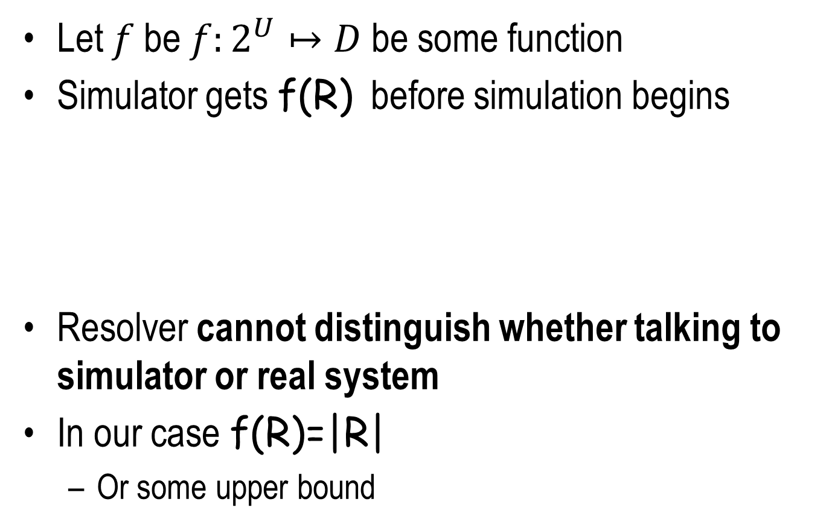
f-Zero Knowledge
Let $f$be $f:2^{U}↦D$be some function
Simulator gets f(R) before simulation begins
Resolver cannot distinguish whether talking to simulator or real system
In our case f(R)=|R|
  Or some upper bound
Simulator
R
Resolver
No rewinding!
  In the HIBE construction
  f is null

Slide 14
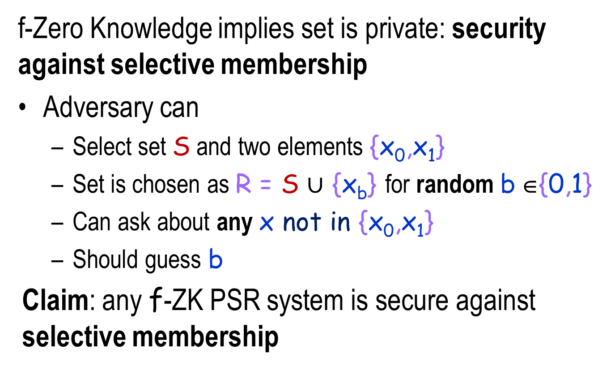
f-Zero Knowledge implies hardness of zone enumeration
When f(R)=|R|
f-Zero Knowledge implies set is private: security against selective membership
Adversary can
  Select set S and two elements {x₀,x₁}
  Set is chosen as R = S $∪$ {x_{b}} for random b ∈{0,1}
  Can ask about any x not in {x₀,x₁}
  Should guess b
Claim: any f-ZK PSR system is secure against selective membership

Slide 15
NSEC3 is not secure against selective membership
After learning h(R) can easily determine whether x₀ or x₁ are in R

Slide 16
Previous work
Work in DNSSEC
Zero-Knowledge Sets [Micali, Rabin & Kilian]
  Too ambitious: even the primary not trusted
  Too inefficient: best known proposal [Chase et al.]:
    log |U| public-key operations
Verifiable Data Structures
    Certificate Revocation List [Naor-Nissim]
    General language for such data structures

Slide 17
Public Key Authentication and Signatures
Digital Signatures: a prover/signer
Publishes a public signing key PK_{S}
  Keeping SK_{S} secret
For any message m the signer, knowing SK_{S}, can generate signature σ.
Given m, PK_{S} and σ verifier V can check the validity of the signature.
Can the protocol be Interactive?
  Lose transferability but still want unforgeability
Not transferable to third party

Slide 18
Interactive Authentication security
Existential unforgeability against adaptive chosen message attack
  Adversary can ask to authenticate any sequence m₁, m₂, …
  Has to succeed in making V accept a message m not authenticated before
  Has complete control over the channels
Selective unforgeability against adaptive chosen message attack
  Adversary selects the message m₀ it will forge
  can ask to authenticate any sequence m₁, m₂, … not including m₀
  Has to succeed in making V accept the message m₀ selected ahead of time
  Has complete control over the channels

Slide 19
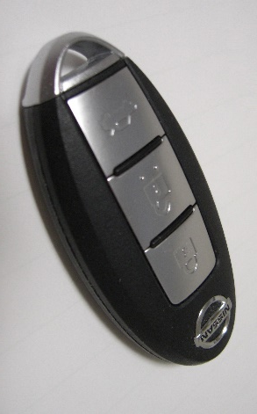
Public-key Identification
Authenticator wants to prove that it is alive and engaging in the protocol
Example: key wants prove to door/car that it is who it claims to be (watch out for mafia attack…)
Can get it from public-key authentication
Authenticate random message
Enough to have selective unforgeability

Slide 20
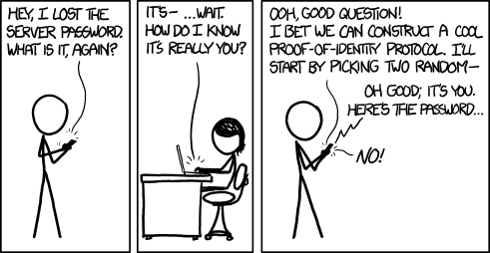
Obligatory xkcd Cartoon
Notes:
Completely unrelated

Slide 21
Known Constructions of Public-key Authentication
Signatures can be based on one-way functions
  But not efficiently
  Lower bound [Barak-Mahmoody]
Public-key Authentication can be based on CCA secure encryption
Public-key identification can be based on zero-knowledge proofs of knowledge [FFS]
Computationally non trivial operations

Slide 22
Claim: Secondary Must Work Hard
Given a PSR system satisfying Completeness, Soundness and f-ZK can construct:
A public-key authentication scheme
  Secure in the selective sense
  Work of the online authenticator similar to the work of the secondary
Proof:
Consider a set R={m_{b}} with a single element
Authentication for a message m_{i}:
  proof that m_{i} is not in R
security against
selective membership
True even if Secondary is trusted: Primary plays role of secondary

Slide 23
Claim: Secondary Must Work Hard
Proof:
Consider a set R={m_{b}} with a single element
Authentication for a message m_{i}:
  proof that m_{i} is not in R
To break security against selective membership:
m_{b}∈_{R} {m₀, m₁}
Run forger with target m_{b’} for b’∈_{R}{0,1}
  until ready to forge
If forge successful (accepted): guess b = b’
otherwise: flip a coin to guess b

Slide 24
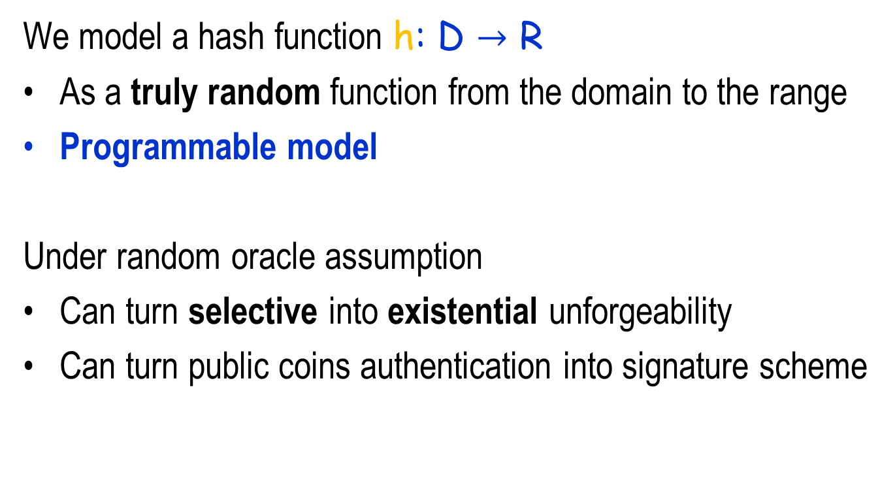
Random Oracle Assumption
  We model a hash function h: D $→$ R
  As a truly random function from the domain to the range
  Programmable model
  Under random oracle assumption
  Can turn selective into existential unforgeability
  Can turn public coins authentication into signature scheme

Slide 25
What Do We Have to Say
Model the problem
  Primary-Secondary-Resolvers Membership Proof Systems
Explain why current attempts have all failed
  Show that the secondary must be performing online public-key authentication
  Can convert to signatures in some circumstances
Suggest various constructions to PSRs
  Based on RSA plus random oracles
  Based on VRFs and VUFs
  Based on HIBEs
Completeness, Soundness &
Privacy (Zero-Knowledge)
They were not making the secondary work hard: only a few hashing and retrieval operations!
Conclusion is true even in the ``trusted” secondary model!
NSEC5
BLS

Slide 26
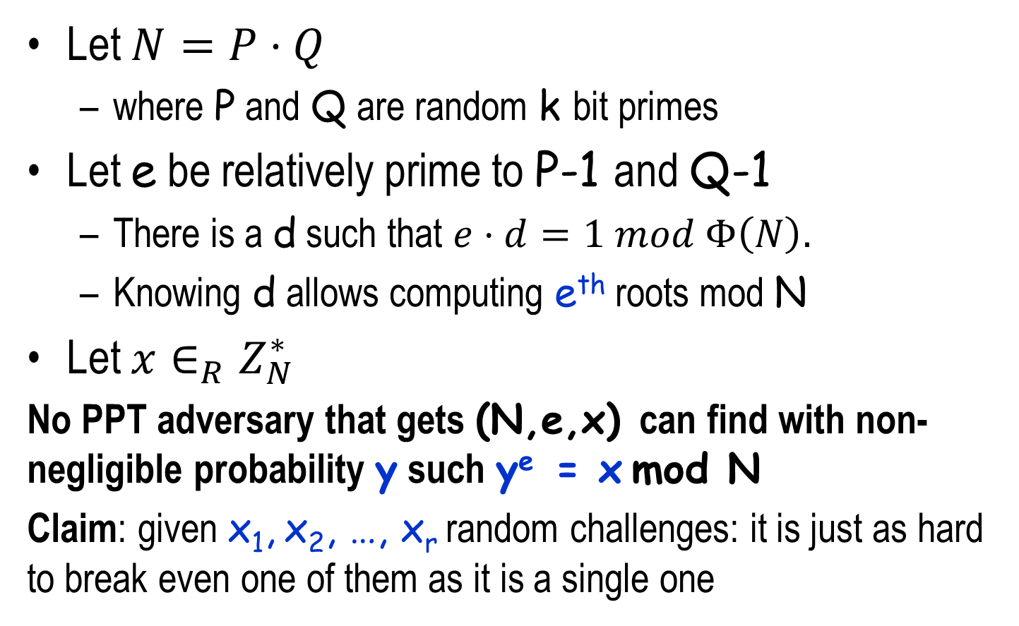
RSA Assumption
RSA(y)= y^{e} mod N
Let $N=P⋅Q$
  where P and Q are random k bit primes
Let e be relatively prime to P-1 and Q-1
  There is a d such that $e⋅d=1 mod Φ\left(N\right).$
  Knowing d allows computing e^{th} roots mod N
Let $x∈_{R}Z_{N}^{∗}$
No PPT adversary that gets (N,e,x) can find with non-negligible probability y such y^{e} = x mod N
  Claim: given x₁, x₂, …, x_{r} random challenges: it is just as hard to break even one of them as it is a single one
RSA⁻¹(x)= x^{d} mod N

Slide 27
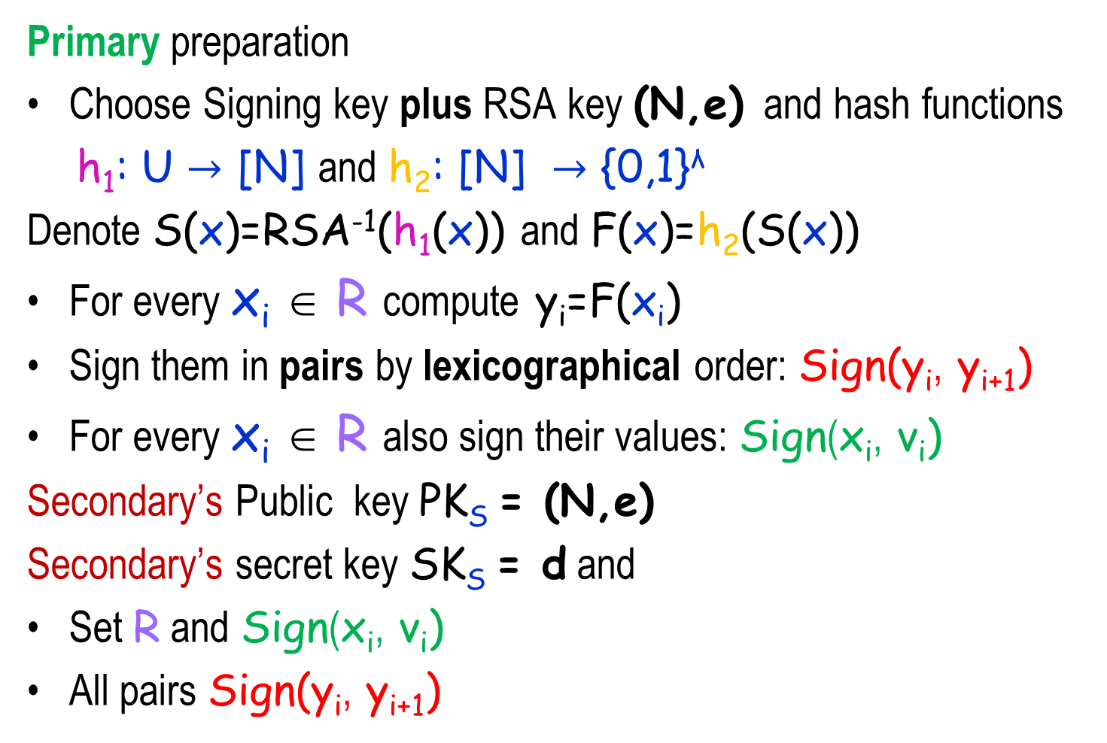
How NSEC5 Works
Primary preparation
Choose Signing key plus RSA key (N,e) and hash functions
  h₁: U $→$ [N] and h₂: [N] $→$ {0,1}^{λ}
Denote S(x)=RSA⁻¹(h₁(x)) and F(x)=h₂(S(x))
For every x_{i} ∈ R compute y_{i}=F(x_{i})
Sign them in pairs by lexicographical order: Sign(y_{i}, y_{i+1})
For every x_{i} ∈ R also sign their values: Sign(x_{i}, v_{i})
  Secondary’s Public key PK_{S} = (N,e)
  Secondary’s secret key SK_{S} = d and
Set R and Sign(x_{i}, v_{i})
All pairs Sign(y_{i}, y_{i+1})
Random oracles
Plays the role of
h(x) in NSEC3
I_{S}

Slide 28
NSEC5 RSA Construction
Denote S(x)=RSA⁻¹(h₁(x)) and F(x)=h₂(S(x))
For every x_{i} ∈ R compute y_{i}=F(x_{i})
Sign them in pairs by lexicographical order: Sign(y_{i}, y_{i+1})
For every x_{i} ∈ R also sign their values: Sign(x_{i}, v_{i})
  Secondary
  Given query x∈R, the secondary returns Sign(x_{i}, v_{i})
Given query x∉R, the secondary returns:
  Sign(y_{i}, y_{i+1}) and S(x) such that y_{i} < F(x) < y_{i+1}
A Resolver verifies query x by checking that:
  y_{i} < h₂(S(x)) =F(x) < y_{i+1}
  RSA(S(x))=h₁(x)

Slide 29
NSEC5 RSA Performance
Recall: S(x)=RSA⁻¹(h₁(x)) and F(x)=h₂(S(x))
Performance comparable to NSEC3
Primary: Signature on pairs Sign(y_{i}, y_{i+1})
Signature on values: Sign(x_{i}, v_{i})
For every x_{i} ∈ R compute y_{i}=F(x_{i})
  Secondary
  For query x∉R: secondary computes y=F(x) and returns:
  Sign(y_{i}, y_{i+1}) and S(x)
A Resolver verifies query x by checking that:
  y_{i} < h₂(S(x)) = F(x) < y_{i+1}
  RSA(S(x))=h₁(x)
From lower bound:
must work
as hard as signing!

Slide 30
Why Does the RSA Construction Work?
Claim: For every x∈U the value F(x) is pseudo-random:
  No PPT adversary A who gets x and can ask for values F(x_{i}) and S(x_{i}) on any sequence x₁, x₂… not including x
    can distinguish F(x) from random
  Proof: Challenge (N,e,z)
  Prepare many pairs z_{i} = RSA(c_{i}) = c_{i}^{e} mod N for random c_{i}
    Every time A issues query x_{i}: set oracle h₁ at location x_{i} to z_{i,}
    Return S(x_{i}) = c_{i}
    When oracle h₁ is queried at x: set to challenge value z
  Proof generalizes to many challenge values

Slide 31
The RSA Construction Works
Completeness: what could go wrong? If a query x_{i}∉R collides with a value x_{j} ∈ R,
then the secondary cannot prove that x_{i} is not in R
What is the probability of that event?
  From pseudo-randomness it is low.
Soundness: if secondary can cause a wrong conclusion to be accepted
if an x_{i}∉R was accepted as in R : forged for x_{i}∉R a signature that it is in R
if an x_{i}∈R was accepted as not in R: forged for some non existent pair (y_{i}, y_{i+1}) value Sign(y_{i}, y_{i+1})
From uniqueness of RSA

Slide 32
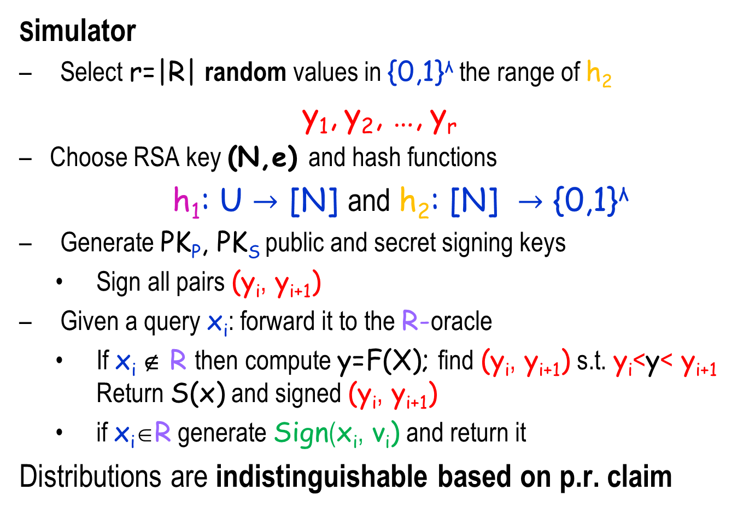
f-Zero-knowledge for f(R)=|R|
  Simulator
  Select r=|R| random values in {0,1}^{λ} the range of h₂
  y₁, y₂, …, y_{r}
  Choose RSA key (N,e) and hash functions
  h₁: U $→$ [N] and h₂: [N] $→$ {0,1}^{λ}
  Generate PK_{P}, PK_{S} public and secret signing keys
    Sign all pairs (y_{i}, y_{i+1})
  Given a query x_{i}: forward it to the R-oracle
    If x_{i} ∉ R then compute y=F(X); find (y_{i}, y_{i+1}) s.t. y_{i}<y< y_{i+1} Return S(x) and signed (y_{i}, y_{i+1})
    if x_{i}∈R generate Sign(x_{i}, v_{i}) and return it
  Distributions are indistinguishable based on p.r. claim
R

Slide 33
What Do We Have to Say
Is this a very specific scheme, or are there many different ones?
    Must we use random oracles for efficiency?
Three strategies for obtaining PSR
Verifiable Random or Unpredictable Function
  NSEC5 and BLS examples
  Hierarchical Identity Based Encryption
    Scheme of Boneh, Boyen & Goh
  Oblivious search - Cuckoo Hashing
    Can be based on conservative assumptions

Slide 34
What Do We Have to Say
Model the problem
  Primary-Secondary-Resolvers Membership Proof Systems
Explain why current attempts have all failed
  Show that the secondary must be performing online public-key authentication
  Can convert to signatures in some circumstances
Suggest various constructions to PSRs
  Based on RSA plus random oracles
  Based on VRFs and VUFs
  Based on HIBEs
Completeness, Soundness &
Privacy (Zero-Knowledge)
NSEC5
BLS

Slide 35
Idea: Proving non-membership by knowledge
Authentication protocol based on public key encryption
Key point: prove identity by ability of decryption
P has a public key P_{K} of an encryption scheme E.
To authenticate a message m:
V → P : Choose x ∈_{R} {0,1}^{n}.
Send Y=E(P_{K}, m°x)
P → V : Verify that prefix of plaintext is indeed m.
If yes - send x.
V accepts iff the received x’=x
DDN

Slide 36
Identity-Based Encryption (IBE)
Public Master-key
email encrypted using public key:
“bob@weizmann.ac.il”
SK_{Bob}
Bob
Alice
Could happen before or after the email was encrypted
CA
I am “bob@weizmann.ac.il”
Public Master-key
Secret Master-key

Slide 37
(Hierarchical) Identity Based Encryption
Identity Based Encryption (IBE):
There is a master public-key MK_{P}
  Corresponding secret key MK_{S}
The public key of identity I is I
The secret key of identity I is SK_{I}
    Can be computed using the master secret key
To send a message to I: encrypt using (I,MK_{P})
  Hierarchical Identity Based Encryption (HIBE):
IDs are represented as tuples with up to n coordinates (I₁,…, I_{n})
Each prefix J=(I₁,…, I_{j}) gets secret key SK_{J}
from which SK_{I} can be derived for every I where J is a prefix of I
J=(I₁,…, I_{j})
I=(I₁,…, I_{j}, I_{j+1},…, I_{n})

Slide 38
Hierarchical Identity Based Encryption
SK_{J}
SK_{I}
Key for Subset

Slide 39
Hierarchical Identity Based Encryption
IDs are represented as tuples with up to n coordinates (I₁,…, I_{n})
Setup: generate master keys MK_{P} and MK_{s}.
MKeyGen: gets MK_{s} and ID J and outputs the secret key SK_{J}
KeyGen: gets SK_{J} and I a descendant of J and generates SK_{I}
Encrypt: using MK_{P}, encrypts message m under identity I
Decrypt: using the key SK_{I} decrypts ciphertexts intended to I
Security -IND-sID-CPA
Choose a target identity I and messages m₀, m₁, then get MK_{P}
Issue key queries for identities which are not prefixes/ancestors of I
Get CT=Encrypt(MK_{P},I,m_{b}) for uniformly at random chosen b and try to guess b
Need only selective id and chosen plaintext security

Slide 40
HIBE based PSR
Translate universe to binary: U={0,1}^{n}
Primary:
Run setup for HIBE of depth n with binary identities
Start with all the nodes in T a binary tree of depth n
For every x=(b₁,...,b_{n})∈R:
  Remove all ancestors x’=(b₁,…,b_{m}) from T
For every surviving (top) full binary subtree J=(b₁,…,b_{m}): generate key SK_{J} and give to Secondary
Number of keys: at most r log (|U|/r)

Slide 41
Subset Cover of non elements
Elements in R
non-elements
Key for Subset

Slide 42
HIBE based PSR
Translate universe to binary: U={0,1}^{n}
Resolver query for x∈U:
  Encrypt a random challenge w under identity x:
  Encrypt(MK_{P}, x, w) = CT
  Secondary (receiving x and CT):
  If x∈R return the signature Sign(x,v),
  Else (x∉R): Find a key in T for a prefix of x,
  Generate SK_{x}
  Decrypt CT and return w to the resolver

Slide 43
The HIBE Construction Works
Perfect Completeness:
For every x∈R: return precomputed signature: sign(x,v)
For every x∉R: the secondary can decrypt any message intended for x and prove non-membership
Soundness: a secondary causes a wrong conclusion only if:
For x∉R to be accepted as in R: forge a signature Sign(x,v) for some v, contradicting unforgeability.
For x∈R to be accepted as not in R: decrypt successfully a random challenge
  without the key SK_{x} and without any key for an ancestor of x,
  contradicting HIBE selective security
    because R is chosen in advance

Slide 44
f-Zero-knowledge for any f(R)
  Simulator
  Runs the setup algorithm for the PSR and replaces the set of secret HIBE keys T, with the secret master key MK_{s}.
  Given a query x_{i}: forward it to R-oracle
    If x_{i} ∉ R: generate the private key for x_{i}, SK_{xi}, decrypt the random challenge from the resolver and send it back to him.
    if x_{i}∈R: generate Sign(x_{i}, v_{i}) and return it
    Distributions are identical
      Perfect Zero-Knowledge!
R

Slide 45
Using the HIBE by Boneh, Boyen & Goh
Pick a bilinear map e: GxG→ G₁ (e(g₁^{x},g₂^{y})=e(g₁,g₂)^{xy})
Primary
Setup: select randomly g∈G, a∈Z_{p}*, set g₁=gª and select more random elements g₂, g₃, h₁,…, h_{n}∈G.
Choose randomly J₀, J₁∈Z_{p}* and compute
  AUX=(h₁^{J0}, h₁^{J1}, …, h_{n}^{J0}, h_{n}^{J1}).
Set MK_{s}=g₂ª and MK_{P}=(g, g₁, g₂, g₃, h₁, …, h_{n}, AUX,e)
Performance: 2n exponentiations
MKeyGen: for ID=(I₁,…, I_{k}) (I_{i} ∈{J₀, J₁}) draw randomly r∈Z_{p}* output SK_{ID}=(MK_{s}⬇(h₁^{I1}⬇⬇⬇h_{k}^{Ik}⬇g₃)^{r},g^{r},h_{k+1}^{r},…,h_{n}^{r})
Performance: n-k+1 exponentiations (using AUX)
Need to do for every root of a full binary tree (at most r log |U|)
G of prime order p
n = log |U|

Slide 46
The Boneh, Boyen & Goh HIBE
Primary
Choose randomly J₀, J₁∈Z_{p}* and compute
  AUX=(h₁^{J0}, h₁^{J1},…, h_{n}^{J0}, h_{n}^{J1}).
Set MK_{s}=g₂ª and MK_{P}=(g, g₁, g₂, g₃, h₁,…, h_{n}, AUX,e)
Performance: 2n exponentiations
MKeyGen: for ID=(I₁,…, I_{k}) (I_{i} ∈{J₀, J₁}) draw randomly r∈Z_{p}* output SK_{ID}=(MK_{s}⬇(h₁^{I1}⬇⬇⬇h_{k}^{Ik}⬇g₃)^{r},g^{r},h_{k+1}^{r},…,h_{n}^{r})
Performance: n-k+1 exponentiations (using AUX)
Secondary
KeyGen: gets SK_{J}=(a₀,a₁,b_{k+1},…,b_{n}) and I a descendant of J of depth n. Select randomly t∈ Z_{p}* and compute:
SK_{I}=(a₀b_{k+1}^{Ik+1}⬇⬇⬇b_{n}^{In}((h₁^{I1}⬇⬇⬇h_{n}^{In}⬇g₃)^{t}), a₁⬇g^{t})
Performance: 4 exponentiations + O(n) multiplications
When computing keys for the leaves (depth n) only 4 exponentiations are needed. Can compute b_{k+1}^{Ik+1}⬇⬇⬇b_{n}^{In} by first multiplying b_{i} with the same exponent.

Slide 47
HIBE by Boneh, Boyen & Goh
MK_{s}=g₂ª MK_{P}=(g, g₁, g₂, g₃, h₁,…, h_{n}, AUX,e)
Bilinearity of e: e(g₁^{x},g₂^{y})=e(g₁,g₂)^{xy}
Encrypt: to encrypt M under identity I =(I₁,…, I_{k}) draw at random s∈ Z_{p} and compute
CT=(e(g₁,g₂)^{s}⬇M, g^{s}, (h₁^{I1}⬇⬇⬇h_{k}^{Ik}⬇g₃)^{s})
Performance: 1 pairing (can be avoided by adding e(g₁,g₂) to AUX) +3 exponentiations + O(n) multiplications
Decrypt: decryption of ciphertext CT=(A,B,C) intended for I using the key SK_{I}=(a₀,a₁,b_{k+1},…,b_{n}) is as follows:
Performance: 2 pairing computations and 1 multiplication

Slide 48
Conclusions
Denial of existence requires signatures*
Denial of existence can be done
  As efficiently as one can expect:
    Assuming random oracle
    A variety of methods (VRF/VUF, HIBE, Cuckoo Hashing)
    Requiring “constant number of exponentiations”
Many cryptographic primitives can be utilized
Dynamic Case

Slide 49
Based on
NSEC5: Provably Preventing DNSSEC Zone Enumeration Sharon Goldberg, Moni Naor, Dimitris Papadopoulos, Leonid Reyzin, Sachin Vasant and Asaf Ziv
    Cryptology ePrint Archive: Report 2014/582, to appear NDSS 2015
PSR Membership Proof Systems, Moni Naor and Asaf Ziv
Project page: http://www.cs.bu.edu/~goldbe/papers/nsec5.html

Slide 50
Verifiable Random Functions
Setup: generates two keys (PK,SK) for a function F
Prove: gets SK and outputs F(x) with its proof π
Verify: gets PK, x, y, π and verifies that F(x)=y using π
properties:
Provability:(PK,SK)∈Setup → Verify(PK,x,Prove(SK,x))=1
Uniqueness: (PK,SK)∈Setup and Verify(PK,x,y,π)=1 then ∀z≠y and ∀π’ Verify(PK,x,z, π’)=0
Pseudorandomness: cannot distinguish F(x) from a random value for a chosen x even after querying F(x₁),...,F(x_{n})
Creator commited to values

Slide 51
VRF based PSR
Very similar to NSEC5: VRF replaces h₂(S(x))
Primary: Run setup for VRF and get F and (PK,SK)
For every x_{i} ∈ R compute y_{i}=F(x_{i})
Signature on pairs Sign(y_{i}, y_{i+1})
Signature on values: Sign(x_{i}, v_{i})
  Secondary
  For query x∉R: secondary computes y=F(x) and π and returns: Sign(y_{i}, y_{i+1}) and y and the proof π
A Resolver verifies query x by checking that:
  y_{i} < y< y_{i+1}
  Verify(PK,x,y, π)=1

Slide 52
VRF based PSR
For every x_{i}∈R compute y_{i}=F(x_{i})
Sign in pairs by lexicographical order:
Sign(y_{i}, y_{i+1})
For every x_{i}∈R also sign their values:
Sign(x_{i}, v_{i})
Given query x
  If x∈R, then the secondary returns Sign(x_{i}, v_{i})
  If x∉R, then a proof of non existence is:
  the signed pair Sign(y_{i}, y_{i+1}) combined with a proof for F(x) such that y_{i} < F(x) < y_{i+1}
Similar to NSEC5 but The VRF replaces h₂(S(x))

Slide 53
Verifiable Unpredictable Functions
Setup: generates Public-Secret keys (PK,SK) for a function F
Prove: gets SK and outputs F(x) with its proof π
Verify: gets PK, x, y, π and verifies that F(x)=y using π
properties:
Provability: (PK,SK)∈Setup → Verify(PK,x,Prove(SK,x))=1
Uniqueness: (PK,SK)∈Setup and Verify(PK,x,y, π)=1 then ∀z≠y and ∀π’ Verify(PK,x,z, π’)=0
Unpredictability: cannot predict F(x) for a chosen x even after querying F(x₁),..,F(x_{n}) with more than a negligible probability.

Slide 54
VUF based PSR
Construct a selective VRF F from VUF f using GL hardcore bits and random strings r,r_{1,…,} r_{m} s.t. |r|=|x| and |r_{i}|=|f(x)|:
i^{th} bit of F(x) is: F^{i}(x)=<f(x⊕r),r_{i}> mod 2
Proof π is the proof for the VUF on (x⊕r).
The value of F can be verified using the public strings r,r_{1,…,} r_{m}
F is pseudorandom against a challenge chosen in advance (before r,r_{1,…,} r_{m} are chosen). I.e. sVRF which suffices for PSR
Problem with the range of F: need m to be large to avoid collisions!
Solution: instead of a large m, use k such functions F₁,…, F_{k}
Choose m=2log|R| and k=log_{|R|}2^{2n} to get probability of collision 1/2^{n} : Pr(F(x) ∈{F(R)})=1/|R|
  for x ∈ U={0,1}^{n} Pr(j: F_{j}(x) ∈F_{j}(R))=1/|R|^{k}=1/2^{2n}
So probability some x ∈ U collides with all functions is 1/2^{n}

Slide 55
VUF based PSR
Primary: Signature on values: Sign(x_{i}, v_{i})
Run setup for k VUFs and get f₁,..,f_{k}
transform every f_{j} to a sVRF: F_{j} with keys (PK_{j},SK_{j})
For every x_{i}∈R and j∈[k] compute y_{ij}=F_{j}(x_{i})
j∈[k] generate signatures on pairs Sign(y_{ij}, y_{(i+1)j})
  Secondary
  For query x∉R: secondary finds a j∈[k] without a collision:
    Let y=F_{j} (x) and there is an i∈[r] s.t. y_{ij} < y< y_{(i+1)j}
    Returns: Sign(y_{ij}, y_{(i+1)j}) and y and the proof π
Resolver verifies query x by checking that:
  y_{ij} < y< y_{(i+1)j}
  Verify y=F_{j} (x) using π and PK_{j}
w.h.p such a j exists

Slide 56
A random oracle VUF - BLS
The signature scheme by Boneh, Lynn and Shacham yields a VUF.
A gap Diffie-Hellman group G* with a generator g:
  For a,b,c∈Z_{p}* given (g,gª,g^{b},g^{c}) the decision whether c=ab is easy.
  For a,b∈Z_{p}* given (g,gª,g^{b}) computing g^{ab} is hard.
Use a full domain hash h:{0,1}*→ G*
Setup: pick a random SK=s∈Z_{p}* and PK=g^{s}
Prove: F(x)=h(x)^{SK} =σ (no need for a proof)
Verify: Given PK=g^{s}, x, σ, compute h=h(x) and verify that
(g, g^{s},h, σ) constitute a valid Diffie-Hellman tuple
VUF properties:
  Provability and uniqueness follow from the deterministic nature of the scheme
  Unpredictability follows from the existential unforgeability of the scheme
  Modeled as a
  Random oracle
Can turn to a VRF by another random oracle call

