Slide 1
The Internet!
Layers, TCP, UDP, IP
DDoS Reflection Attacks
IPSEC, ARP
Sharon Goldberg CS558
Boston University Spring 2015
Most slides and images borrowed from others.

Slide 2
Internet Infrastructure
ISP
ISP
ISP
Local and interdomain routing
  TCP/IP for routing and messaging
  BGP for routing announcements
Domain Name System
  Find IP address from symbolic name (www.cs.stanford.edu)
Based on slides from CS155 at Stanford

Slide 3
TCP Protocol Stack
Application protocol
Application
Application
Transport
TCP protocol
Transport
Port #
IP addresses
MAC address
Network
IP protocol
IP
IP protocol
Network
Link
Data Link
Network Access
Data Link
Link
Based on slides from CS155 at Stanford

Slide 4
Data Formats
TCP Header
Application
Application message - data
message
Transport (TCP, UDP)
segment
TCP
data
TCP
data
TCP
data
Network (IP)
packet
IP
TCP
data
Link Layer
frame
ETH
IP
TCP
data
ETF
IP Header
Link (Ethernet)
Header
Link (Ethernet)
Trailer
Based on slides from CS155 at Stanford

Slide 5
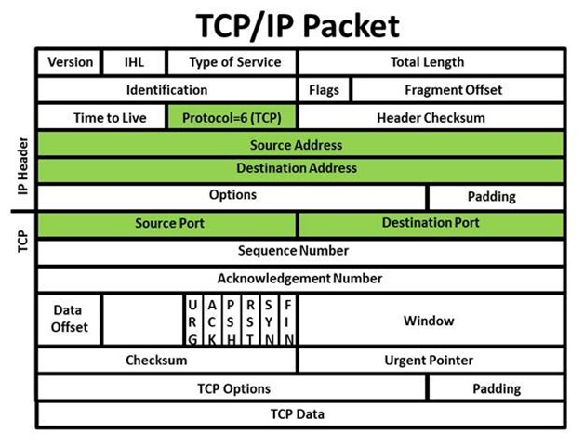
Source:
https://devcentral.f5.com/articles/application-is-more-than-header-deep

Slide 6
IP Prefixes & Addresses
204.16.254.0/24 is
204
16
254
*
0 | 1 | 1 | 0 | 1 | 0 | 0 | 0 | 0 | 0 | 0 | 0 | 1 | 0 | 0 | 0 | 1 | 1 | 1 | 1 | 1 | 1 | 1 | 0
1 8 16 24 32

Slide 7


IP Routing
Based on slides from CS155 at Stanford
Meg
Office gateway
Packet
Source
121.42.33.12
Destination
132.14.11.51
Tom
121.42.33.12
132.14.11.1
121.42.33.1
ISP
132.14.11.51
ROUTING TABLE
Destination Prefix | Next Hop IP
132.14.0.0/16 | 123.14.11.11
132.0.0.0/8 | 13.23.45.55
Typical route uses several hops
IP: no ordering/delivery guarantees, connectionless, Best effort

Slide 8
IP Protocol Functions (Summary)
Based on slides from CS155 at Stanford
Routing
  IP host knows location of router (gateway)
  IP gateway must know route to other networks
Fragmentation and reassembly
  If max-packet-size less than the user-data-size
Error reporting
  ICMP packet to source if packet is dropped
TTL field: decremented after every hop
  Packet dropped f TTL=0. Prevents infinite loops.

Slide 9
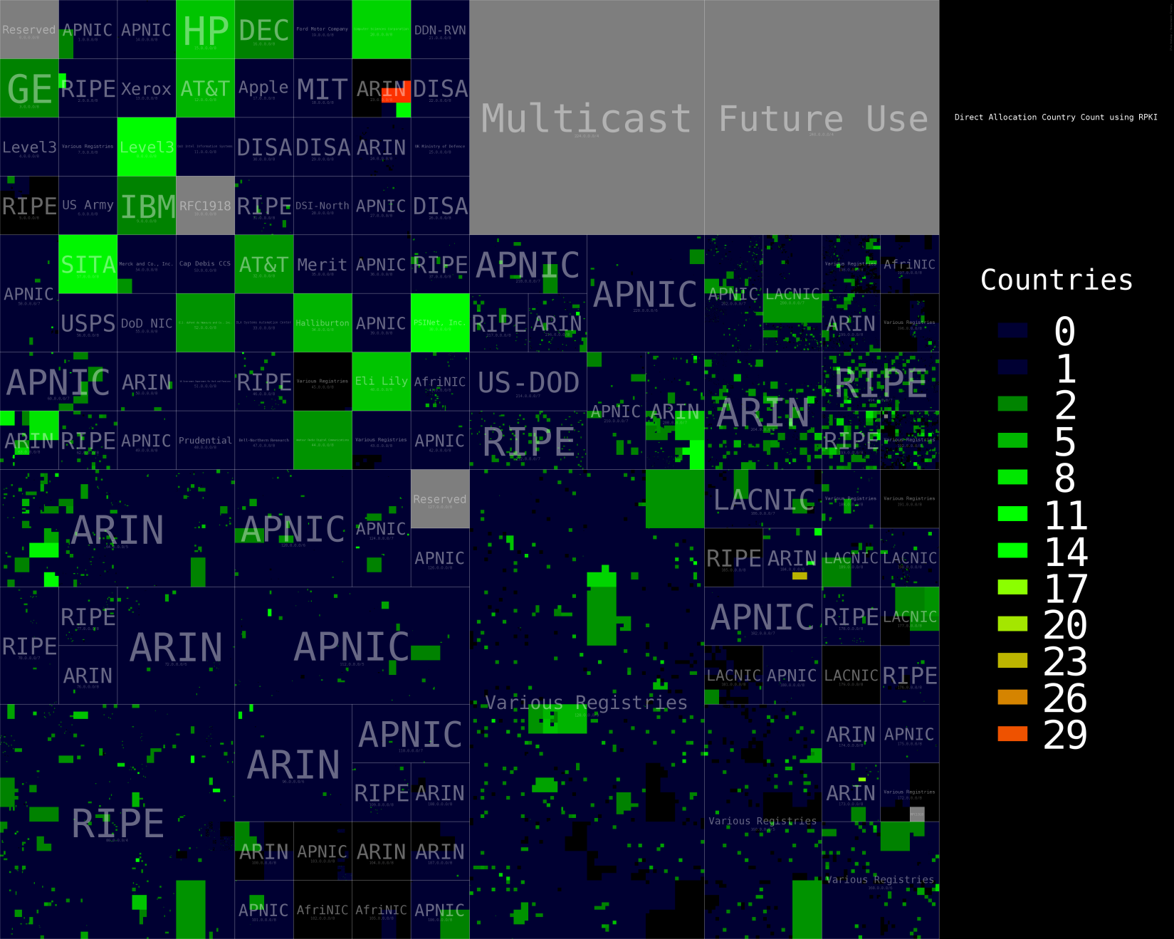
The IP address space
Notes:
DON’T FORGET TO EXPLAIN WHAT A HILBERT CURVE IS, AND ALSO WHAT A DIRECT ALLOCATION IS!

Slide 10

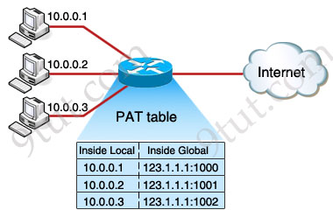
NATS

Slide 11
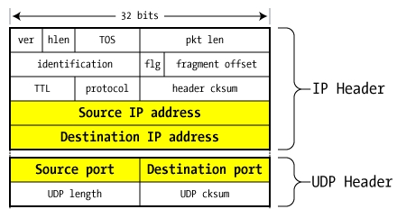
User Datagram Protocol (protocol=17)
Based on slides from CS155 at Stanford
UDP
Unreliable transport on top of IP:
  No acks or congenstion control
  Used for VoIP, video, NTP (network time protocol) anything else where latency matters more than reliability

Slide 12
Problem: no src IP authentication
Based on slides from CS155 at Stanford
Client is trusted to embed correct source IP
  Easy to override using raw sockets
  Libnet: a library for formatting raw packets with arbitrary IP headers
Anyone who owns their machine can send packets
with arbitrary source IP
  … response will be sent back to forged source IP
Implications: (solutions in DDoS lecture)
  Anonymous DoS attacks;
  Anonymous infection attacks (e.g. slammer worm)

Slide 13

DoS Reflection & Amplification Attack
Using protocols over UDP: like NTP, DNS etc
UDP
Public DNS Server
8.8.8.8
Huge response!
DNS response
Source IP
8.8.8.8
Tom
Short query
Dest IP
132.14.11.51
DNS Data
Evillll Meg
DNS Query
Source IP
132.14.11.51
132.14.11.51
Dest IP
8.8.8.8
Tom gets hit by too
many packets
121.42.33.12

Slide 14
Transmission Control Protocol
Based on slides from CS155 at Stanford
TCP
Connection-oriented, preserves order
  Sender
    Break data into packets
    Attach packet numbers
  Receiver
    Acknowledge receipt; lost packets are resent
    Reassemble packets in correct order
Book
1
19
1
Mail each page
5
1
Reassemble book

Slide 15
Source:
https://devcentral.f5.com/articles/application-is-more-than-header-deep

Slide 16
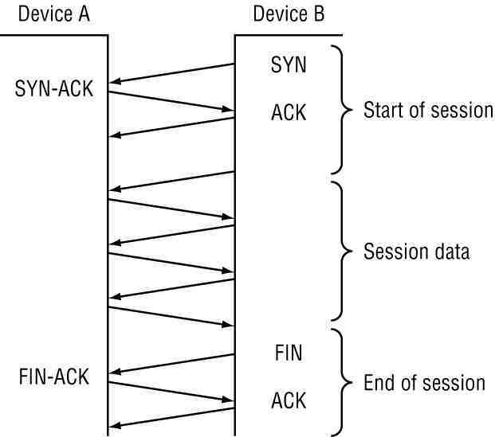
FROM : http://codeidol.com/img/csharp-network/f0209_0.jpg

Slide 17
Review: TCP Handshake
Based on slides from CS155 at Stanford
C
S
SYN:
SN_{C}←rand_{C}
AN_{C}←0
Listening
SN_{S}←rand_{S}
AN_{S}←SN_{C}
Store SN_{C} , SN_{S}
SYN/ACK:
Wait
SN←SN_{C}+1
AN←SN_{S}
ACK:
Established
Received packets with SN too far out of window are dropped

Slide 18
Basic Security Problems
Based on slides from CS155 at Stanford
1. Network packets pass by untrusted hosts
  Eavesdropping, packet sniffing
  Especially easy when attacker controls a
  machine close to victim
2. TCP state can be easy to guess
  Enables spoofing and session hijacking
  Depending on how sequence number is chosen
Denial of Service (DoS) vulnerabilities
  Syn connection state attacks

Slide 19
1. Packet Sniffing
Based on slides from CS155 at Stanford
Promiscuous NIC reads all packets
Read all unencrypted data (e.g., “wireshark”)
ftp, telnet (and POP, IMAP) may send passwords in clear
Eve
Network
Alice
Bob
Prevention: Encryption (next lecture: IPSEC)

Slide 20
2. TCP Connection Spoofing
Based on slides from CS155 at Stanford
Why random initial sequence numbers? (SN_{C} , SN_{S} )
Suppose init. sequence numbers are predictable
  Attacker can create TCP session on behalf of forged source IP
TCP SYN
Server
attacker
srcIP=victim
Victim
SYN/ACK
dstIP=victim
SN=server SN_{S}
ACK
srcIP=victim
AN=predicted SN_{S}
server thinks command
is from victim IP addr
command
Notes:
Example commands: send spam email on behalf of victim IP address

Slide 21
Example DoS vulnerability [Watson’04]
Based on slides from CS155 at Stanford
Suppose attacker can guess seq. number for an existing connection:
  Attacker can send Reset packet to
  close connection. Results in DoS.
  Naively, success prob. is 1/2³² (32-bit seq. #’s).
  Most systems allow for a large window of
  acceptable seq. #’s
    Much higher success probability.
Attack is most effective against long lived connections, e.g. BGP

Slide 22
Random initial TCP SNs
Based on slides from CS155 at Stanford
Unpredictable SNs prevent basic packet injection
  … but attacker can inject packets after
  eavesdropping to obtain current SN
Most TCP stacks now generate random SNs
  Random generator should be unpredictable
  GPR’06: Linux RNG for generating SNs is predictable
    Attacker repeatedly connects to server
    Obtains sequence of SNs
    Can predict next SN
    Attacker can now do TCP spoofing (create TCP session with forged source IP)

Slide 23
Securing the IP/TCP stack
HTTP
FTP
SMTP
HTTP
FTP
SMTP
SSL/TLS
TCP
TCP
IP/IPSEC
IP
At the Network Level
At the Transport Level
S/MIME
PGP
SET
Kerberos
SMTP
HTTP
UDP
TCP
IP
At the Application Level

Slide 24
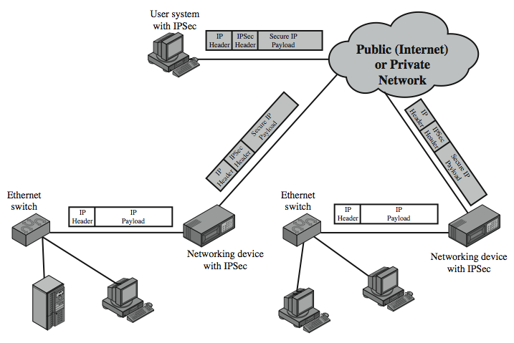
Who uses IPsec? From Stallings 5th edition

Slide 25
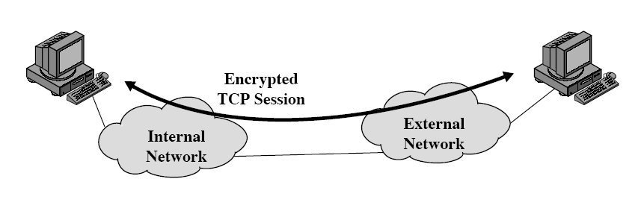
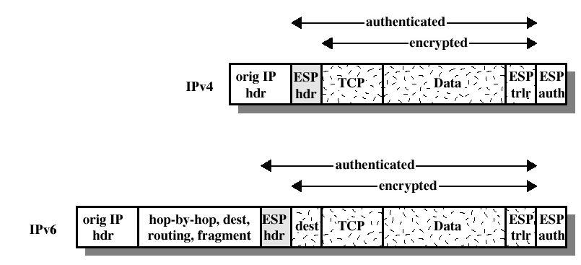
Mode 1: Transport
Notes:
What are some attacks that could arise due to not authing the IP header?

Slide 26
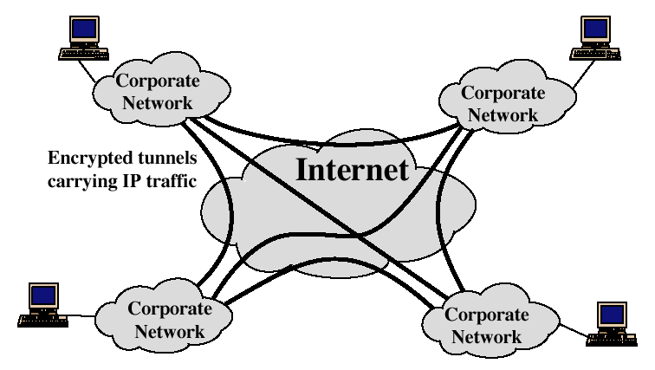
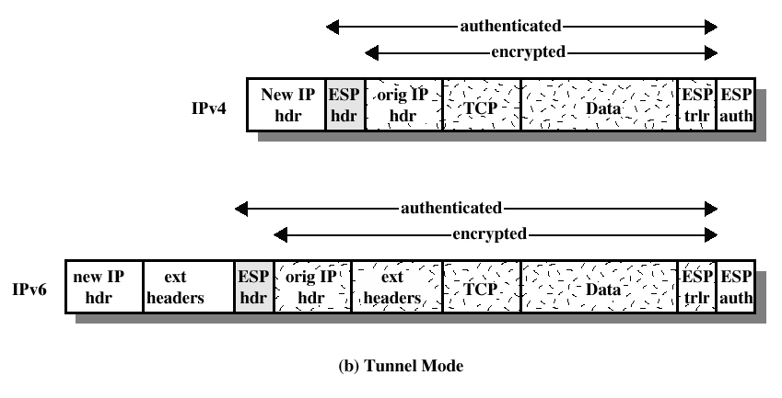
Mode 2: Tunnel

Slide 27
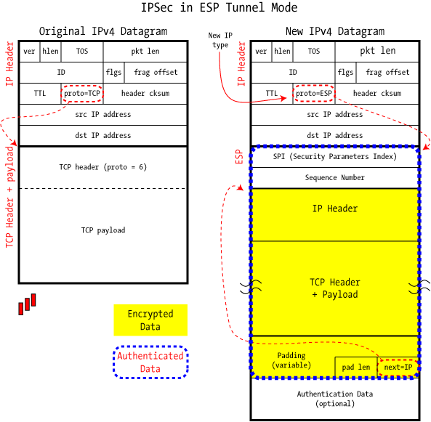
ESP Tunnel mode
(From Steve Friedl)
Note: ToS leaks info.
Source and dest address are not authenticated (vulnerable to IP address spoofing) between the tunnels.
(DoS attacks too?)
Source and dest address INSIDE the tunnel is protected.

Slide 28
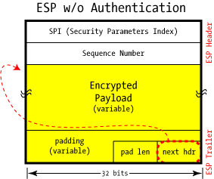
ESP without authentication (From Steve Friedl)
BAD IDEA!!!!!!!!!!!!
Now we can encrypt, or encrypt and authenticate
The padding allows us to reduce traffic analysis attacks, but people almost never use it.

Slide 29
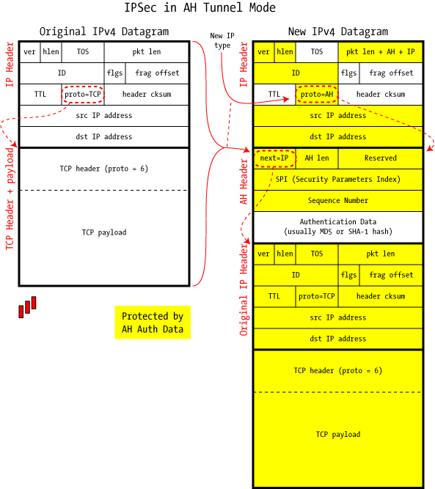
AH Tunnel mode
(From Steve Friedl)
Authenticated connection for VPN
Packet encapsulated,
source and dest address protected
Can’t work with NATs

Slide 30
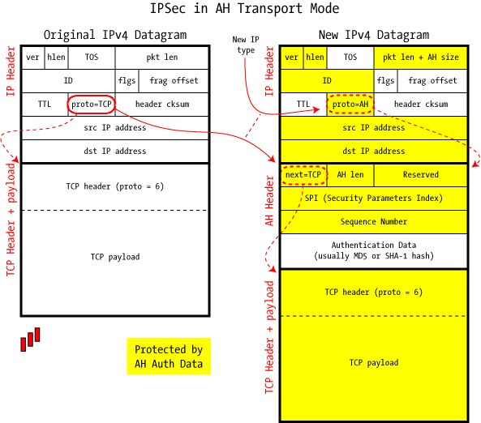
AH Transport mode (From Steve Friedl)
Authenticated connection between two hosts (HMAC!!)
Doesn’t work with NAT (network address translation)

Slide 31
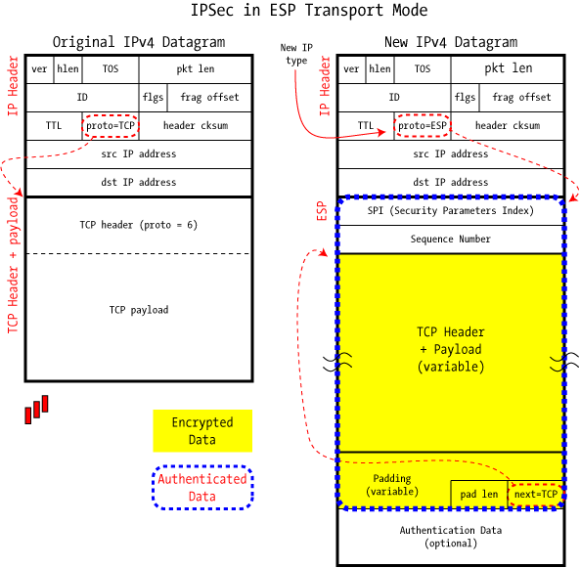
ESP Transport mode
(From Steve Friedl)
Note: ToS leaks info.
Source and dest address are not authenticated (vulnerable to IP address spoofing!)
P₀
P₁
P₂

Slide 32
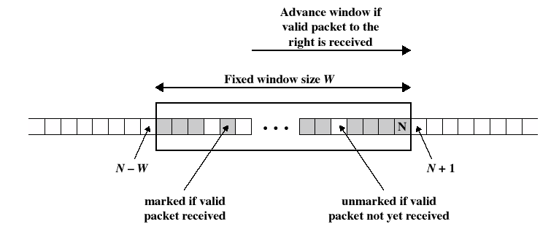
AH – Anti-replay Service in Ipsec
From Stallings 5th edition
window size W (default is 64)
N: highest seq. number for a valid paket recevied so far
If a received packet falls in the window
  if authenticated and unmarked, mark it
  if marked, then replay!
If a received packet is > N
  if authenticated, advance the window so that this packet is at the rightmost edge and mark it
If a received packet is <= N-W
  packet is discarded

Slide 33
Other considerations
Traffic analysis :
  packet lengths,
  Timing
  Source and destination addresses
  ToS fields
Dealing with NATs
Replay attacks
Key management!!!

Slide 34
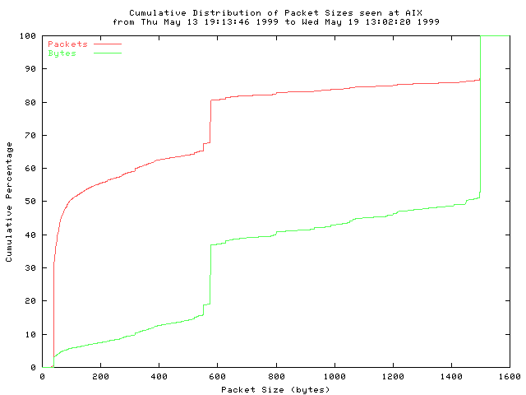
From CAIDA

Slide 35
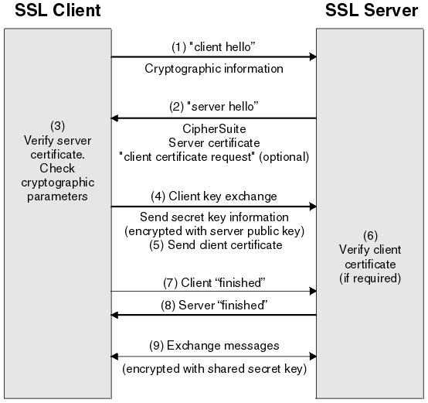
TLS Handshake

Slide 36
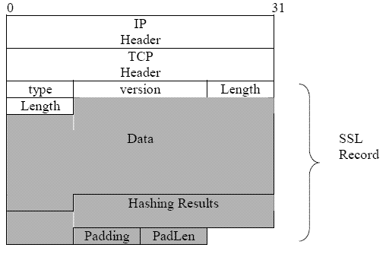
TLS packet format
As opposed to unsecured HTTP URLs which begin with "http://" and use port 80 by default, secure HTTPS URLs begin with "https://" and use port 443 by default.

Slide 37
IPSEC VS TLS?
People are still talking about this! http://www.metzdowd.com/pipermail/cryptography/2014-April/020674.html
[Cryptography] IPsec is worse than unusable (Re: TLS/DTLS Use Cases)
Nico Williams nico at cryptonector.com
Wed Apr 2 11:59:52 EDT 2014
Previous message: [Cryptography] TLS/DTLS Use Cases
Next message: [Cryptography] IPsec is worse than unusable (Re: TLS/DTLS Use Cases)
Messages sorted by: [ date ] [ thread ] [ subject ] [ author ]
On Tue, Apr 01, 2014 at 10:31:54PM -0400, Jerry Leichter wrote:
> IPSec has many faults - so many as to render it unusable - but it did > get one thing right: To most code, an IPSec socket looks just like a > plain TCP socket. Anything that talks TCP can talk TCP "securely" > over IPSec with essentially no changes. ("Securely" in quotes because > it's a rather specialized notion of "securely".)

Slide 38
What is ARP?
Address Resolution Protocol (ARP) is how network devices associate MAC addresses with IP Addresses so that devices on the local network can find each other. ARP is basically a form of networking roll call.
ARP, a very simple protocol, consists of merely four basic message types:
An ARP Request. Computer A asks the network, "Who has this IP address?"
An ARP Reply. Computer B tells Computer A, "I have that IP. My MAC address is [whatever it is]."
A Reverse ARP Request (RARP). Same concept as ARP Request, but Computer A asks, "Who has this MAC address?"
A RARP Reply. Computer B tells Computer A, "I have that MAC. My IP address is [whatever it is]“
FROM: http://www.watchguard.com/infocenter/editorial/135324.asp

Slide 39
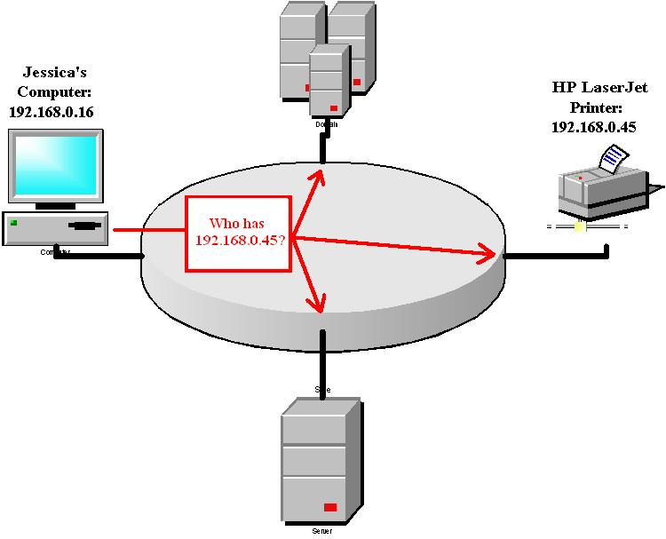

Slide 40
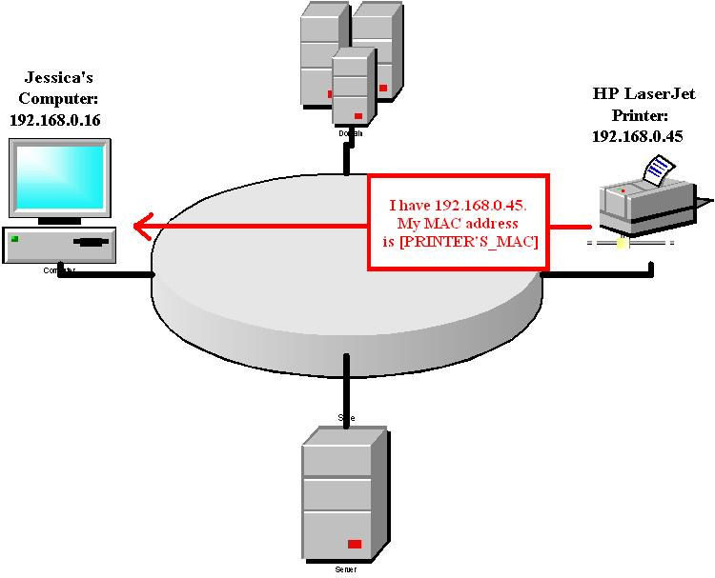

Slide 41
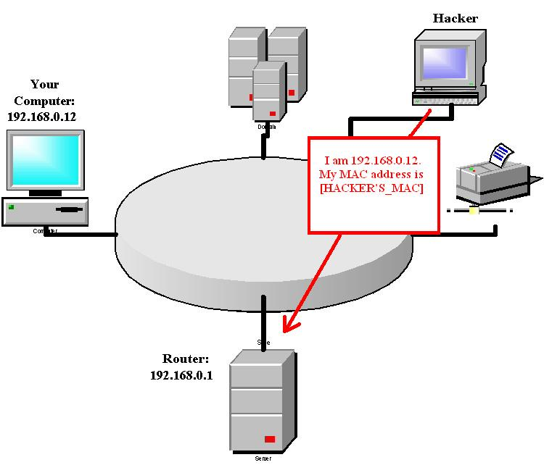
ARP poisoning

Slide 42
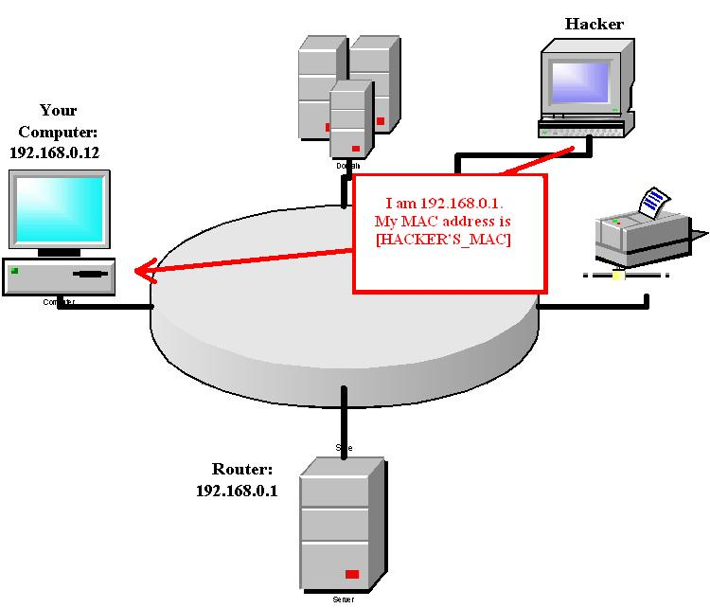
ARP poisoning

Slide 43
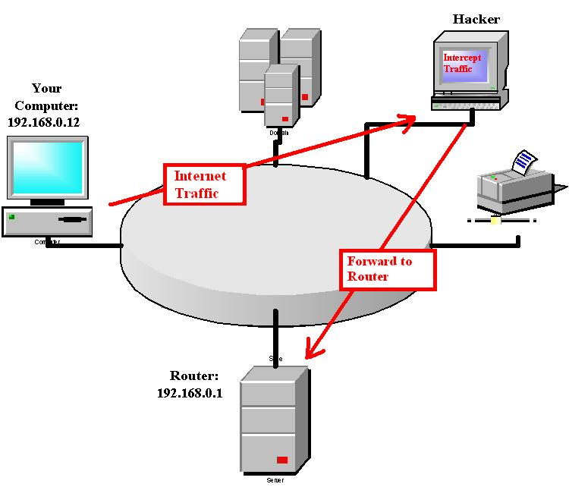
ARP poisoning
What is the threat model for arp poisoning?

Slide 44
Great Cannon of China
The GC is currently aimed only at specific destination IP addresses
  When we probed an IP address adjacent to the Baidu server (123.125.65.121), the GC ignored the requests completely, although the GFW acted on censorable requests to this host
If the GC saw a request for certain Javascript files on one of these servers, it appeared to probabilistically take one of two actions:
  it passed the request onto Baidu’s servers unmolested (roughly 98.25% of the time), or
  it dropped the request before it reached Baidu and instead sent a malicious script back to the requesting user (roughly 1.75% of the time).
In this case, the requesting user is an individual outside China browsing a website making use of a Baidu infrastructure server (e.g., a website with ads served by Baidu’s ad network).
The malicious script enlisted the requesting user as an unwitting participant in the DDoS attack against GreatFire.org and GitHub.

Slide 45
Topics (Week of December 1, 2015)
Review IP address and routing tables
ARP and ARP spoofing
Spoofing source IP addresses
UDP, UDP Reflection attacks using source address spoofing (DNS, NTP)
TCP, Forging TCP connections, TCP sequence numbers, Censorship via TCP resets
TLS packet formats
Traffic analysis on IP and TLS packets
Censorship techniques
  IP-based filtering
  DNS & DNS based filtering
  TCP-reset based filtering
  Malicious MiTM packet injection & great cannon of china

