Slide 1
Policy Learning II: Reinforcement Learning I

Slide 2
Last Time
Value Iteration
Calculate $U(s)$ for each state $s$
Use utilities to select optimal action in each state
Bellman is a contraction function → converges to optimal solution!
Policy Iteration
Start with some initial policy (can be chosen at random)
Alternate between two steps:
Policy evaluation:
Given $π_{i}$, calculate $u_{i}=U^{π_{i}}$
Policy improvement:
Calculate new MEU policy $π_{i+1}$ using one-step lookahead (bellman equation) from $u_{i}$
Terminate when policy improvement → no changes in utility values
Utility values converge between iterations

Slide 3
Today: Learning (from Examples)
The problem:
Value Iteration & Policy Iteration require:
(advanced) knowledge of transition model
(advanced) knowledge of reward function
What if we don’t know these? (i.e. world is “black box”)?
The plan:
get a bunch of trials
Get better

Slide 4
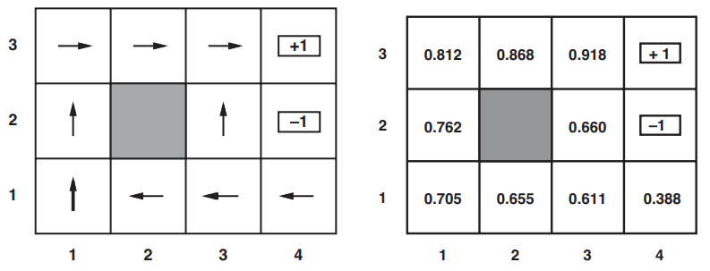
How?
For now, let us fix our policy
Whatever the policy $π$ is, agent always follows policy
Skill issue: get a good policy!
Get a bunch of trials
Record state & reward each time
Keep going until terminal state is reached
Goal: Learn the expected utility $U^{π}\left(s\right)$
$U^{π}\left(s\right)=𝔼\left[\sum_{t=0}^{∞}{γ^{t}R\left(S_{t}\right)}\right]$

Slide 5
How to Learn $U^{π}\left(s\right)$
$\left(1,1\right)$ samples!
$\left(1,2\right)$ samples!
$\left(1,3\right)$ samples!
Method 1: Direct Utility Estimation
Idea: $U^{π}\left(s\right)$ is expected (total) reward for rest of the trajectory
Called expected “reward to go”
Each trial provides a sample (for each state visited)
Keep running average for ${\hat{U}}^{π}\left(s\right)$
$\lim_{n→∞}{{\hat{U}}^{π}\left(s\right) }=U^{π}\left(s\right)$
Consider this trajectory:
1 sample for a trajectory starting at (1,1) (total reward = 0.72)
2 samples for a trajectory starting at (1,2) (total rewards = 0.76, 0.84)
2 samples for (1,3) (total rewards = 0.8, 0.88)
…

Slide 6
Problem with Direct Utility Estimation
Utilities are not independent of each other
A more accurate representation of utility dependencies:
$$U^{π}\left(s\right)=R\left(s\right)+γ\sum_{s′}{\operatorname{Pr}\left[s^{′}\right|s,a]U^{π}\left(s^{′}\right)}$$
Consider this trial:
When we reach (3,2): brand new state
Great! Opportunity for learning!
Reaches (3,3): a good state (learned from prior trial)
Since (3,3) is reachable from (3,2)…shouldn’t (3,2) be a good state (i.e. high utility)?
Problem: Direct Utility Estimation doesn’t learn anything until after the trial is done!

Slide 7
Problem with Direct Utility Estimation
Consider all function our model can learn
Really, really, really big space (called a “hypothesis space”)
Consider: $n$ boolean variables, 1 output (true or false)
Goal: learn the function from data ($m$ examples)
How many functions could exist?
$2^{n}$ combinations of variables ($x_{i}$ or $¬x_{i}$)
Function output t/f (for every assignment)
$∴2^{2^{n}}$ functions
Direct Utility Estimation:
Considers a hypothesis space which is bigger than it needs to be
Harder to learn!
Converges really slowly!
$$x_{1}$$ | $$x_{2}$$ | $$…$$ | $$x_{n}$$ | $$y$$
t | t | … | f | t
f | t | … | f | t
f | t | … | f | f
t | f | … | f | f
… | … | … | … | …

Slide 8
How to Learn $U^{π}\left(s\right)$
Method 2: Adaptive Dynamic Programming (ADP)
Uses constraints (i.e. dependencies) between state utilities
Learn the transition model!
Then solve the MDP (using modified policy iteration, etc)
How to learn transition model?
Fully observable world:
Record $\left(s,a,s^{′}\right)$ triple and learn the relationship $\left(s,a\right)→s′$
For example, keep pmf for each state $Pr\left[s^{′} | s,a\right]$
count frequencies!

Slide 9
Passive ADP
Global variables
Estimate transition model
Make utilities from updated transition model!

Slide 10
ADP
Bad for large state spaces (same limitation as policy/value iteration)
Why? Too many equations to solve
Another big problem:
The frequencies are sensitive!
What if we don’t “explore” some areas of the map! We won’t have good probs!
Counting frequencies on their own is too aggressive a strategy

Slide 11
“Relaxing” Frequencies
Two methods (in general):
Bayesian esimates
Frequencies may be unlucky (and therefore learned transition model may be wrong)
Keep a prior $Pr⁡[h]$ over models in the hypothesis space
Maintain a posterior $\operatorname{Pr}\left[h \right|D]=\frac{Pr⁡[D|h]\operatorname{Pr}\left[h\right]}{\sum_{h^{′}}{Pr⁡[D|h^{′}]\operatorname{Pr}\left[h^{′}\right]}}$ over models
agent decides to stop learning:
$π^{∗}= \underset{π}{argmax}{\sum_{h}{\operatorname{Pr}\left[h \right|D] u_{h}^{π}}}$

Slide 12
“Relaxing” Frequencies
Second method:
Robust control theory
Keep set of possible models $ℋ$
Optimal policy is one (from $ℋ$) that give the best outcome in the worst case:
$$π^{∗}=\underset{π}{argmax}{\min_{h}{u_{h}^{π}}}$$
$ℋ$ doesn’t have to be entire hypothesis space:
Often set of models that meet some performance criteria (like $\operatorname{Pr}\left[h \right|D]$)

Slide 13
Temporal-Difference Learning
Solving the MDP is not the only way
Use observed transitions to adjust utilities (of observed states) to make them agree with constraints
Lets pretend we observe:
$U^{π}\left(1,3\right)=0.84$ and $U^{π}\left(2,3\right)=0.92$
The more the transition $\left(\left(1,3\right), a\right)→\left(2,3\right)$ is observed, the more we expect $U^{π}\left(1,3\right)=−0.04+U^{π}\left(2,3\right)=0.88$
Adjust $U^{π}\left(1,3\right)$ according to the following:
$U^{π}\left(s\right)←U^{π}\left(s\right)+α\left(R\left(s\right)+γU^{π}\left(s^{′}\right)−U^{π}\left(s\right)\right)$

Slide 14
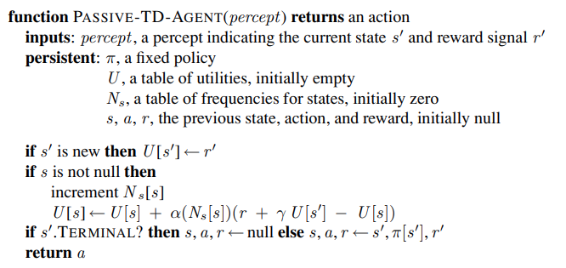
Temporal-Difference Learning
Adjusts utilities to move towards equilibrium
Converges to bellman solution!
Average utility converges
Decay $α$ over time
No transition model learning!
“crude” approx to ADP
(computationally feasible)

Slide 15
Improving Temporal-Difference & ADP
Temporal-Difference:
Why wait for observed trajectories?
Slow
Need lots of trajectories to converge
“Imagine” fake transitions (i.e. transitions that “might” happen)
Can generate large number of “imaginary” transitions
Closer to ADP
More compute → converge quicker
ADP:
Don’t need to compute all updates:
use a heuristic to adjust only “important” updates
Prioritized sweeping heuristic:
Make adjustments to states whose likely successors have (just undergone) large adjustments

