Slide 1
Policy Learning VI: RL IV

Slide 2
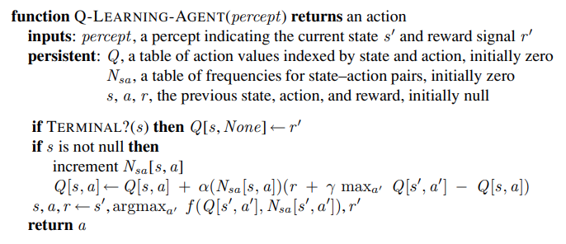
Active Q-Agent
Agent updates Q-function after transition $s→s′$ with action $a$
Agent uses exploratory function $f$ to sometimes ignore policy

Slide 3
Policy Search
Core idea:
Modify the policy until performance stops improving
What kind of policies?
Parameterized:
Only useful if policy uses (significantly) less memory than the # of states
For example:
$$π\left(s\right)= \underset{a}{argmax}{{\hat{Q}}_{θ}\left(s,a\right)}$$

Slide 4
Policy Search
When policy relies solely on Q-functions:
Policy Search → learn Q functions
Different than Q-learning
Q-learning → goal is to learn Q-function that is “close enough” to $Q^{∗}$
policy search → goal is to find Q-functions that are “good enough”
These goals might not produce the same thing!
Problem:
Policy is discontinuous (i.e. not a smooth function)

Slide 5
Policy Search
Why is discontinuity a problem?
Some small change in $θ$ can cause drastic changes is policy
Bad for gradients!
Idea: combine discontinuous estimates into a continuous Prob:
$$π\left(s,a\right)=\frac{e^{{\hat{Q}}_{θ}\left(s,a\right)}}{\sum_{a′}{e^{{\hat{Q}}_{θ}\left(s,a^{′}\right)}}}$$
This is called the softmax function
A form of normalizing a vector → produces probabilities

Slide 6
Policy Search
Why softmax?
Almost deterministic when one action is vastly better than others
Differentiable!
One other nice property:
$$\log\left(\frac{e^{{\hat{Q}}_{θ}\left(s,a\right)}}{\sum_{a^{′}}{e^{{\hat{Q}}_{θ}\left(s,a^{′}\right)}}}\right)$$
$$=\log\left(\frac{e^{{\hat{Q}}_{θ}\left(s,a\right)}}{C}\right)$$
$$={\hat{Q}}_{θ}\left(s,a\right) −log⁡(C)$$

Slide 7
Policy Search
Why is this important?
Remember, we want policy to optimize
$$𝔼\left[R\left(τ\right)\right]=𝔼\left[\sum_{t}{γ^{t}R\left(s_{t}\right)}\right]$$
How can we represent 𝔼?
$$𝔼\left[f\left(x\right)\right]=\sum_{x}{\operatorname{Pr}\left[x\right]f(x)}$$
Looks kinda similar!
$$𝔼\left[\sum_{t}{γ^{t}R\left(s_{t}\right)}\right]=\sum_{t}{π_{θ}\left(s_{t}\right)γ^{t}R\left(s_{t}\right)}$$

Slide 8
Policy Search
We need to differentiate:
$$\frac{∂}{∂θ_{i}}𝔼\left[\sum_{t}{γ^{t}R\left(s_{t}\right)}\right]=\frac{∂}{∂θ_{i}}\sum_{t}{π_{θ}\left(s_{t}\right)γ^{t}R\left(s_{t}\right)}$$
$$=\sum_{t}{\frac{∂}{∂θ_{i}}π_{θ}\left(s_{t}\right)γ^{t}R\left(s_{t}\right)}$$
$$=\sum_{t}{γ^{t}R\left(s_{t}\right)\frac{∂}{∂θ_{i}}π_{θ}\left(s_{t}\right)}$$
$$=\sum_{t}{γ^{t}R\left(s_{t}\right)π_{θ}\left(s_{t}\right)\frac{\frac{∂}{∂θ_{i}}π_{θ}\left(s_{t}\right)}{π_{θ}\left(s_{t}\right)}}$$
$$=\sum_{t}{γ^{t}R\left(s_{t}\right)π_{θ}\left(s_{t}\right)\frac{∂}{∂θ_{i}}\log\left(π_{θ}\left(s_{t}\right)\right)}$$
$$=𝔼\left[\sum_{t}{γ^{t}R\left(s_{t}\right)\frac{∂}{∂θ_{i}}\log\left(π_{θ}\left(s_{t}\right)\right)}\right]$$

Slide 9
Policy Search
Woah!
$$∇_{θ}𝔼\left[\sum_{t}{γ^{t}R\left(s_{t}\right)}\right]=𝔼\left[\sum_{t}{γ^{t}R\left(s_{t}\right)∇_{θ}\log\left(π_{θ}\left(s_{t}\right)\right)}\right]$$
Our gradient = gradient of policy scaled by how good the choices were
Can take sample average to approximate expectation!
Turns out there is a little more we can do here!
$$∇_{θ}𝔼\left[\sum_{t}{γ^{t}R\left(s_{t}\right)}\right]=𝔼\left[\sum_{t}{G_{t}∇_{θ}\log\left(π_{θ}\left(s_{t}\right)\right)}\right]$$
$G_{t}$ = value of trajectory from that point on

Slide 10
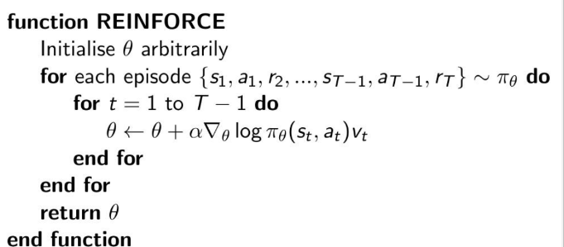
Policy Search with REINFORCE
Transforms search into a Monte-Carlo procedure
Samples one trajectory (i.e. plays one game)
Records trajectory
Updates policy w policy gradient (offline i.e. in between games)
Repeat!

Slide 11
Can We Do Better?
Policy Gradient:
$$𝔼\left[\sum_{t}{G_{t}∇_{θ}\log\left(π_{θ}\left(s_{t}\right)\right)}\right]$$
What if $G_{t}$ was its own function-approx $G_{θ^{′}}$ (could be $Q_{θ^{′}}(s_{t}, a_{t})$)
Already have $π_{θ}$

Slide 12
Actor-Critic RL
The “critic” = a function approximation for the “value” function
Could be Q-value, utility value
The “actor” = a function approximation for the policy
Critic still obeys bellman equation, can use TD learning
$$θ_{i}^{′}←θ_{i}^{′}+α\left(R\left(s\right)+γ{\hat{Q}}_{θ^{′}}\left(s^{′},a^{′}\right)−{\hat{Q}}_{θ^{′}}\left(s,a\right)\right)\frac{∂{\hat{Q} }_{θ^{′}}(s,a)}{∂θ_{i}^{′}}$$
Actor gradients we just derived!
$$θ_{j}←θ_{j}+ηG_{t}∇_{θ}\log\left(π_{θ}\left(s_{t}\right)\right)$$

Slide 13
The Advantage Function (A2C)
What happened to using the Bellman equation?
We can include it for $G_{θ^{′}}$
$G_{θ^{′}}$ just estimates the “value” of the current choice
But we know choices are related!
How good is a choice?
$$A\left(s_{t},a_{t}\right)=Q_{θ^{′}}\left(s_{t},a_{t}\right)−V_{θ^{′′}}\left(s_{t}\right)$$
This is called the advantage function
Do we need two function-approximations, one for $Q_{θ^{′}}$ and one for $V_{θ^{′′}}$
No!
$Q\left(s_{t},a_{t}\right)=𝔼\left[R\left(s_{t+1}\right)+γV\left(s_{t+1}\right)\right]$
Therefore
$$A\left(s_{t},a_{t}\right)=R\left(s_{t+1}\right)+γV_{θ^{′′}}\left(s_{t+1}\right)−V_{θ^{′′}}\left(s_{t}\right)$$
We only need $V_{θ^{′′}}$ and $π_{θ}$!

Slide 14
Offline Actor-Critic RL
Could also do this offline
Sample $N$ trajectories (i.e. play $N$ games) and record trajectories
Build supervised learning datasets
For $k$ training iterations:
Update $π_{θ}$ and $G_{θ^{′}}$
Repeat
Useful for scaling:
A3C (Async A2C) = play lots of games in parallel (in eplore step), update after

Slide 15
NN Q-function
$$a_{1}^{2}$$
$$a_{1}^{4}$$
$$a_{1}^{1}$$
$$a_{1}^{3}$$
$$a_{1}^{5}$$
$$s$$
$$a_{2}^{2}$$
$$a_{2}^{4}$$
$$a_{2}^{3}$$
$$a_{2}^{1}$$
$$a_{3}^{2}$$
$$a_{3}^{4}$$
$$a_{1}^{6}$$
$$Q(s,a)$$
$$a$$
$$a_{3}^{3}$$
$$a_{4}^{2}$$
$$a_{4}^{4}$$
NN takes place of tabular Q-function
How to apply updates?
If we had a table:
Since we have a NN…cannot adjust Q value directly (like in above equation):
$$θ_{i}←θ_{i}+α\left(R\left(s\right)+γ\max_{a^{′}} {\hat{Q}}_{θ}\left(s^{′},a^{′}\right)−{\hat{Q}}_{θ}\left(s,a\right)\right)\frac{∂{\hat{Q} }_{θ}(s,a)}{∂θ_{i}}$$
Gradient descent!
Error (loss function) = $R\left(s\right)+γ\max_{a^{′}} {\hat{Q}}_{θ}\left(s^{′},a^{′}\right)−{\hat{Q}}_{θ}\left(s,a\right)$
$$a_{4}^{3}$$
$$a_{2}^{5}$$
$$a_{3}^{1}$$
$$a_{5}^{2}$$
$$a_{5}^{4}$$
$$Q\left(s,a\right)←Q\left(s,a\right)+α\left(R\left(s\right)+γ\max_{a^{′}} Q\left(s^{′},a^{′}\right)−Q\left(s,a\right)\right)$$

Slide 16
Training a NN Q-function
For now, let us assume exporation function $f$ is randomized impl.
With some probability $p$, ignore policy and choose random action
With remaining probability $1−p$, follow policy
Let us observe the transition $\left(s,a,s^{′}\right)$ where we have recorded $R(s)$ and $R\left(s^{′}\right)$
Fix the policy (i.e. just use the NN):
Calculate TD error by iterating over possible actions $a^{′}$ in $s^{′}$
$$e=R\left(s\right)+γ\max_{a^{′}} {\hat{Q}}_{θ}\left(s^{′},a^{′}\right)−{\hat{Q}}_{θ}\left(s,a\right)$$
Backprop $e$ through the network treating $e$ like it is any other error function

