Slide 1
Policy Learning I

Slide 2
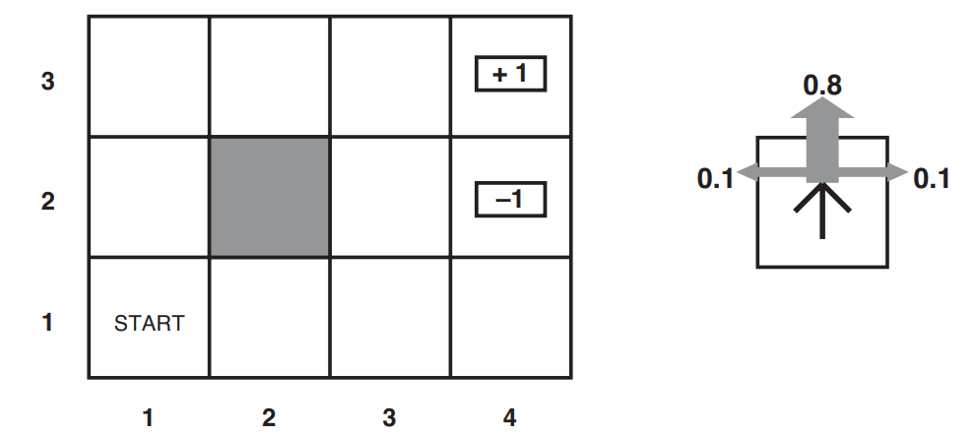
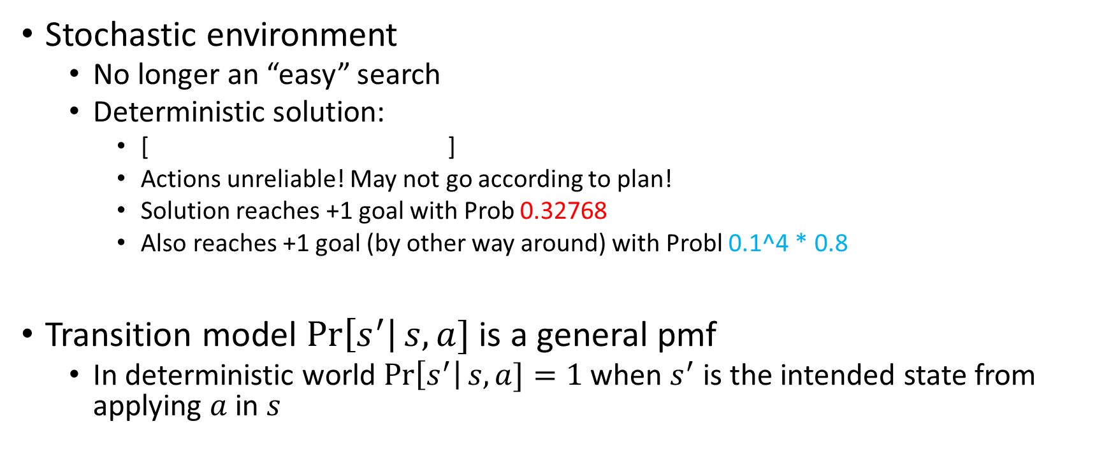
Sequential Problems
Stochastic environment
  No longer an “easy” search
  Deterministic solution:
    [ ]
    Actions unreliable! May not go according to plan!
    Solution reaches +1 goal with Prob 0.32768
    Also reaches +1 goal (by other way around) with Probl 0.1^4 * 0.8
Transition model $\operatorname{Pr}\left[s^{′}\right|s,a]$ is a general pmf
  In deterministic world $\operatorname{Pr}\left[s^{′}\right|s,a]=1$ when $s^{′}$ is the intended state from applying $a$ in $s$

Slide 3
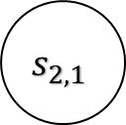
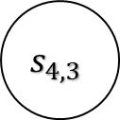
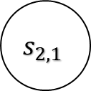
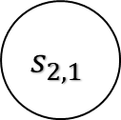
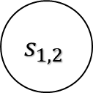
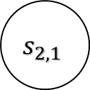
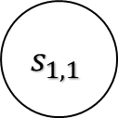
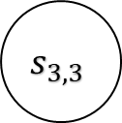
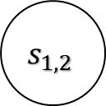
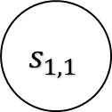
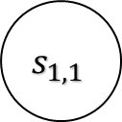
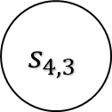
Trajectories
The observed sequence of states (and actions) is called a trajectory
From a single start state, lots of trajectories possible
$$s_{1,1}$$
$$s_{1,1}$$
$$s_{4,3}$$
$$s_{4,3}$$
$$s_{1,2}$$
$$s_{1,2}$$
$$s_{1,1}$$
$$s_{2,1}$$
$$s_{2,1}$$
$$s_{3,3}$$
$$s_{2,1}$$
$$s_{2,1}$$

Slide 4
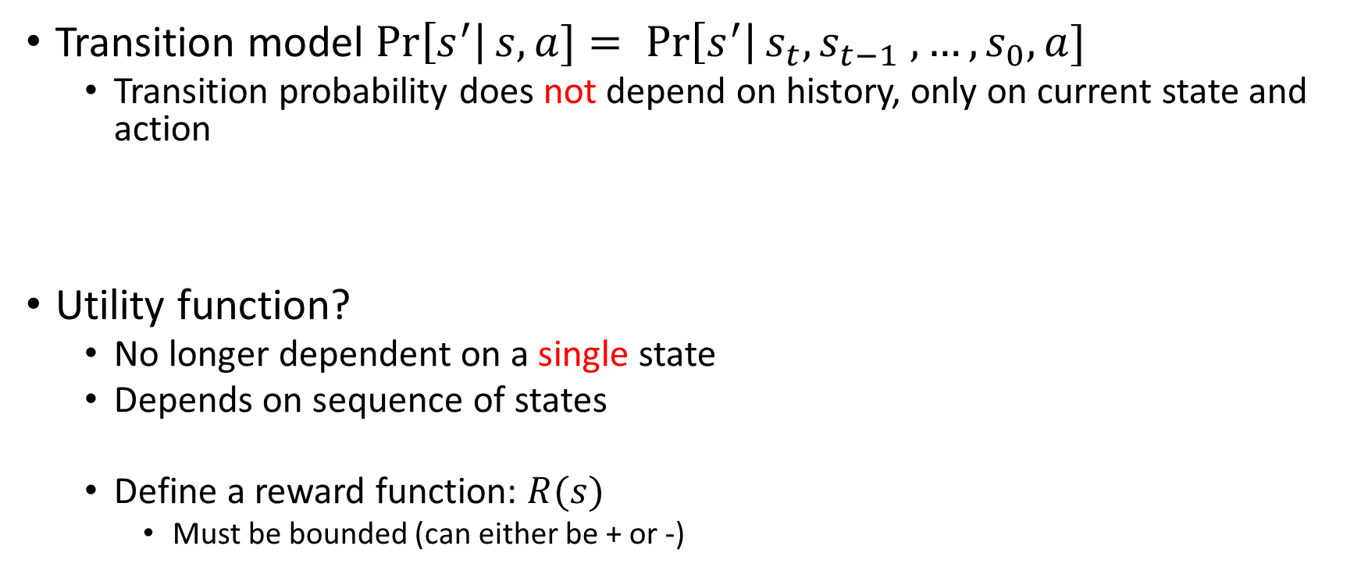
Markovian Assumption & Utilities
Transition model $\operatorname{Pr}\left[s^{′}\right|s,a]= \operatorname{Pr}\left[s^{′}\right|s_{t}, s_{t−1} , …, s_{0},a]$
  Transition probability does not depend on history, only on current state and action
Utility function?
  No longer dependent on a single state
  Depends on sequence of states
  Define a reward function: $R(s)$
    Must be bounded (can either be + or -)

Slide 5
Utilities from Rewards?
Many ways of doing this
For now, consider utility = sum of rewards along that trajectory
Utility of a 10-step trajectory (ending in +1 goal) = 0.6
  Negative reward incentivizes agent to find solution early
  (We design our agents to maximize utility)

Slide 6
MDP
A sequential decision problem
  Fully observable world
  Stochastic env
  Markovian transition model
  Additive rewards
This is called a Markov Decision Process
  Set of states (with initial state)
  Actions for each state
  Transition model
  Reward function

Slide 7
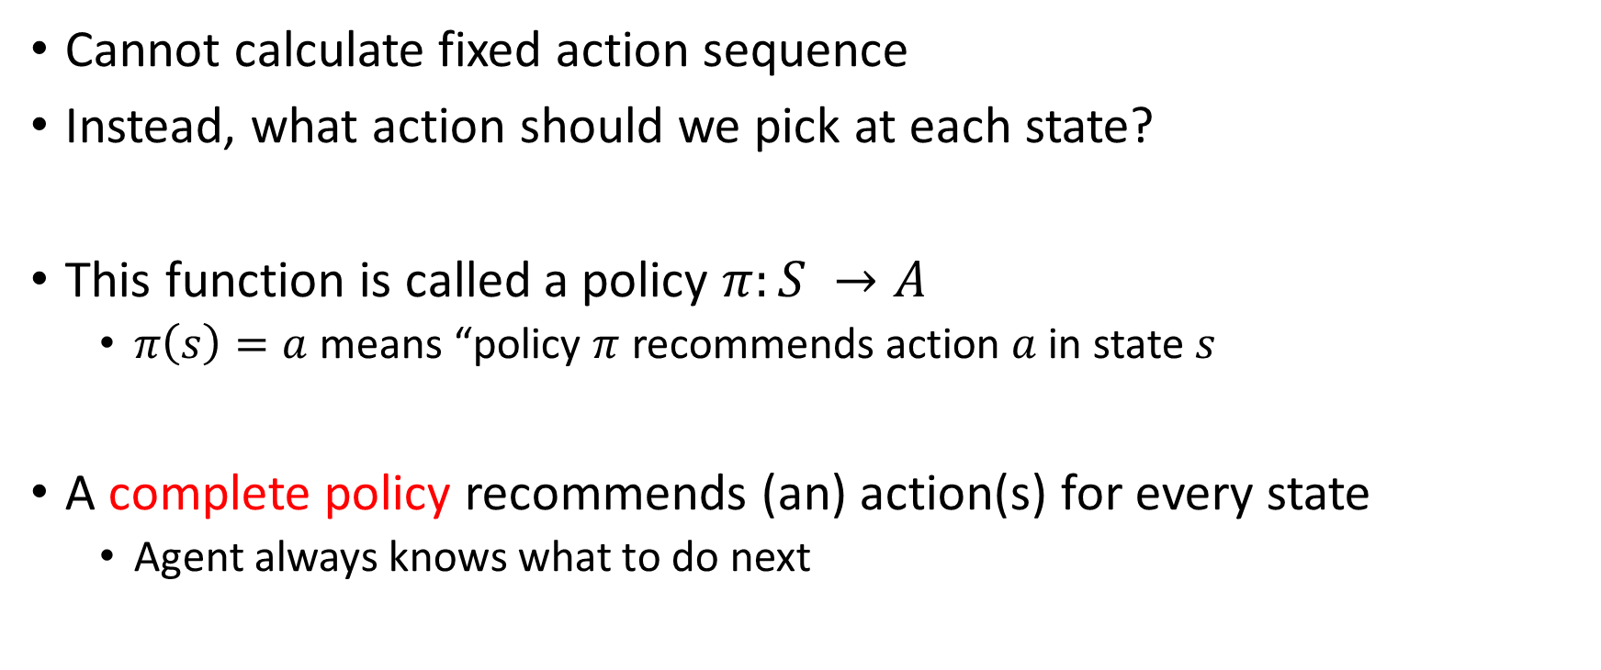
Policies
Cannot calculate fixed action sequence
Instead, what action should we pick at each state?
This function is called a policy $π:S →A$
  $π\left(s\right)=a$ means “policy $π$ recommends action $a$ in state $s$
A complete policy recommends (an) action(s) for every state
  Agent always knows what to do next

Slide 8
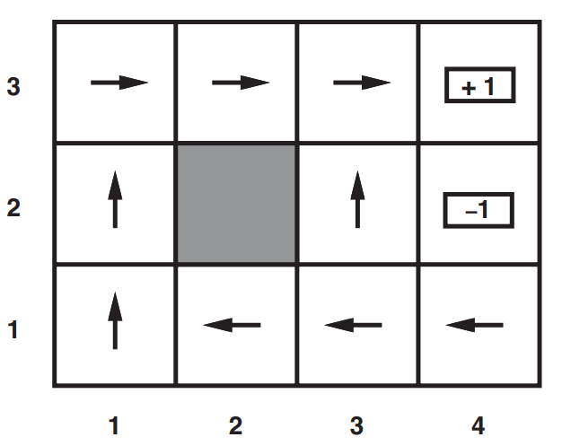
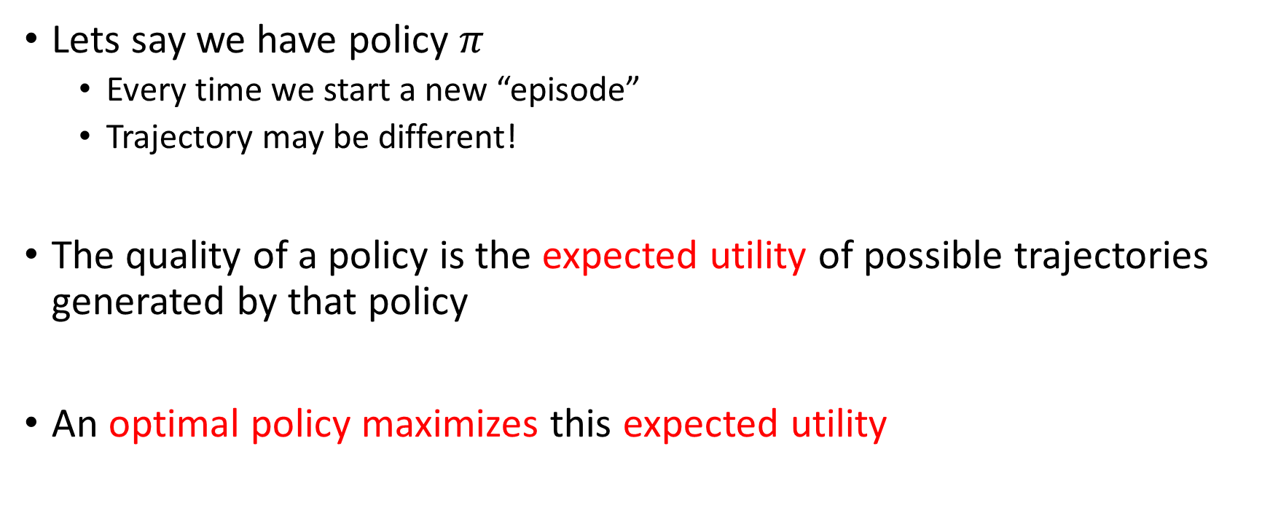
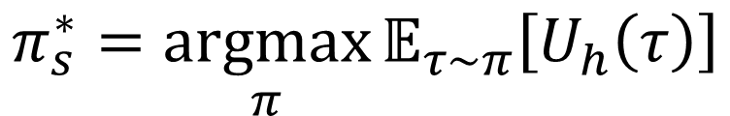
Optimal Policies
Lets say we have policy $π$
  Every time we start a new “episode”
  Trajectory may be different!
The quality of a policy is the expected utility of possible trajectories generated by that policy
An optimal policy maximizes this expected utility
$$π_{s}^{∗}=\underset{π}{argmax}{𝔼_{τ∼π}\left[U_{h}\left(τ\right)\right]}$$

Slide 9
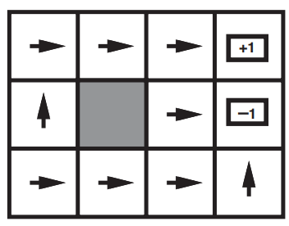
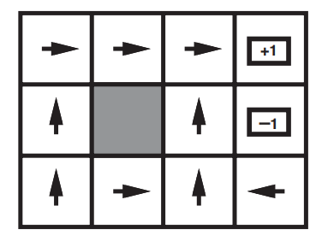
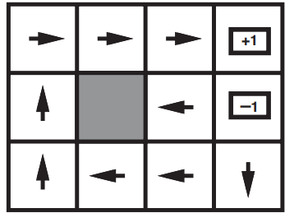
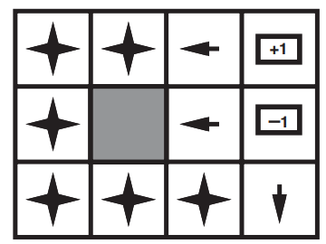




Optimal Policies are Sensitive to Rewards
$$R(s) < −1.6284$$
$$−0.4278< R(s) < −0.085$$
$$−0.0221<R(s) <0$$
$$R\left(s\right)>0$$

Slide 10
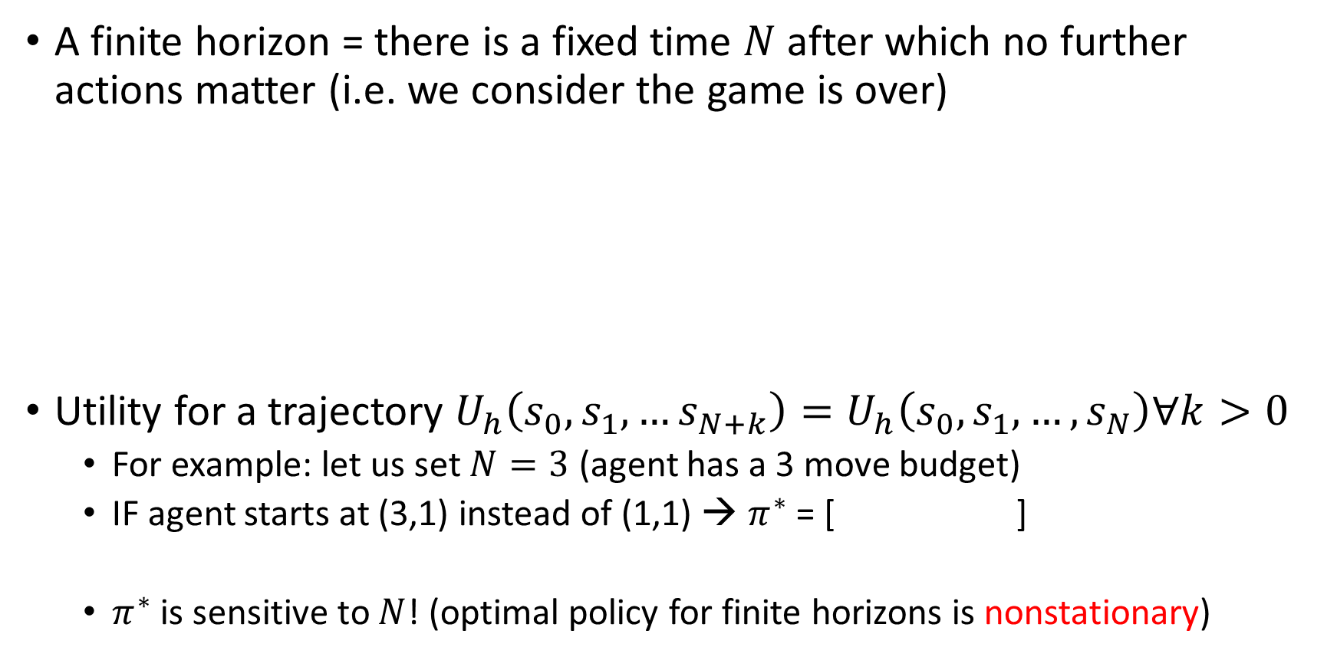
Finite Horizons
A finite horizon = there is a fixed time $N$ after which no further actions matter (i.e. we consider the game is over)
Utility for a trajectory $U_{h}\left(s_{0},s_{1},…s_{N+k}\right)=U_{h}\left(s_{0},s_{1},…,s_{N}\right)∀k>0$
  For example: let us set $N=3$ (agent has a 3 move budget)
  IF agent starts at (3,1) instead of (1,1) → $π^{∗}$ = [ ]
  $π^{∗}$ is sensitive to $N$! (optimal policy for finite horizons is nonstationary)

Slide 11
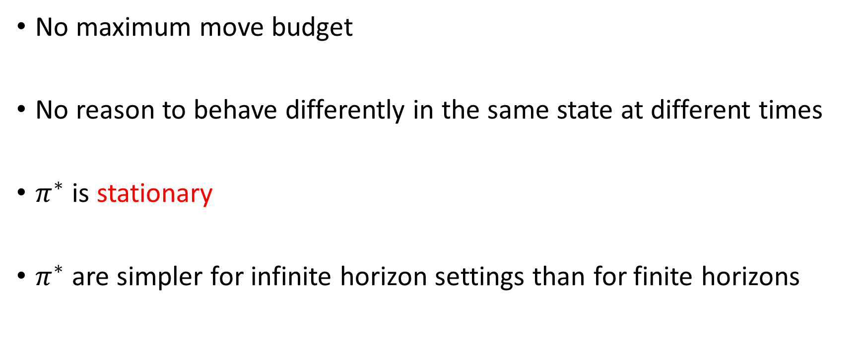
Infinite Horizons
No maximum move budget
No reason to behave differently in the same state at different times
$π^{∗}$ is stationary
$π^{∗}$ are simpler for infinite horizon settings than for finite horizons

Slide 12
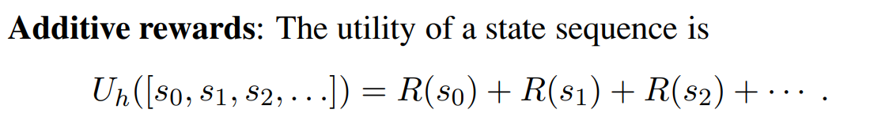
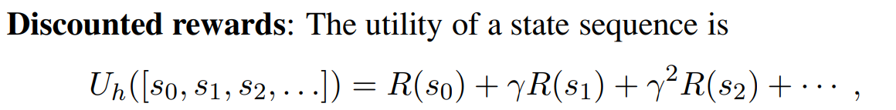

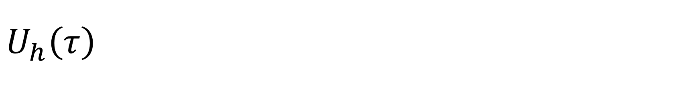
$$U_{h}\left(τ\right)$$
Discount factor $γ∈\left[0,1\right]$. When $γ=1$, we consider the future states as equally valuable to where we are now. $γ=0$ claims the future is insignificant

Slide 13
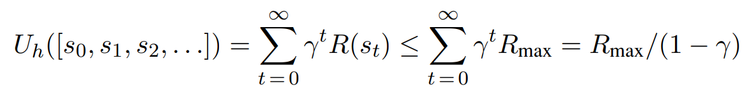
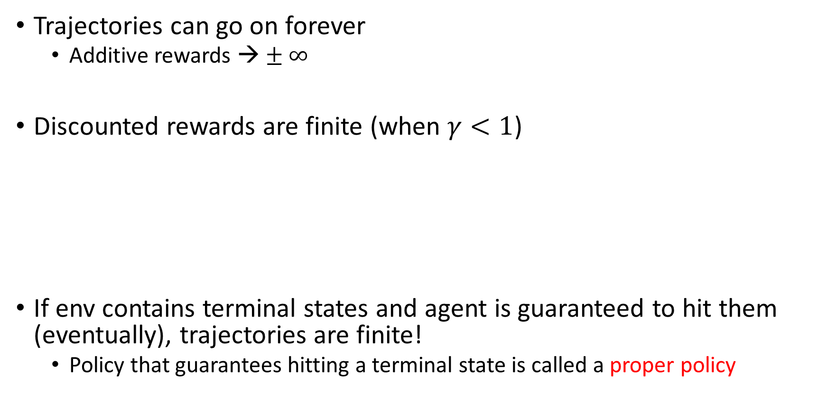
Problem with Additive Rewards
Trajectories can go on forever
  Additive rewards → $± ∞$
Discounted rewards are finite (when $γ<1$)
If env contains terminal states and agent is guaranteed to hit them (eventually), trajectories are finite!
  Policy that guarantees hitting a terminal state is called a proper policy

Slide 14


Another Way to Write Optimal Policies
Since discounted rewards is more general than additive:
  $𝔼_{τ∼π}\left[U_{h}\left(τ\right)\right]→U^{π}\left(s\right)=𝔼[\sum_{t=0}^{∞}{γ^{t}R\left(s_{t}\right)]}$
$$π_{s}^{∗}=\underset{π}{argmax}{U^{π}\left(s\right)}$$

Slide 15

Policy Learning
How to calculate $π^{∗}$
More on this later

