Slide 1
Improving
Authenticated Dynamic Dictionaries
with
Applications to Cryptocurrencies
Leonid
Reyzin
Dmitry
Meshkov
Alexander
Chepurnoy
Sasha
Ivanov
Boston University
(work supported by
Waves Platform)
IOHK Research
&
N. N. Semenov Institute
for Chemical Physics, RAS
IOHK Research
Waves Platform

Slide 2

Motivation: validating transactions
14
PK_{A}
PK_{D}
Stateless validation: Check syntax, signature of PK_{A}, etc.
All required info is in the transaction itself
Stateful validation: Check that PK_{A} has ≥ 14 (+ fee)
Requires knowing how much PK_{A} has based on prior transactions
PK_{A}→ 36
PK_{E}→ 347
PK_{I}→ 12
PK_{M}→ 12
PK_{B}→ 684
PK_{F}→ 98
PK_{J}→ 285
PK_{N}→ 76
…
PK_{C} → 2
PK_{G} → 50
PK_{K} → 463
PK_{O} → 3
PK_{D} → 13
PK_{H} → 54
PK_{L} → 3
PK_{P} → 88
Large (and growing!) dictionary data structure.
Currently in Bitcoin: 1.5GB (serialized).
Even worse in multiasset blockchains: one per asset.

Slide 3



Problem: blockchain validation requires storing a large state
Q: Where to keep this state?
A1: Disk storage => slow validation => DoS [CVE-2013-2293]
A2: RAM => only powerful computers => centralization

Slide 4
Problem: blockchain validation requires storing a large state
Observation: transaction verifier does not need this data structure
PK_{A}→ 36
PK_{E}→ 347
PK_{I}→ 12
PK_{M}→ 12
PK_{B}→ 684
PK_{F}→ 98
PK_{J}→ 285
PK_{N}→ 76
…
PK_{C} → 2
PK_{G} → 50
PK_{K} → 463
PK_{O} → 3
PK_{D} → 13
PK_{H} → 54
PK_{L} → 3
PK_{P} → 88

Slide 5

Problem: blockchain validation requires storing a large state
Observation: transaction verifier does not need this data structure
PK_{A}→ 36
PK_{E}→ 347
PK_{I}→ 12
PK_{M}→ 12
PK_{B}→ 684
PK_{F}→ 98
PK_{J}→ 285
PK_{N}→ 76
…
PK_{C} → 2
PK_{G} → 50
PK_{K} → 463
PK_{O} → 3
PK_{D} → 13
PK_{H} → 54
PK_{L} → 3
PK_{P} → 88
Needs only proof of a single fact: the amount that PK_{A} has
Idea [early versions in Miller ‘12, Ethereum/Wood ‘14, White ‘15]:
Use authenticated data structures (root in block header)
and include a proof of sender’s balance with each transaction.

Slide 6
Authenticated account balances
Block header
Consensus data
Transactions root hash
…
Accounts root hash
hash
hash
hash
hash
hash
hash
PK_{A} 36
PK_{B} 684
PK_{C} 2
PK_{D} 13
PK_{E} 347
PK_{F} 98
PK_{G} 50
PK_{H} 54

Slide 7
Authenticated account balances
Block header
Assume, for now, this can be trusted
Consensus data
Transactions root hash
…
Accounts root hash
hash
hash
hash
hash
hash
hash
PK_{A} 36
PK_{B} 684
PK_{C} 2
PK_{D} 13
PK_{E} 347
PK_{F} 98
PK_{G} 50
PK_{H} 54
14
When a miner includes this transaction,
she includes the Merkle path to “PK_{A} 36”
PK_{A}
PK_{D}
A “light verifier” can check the block without storing the state
(thus getting traditional full-node security guarantees)

Slide 8
Verifier
Block header
Consensus data
Transactions root hash
…
Accounts root hash
Transactions + proofs
Y/N
Verifier
Guaranteed not to take too long (to prevent DoS)

Slide 9
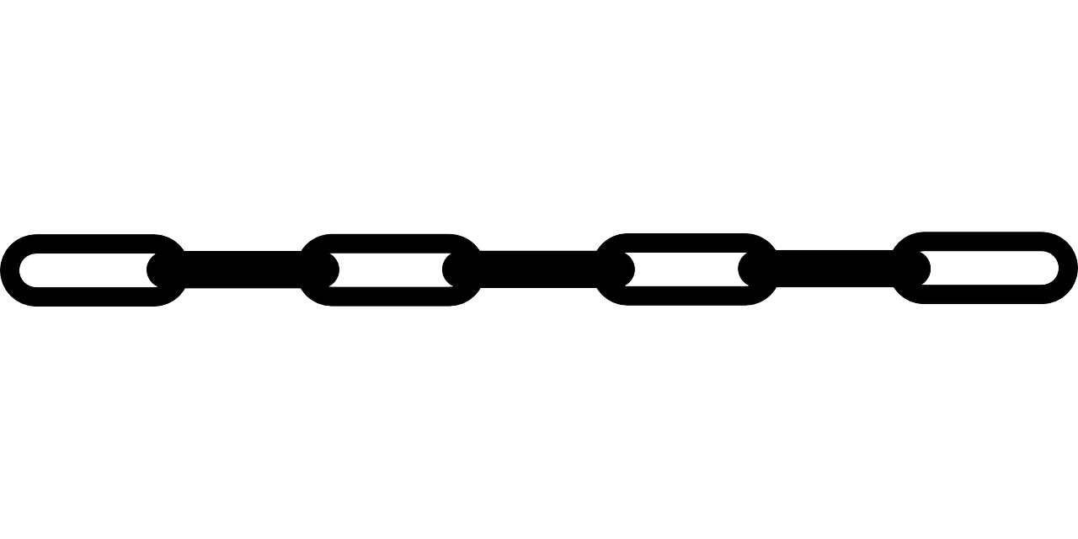
Miner (Prover)
Block header
Next block header
Consensus data
Transactions root hash
…
…
Accounts root hash
New root hash
hash
hash
hash
hash
hash
hash
22
27
PK_{A} 36
PK_{B} 684
PK_{C} 2
PK_{D} 13
PK_{E} 347
PK_{F} 98
PK_{G} 50
PK_{H} 54
14
PK_{A}
PK_{D}
35
PK_{F}
PK_{E}
29
PK_{B}
PK_{H}
…

Slide 10
Verifier Needs to Check New Root Hash
This can be trusted because verified from previous block, all the way
back to genesis
Block header
Next block header
Consensus data
Transactions root hash
…
…
Accounts root hash
New root hash
=
Transactions + proofs
Y/N
+ New root hash
Verifier
Need to support authentication and root hash update for:
- update value of key
- insert new (key, value) + rebalance tree
- delete key + rebalance tree
Ours: 2-party model –
only provers and verifiers
More typical:
3-party model
Note: In typical authenticated data structures
(e.g., Certificate Transparency),
Verifier is not checking the new root. Our model is strictly harder.

Slide 11
Prior Work
: Proof Length
All relevant prior work is based on Merkle trees;
differences are how to structure/rebalance the underlying binary tree
Skip list
[Papamanthou-Tamassia ’07]
Update
existing
1.5 H log N
Insert
new
1.5 H log N
Problem:
(bad randomness => unbalanced tree => very long proofs => DoS)
require trusted randomness
N = # of PKs
H = length of hash

Slide 12
Prior Work
: Proof Length
All relevant prior work is based on Merkle trees;
differences are how to structure/rebalance the underlying binary tree
Skip list
Red-black+
[Miller-Hicks-Katz-Shi ‘14]
Update
existing
work for generic data structures
1.5 H log N
(H+K) log N
Insert
new
1.5 H log N
3 (H+K) log N
trusted randomness
red-black tree rebalancing
requires more nodes
N = # of PKs
H = length of hash
K = length of PK

Slide 13
Prior Work
: Proof Length
All relevant prior work is based on Merkle trees;
differences are how to structure/rebalance the underlying binary tree
Skip list
Red-black+
Various 3-party solutions
Update
existing
1.5 H log N
(H+K) log N
[Naor-Nissim 00,
GT00,GTS01,
AGT01,MNDGKS04,
GPT07,CW11…]
H log N
Insert
new
1.5 H log N
3 (H+K) log N
N/A
trusted randomness
Don’t produce a proof
that allows verifier to compute new root
N = # of PKs
H = length of hash
K = length of PK

Slide 14
Prior Work
: Proof Length
All relevant prior work is based on Merkle trees;
differences are how to structure/rebalance the underlying binary tree
Skip list
Red-black+
Update
existing
1.5 H log N
(H+K) log N
Insert
new
1.5 H log N
3 (H+K) log N
trusted randomness
N = # of PKs
H = length of hash
K = length of PK

Slide 15
Our Work
: Proof Length
All relevant prior work is based on Merkle trees;
differences are how to structure/rebalance the underlying binary tree
Skip list
Red-black+
AVL+
Update
existing
1.5 H log N
(H+K) log N
H log N
Insert
new
1.5 H log N
3 (H+K) log N
H log N
trusted randomness
Source of improvements:
- AVL trees have near-optimal depth (unlike skip lists)
- Rebalancing operations in AVL trees almost never use nodes
that are not on the path to the leaf
N = # of PKs
H = length of hash
- Targeted (as opposed to generic) algorithms
K = length of PK

Slide 16
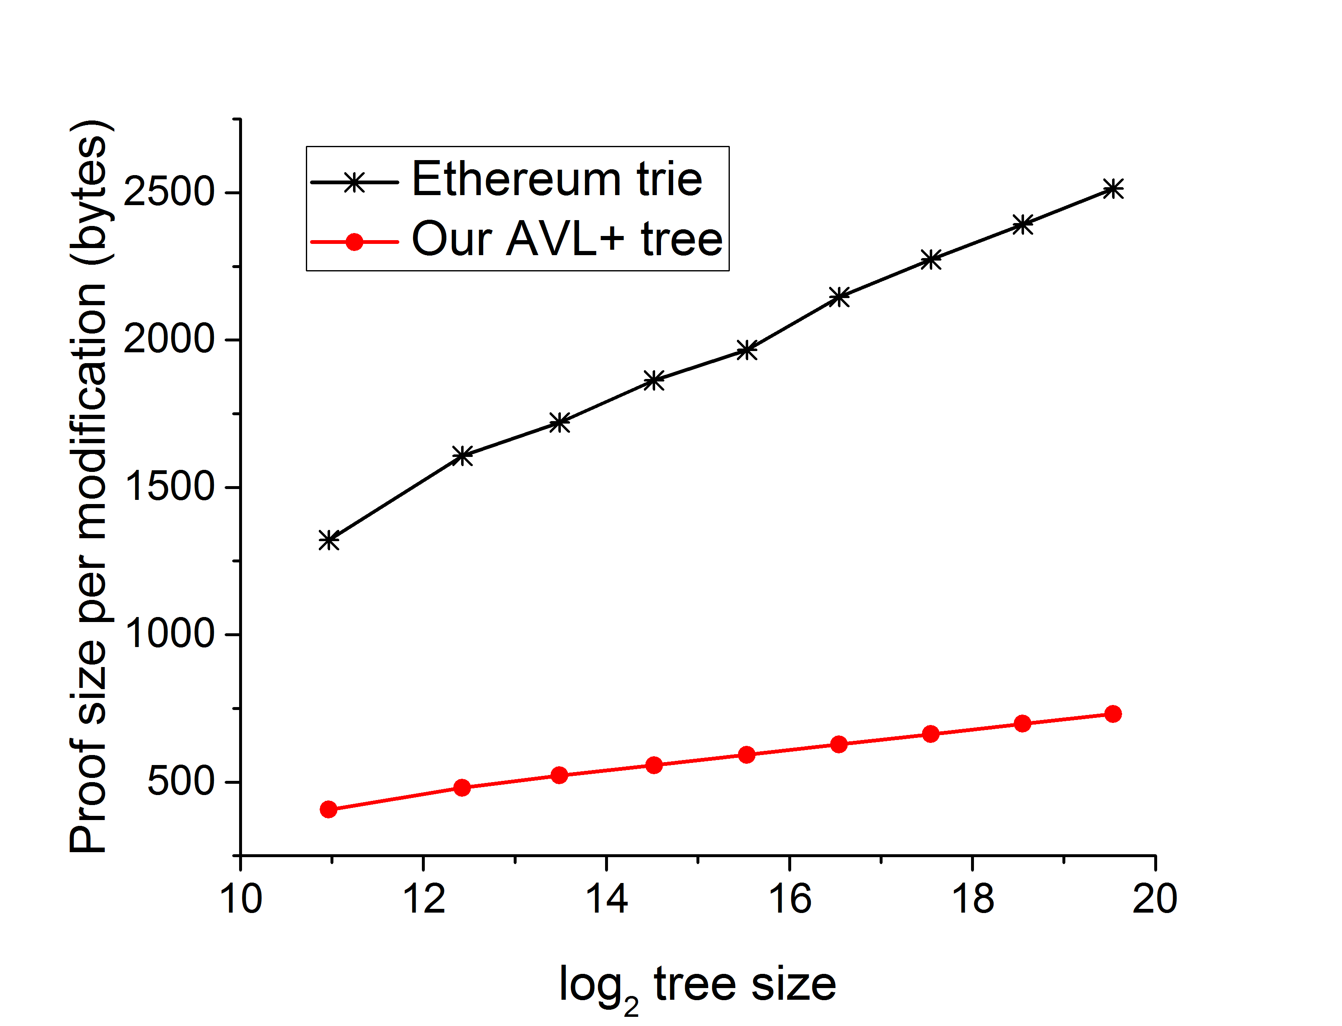
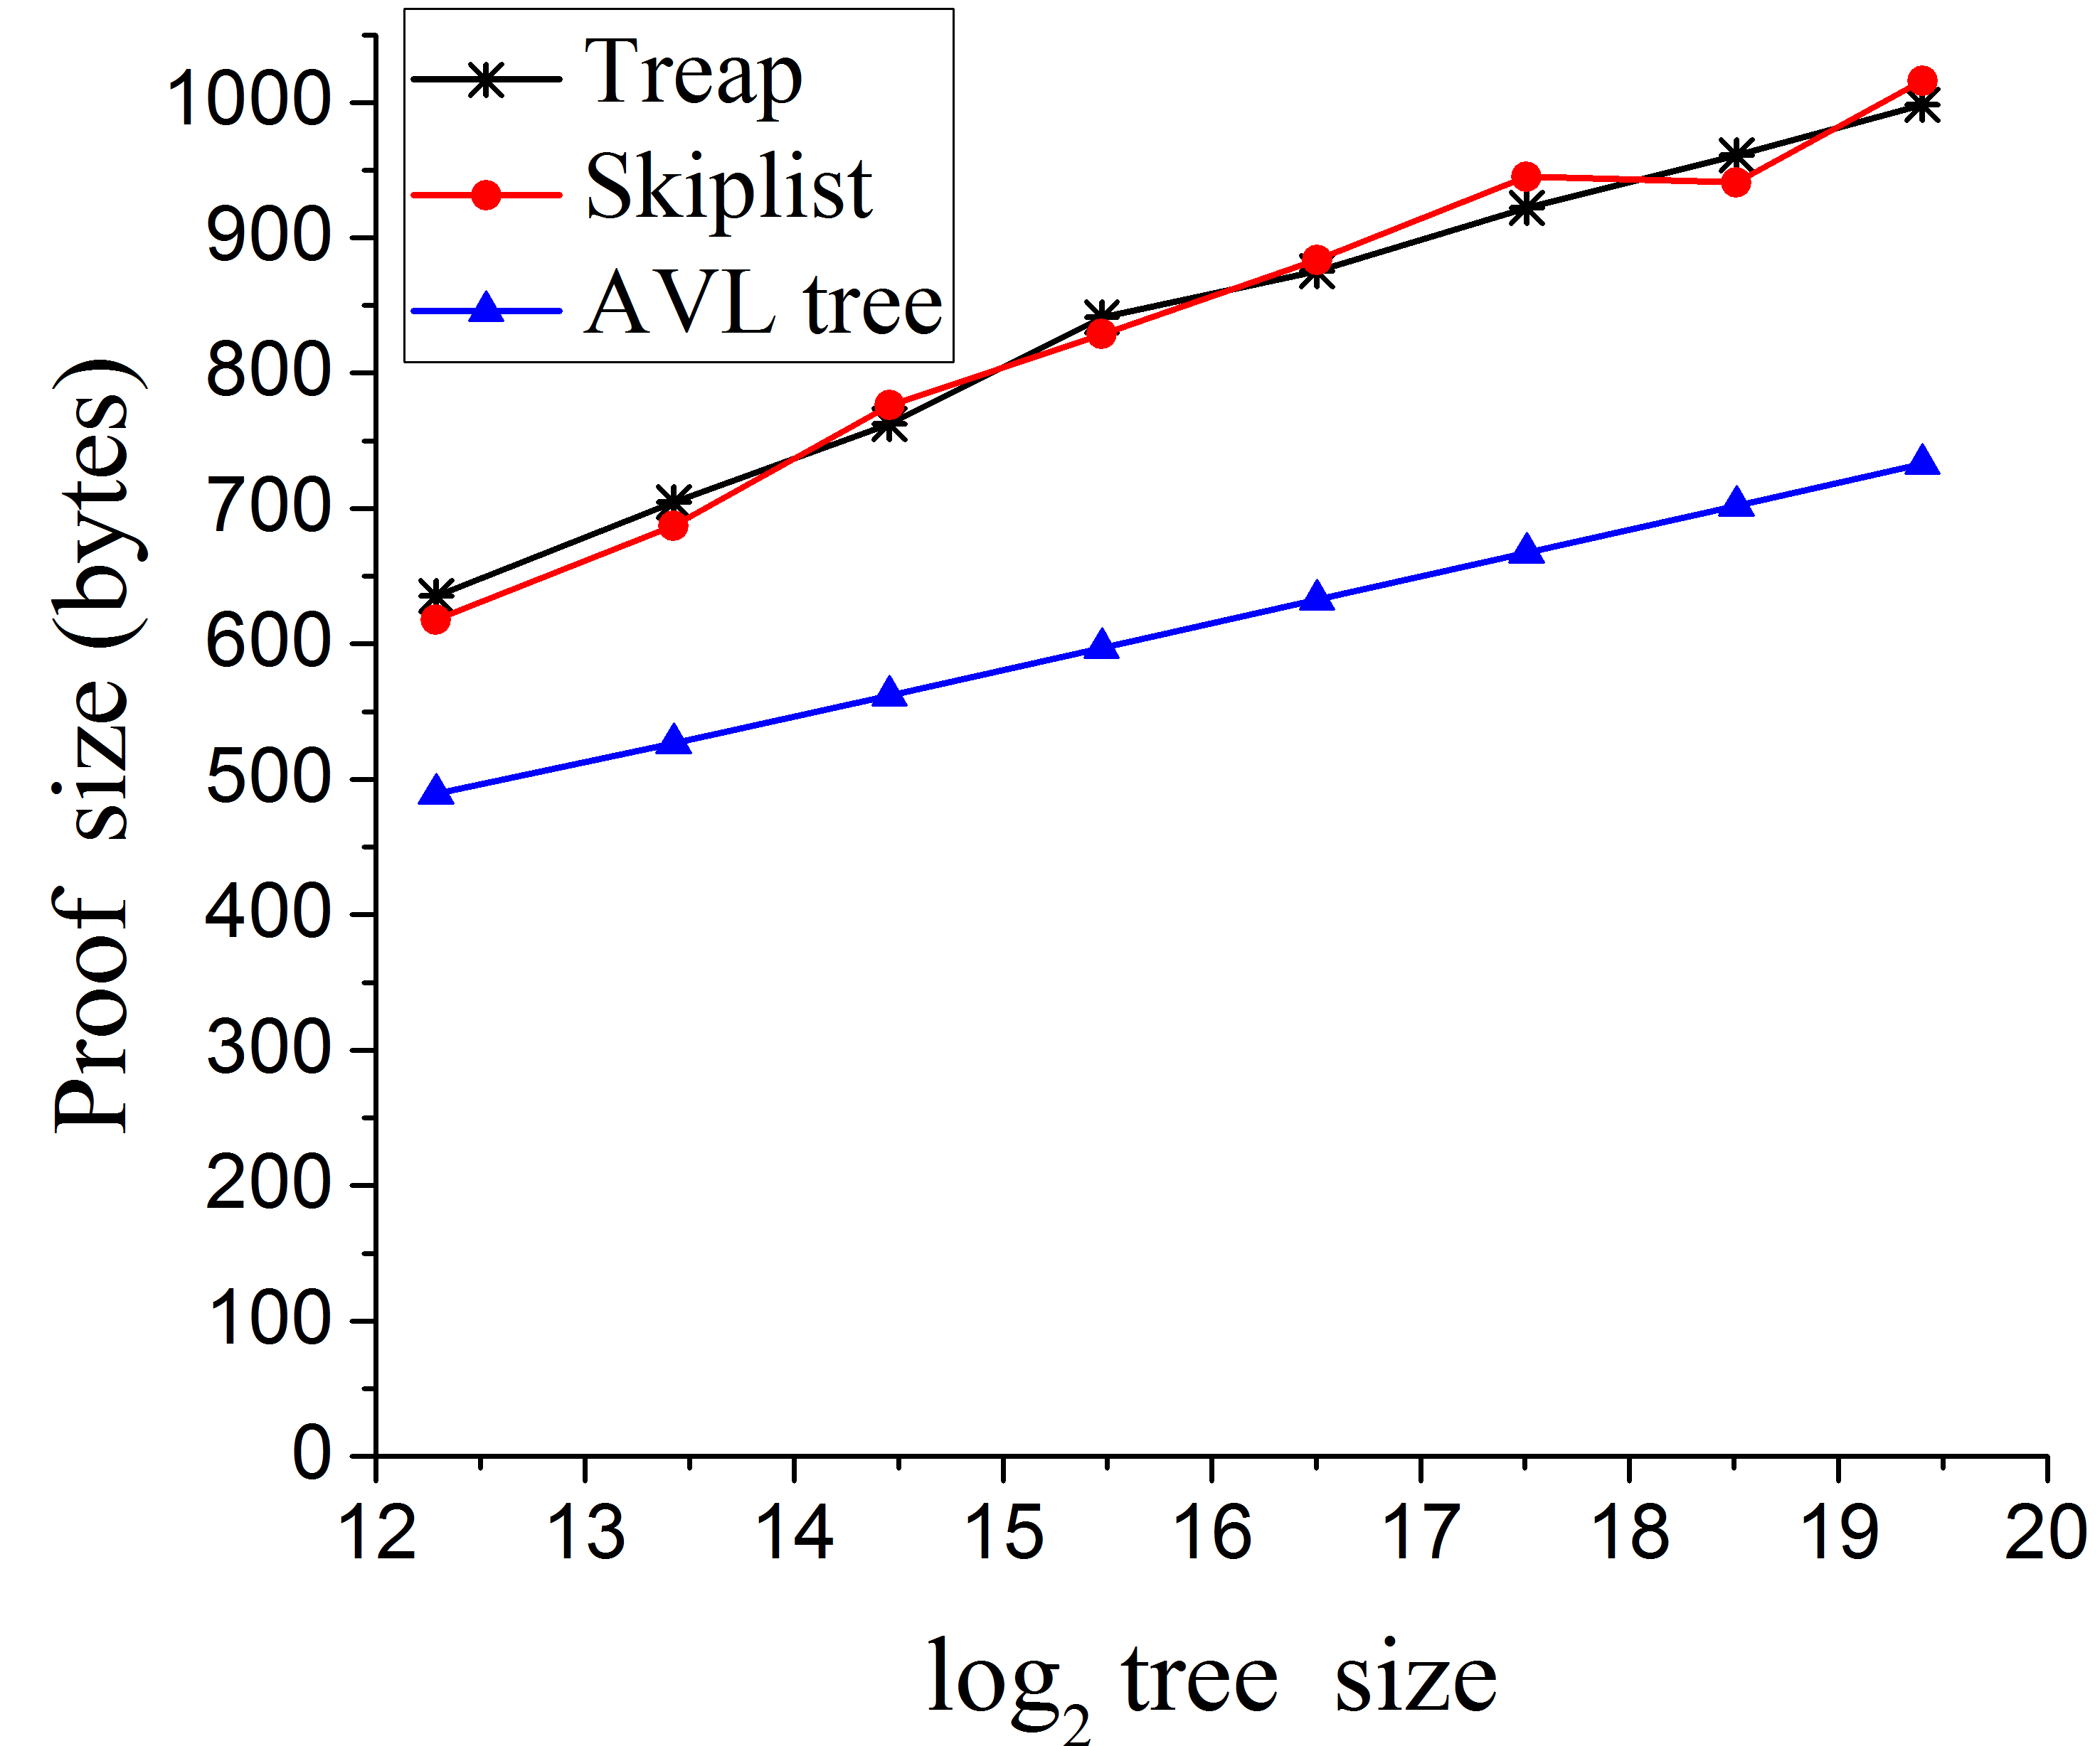
Implementation results: single-op proof size
- For N = 1 000 000 our modify/insert proof size = 765 bytes
(with 256-bit keys/hashes, 64-bit values)
- Deletion proofs are about 50 bytes longer
- Improves many 3-party works (e.g., [Crosby-Wallach ‘11])

Slide 17
Further improvement: combining proofs
Block header
Next block header
Consensus data
Transactions root hash
…
…
Accounts root hash
New accounts root hash
hash
hash
hash
hash
hash
hash
PK_{A} 36
PK_{B} 684
PK_{C} 2
PK_{D} 13
PK_{E} 347
PK_{F} 98
PK_{G} 50
PK_{H} 54
14
PK_{A}
PK_{D}
35
- These proofs overlap.
- Some values can omitted because
verifier will compute them
PK_{F}
PK_{E}
29
PK_{B}
PK_{H}
…

Slide 18
Further improvement: combining proofs
Block header
Next block header
Consensus data
Transactions root hash
…
…
Accounts root hash
New accounts root hash
hash
hash
hash
hash
hash
hash
PK_{A} 36
PK_{B} 684
PK_{C} 2
PK_{D} 13
PK_{E} 347
PK_{F} 98
PK_{G} 50
PK_{H} 54
14
PK_{A}
PK_{D}
35
- These proofs overlap.
- Some values can omitted because
verifier will compute them
PK_{F}
PK_{E}
29
PK_{B}
PK_{H}
…

Slide 19
Further improvement: combining proofs
Block header
Next block header
Consensus data
Transactions root hash
…
…
Accounts root hash
New accounts root hash
hash
hash
hash
hash
hash
hash
PK_{A} 36
PK_{B} 684
PK_{C} 2
PK_{D} 13
PK_{E} 347
PK_{F} 98
PK_{G} 50
PK_{H} 54
14
PK_{A}
PK_{D}
35
- These proofs overlap.
- Some values can omitted because
verifier will compute them
PK_{F}
PK_{E}
29
PK_{B}
PK_{H}
…

Slide 20
Further improvement: combining proofs
Block header
Next block header
Consensus data
Transactions root hash
…
…
Accounts root hash
New accounts root hash
hash
hash
hash
hash
hash
hash
PK_{A} 36
PK_{B} 684
PK_{C} 2
PK_{D} 13
PK_{E} 347
PK_{F} 98
PK_{G} 50
PK_{H} 54
14
PK_{A}
PK_{D}
35
- These proofs overlap.
- Some values can omitted because
verifier will compute them
PK_{F}
PK_{E}
29
PK_{B}
PK_{H}
…

Slide 21
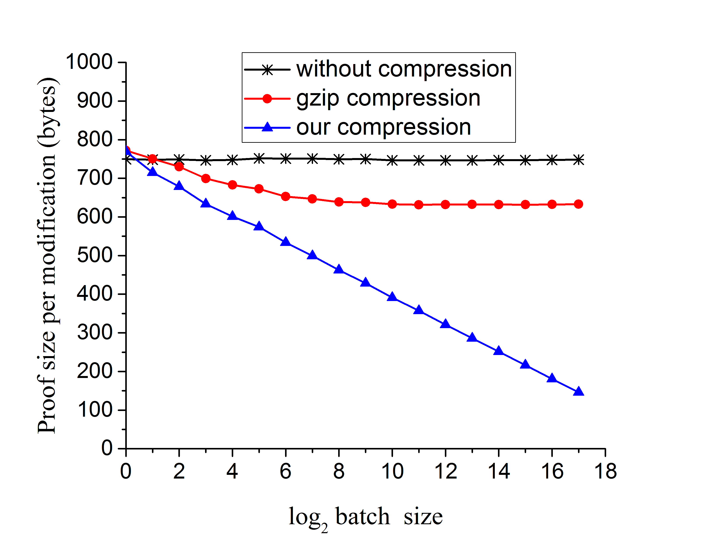
Implementation results: batching proofs
For N = 1 000 000 and batch B = 2000 :
compressed proof is ≈ 370 bytes per operation
(instead of ≈ 760 uncompressed)

Slide 22
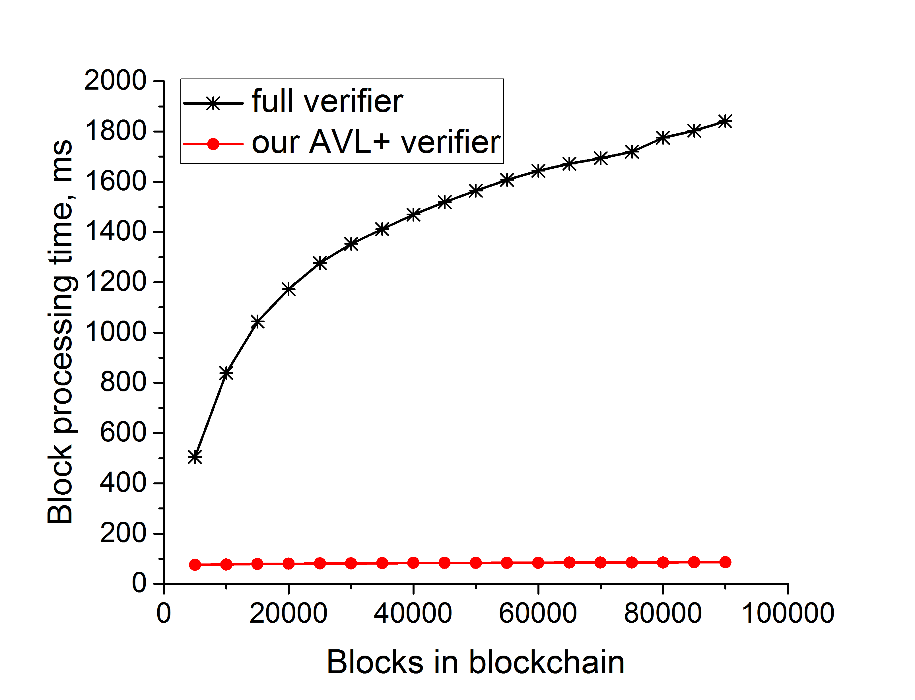

Conclusion: authenticated data structures enable verification on commodity hardware!
Paper:
ia.cr/2016/994
github.com/input-output-hk/scrypto
wavesplatform.com/
Code (public domain):
Coming to Waves Platform:

