Slide 1
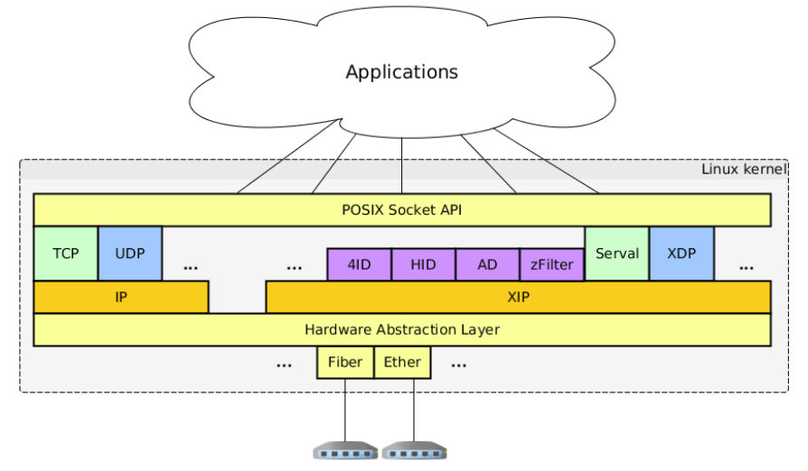
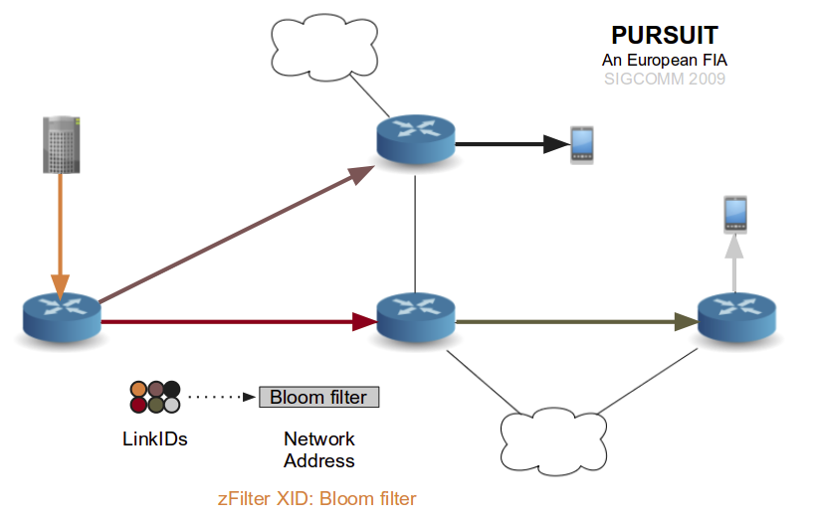
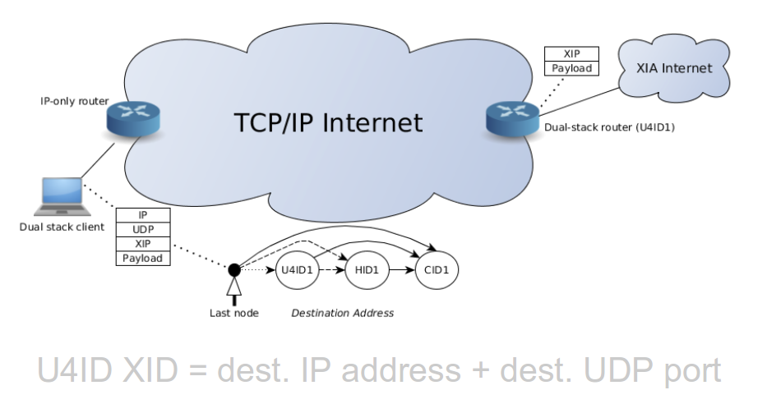
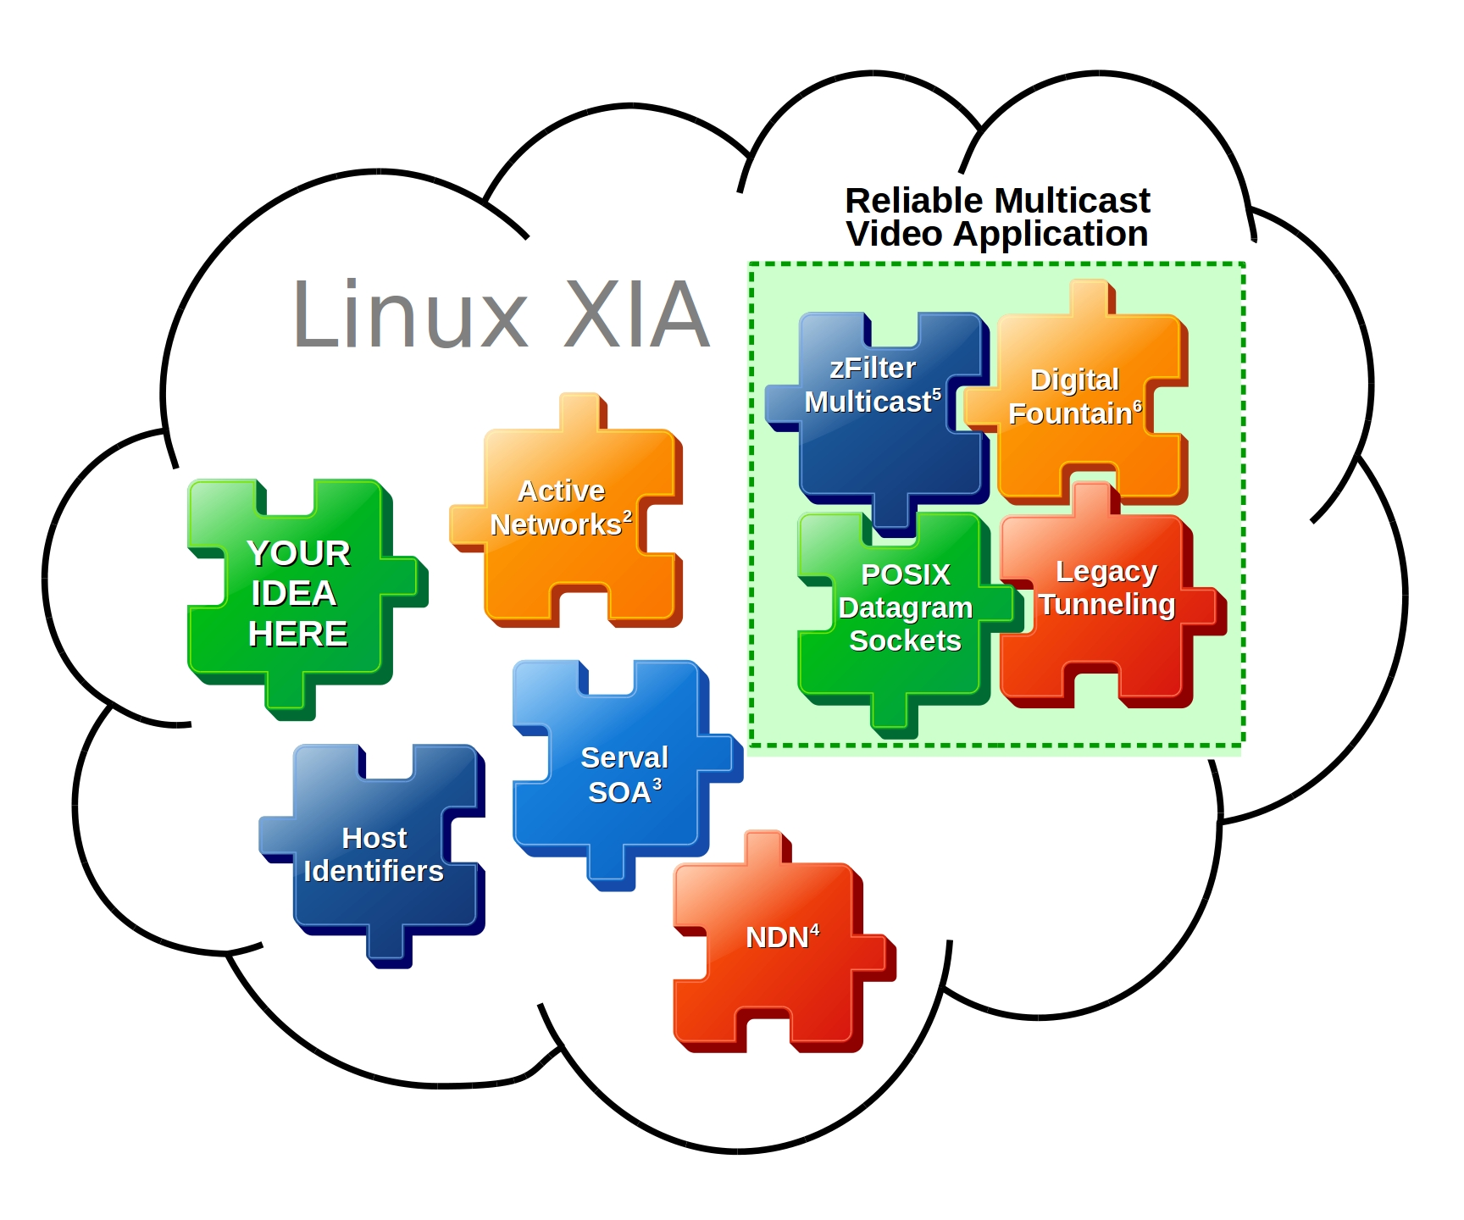
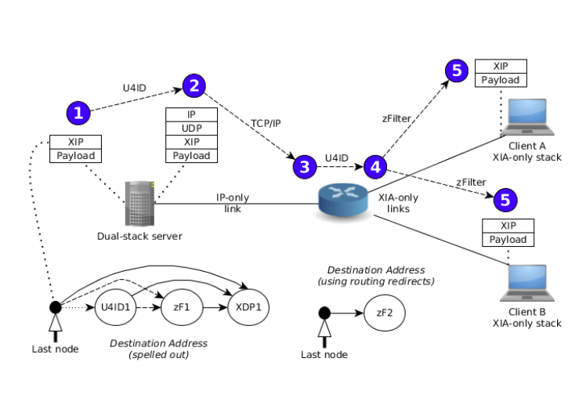
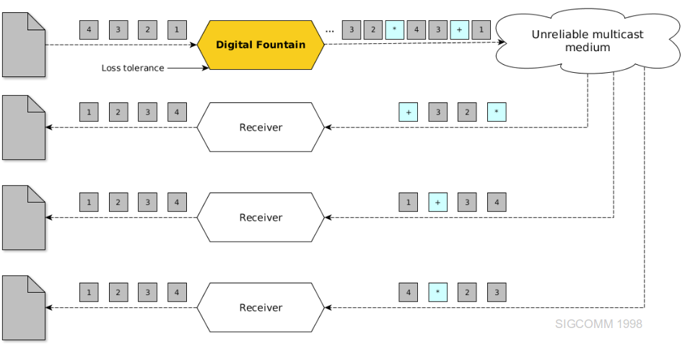
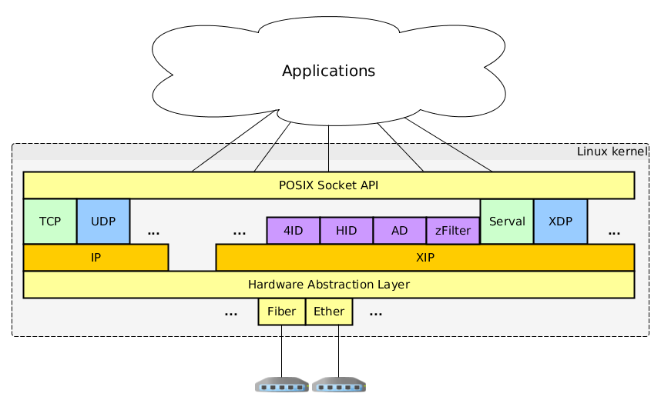
Linux XIA An Interoperable Meta Network Architecture to Crowdsource the Future Internet
Cody Doucette Michel Machado John W. Byers
Motivation
Take-Home Message
Summary of Work
The legacy Internet is not well-suited to increasingly complex needs: security, mobility, management...
Many future Internet architecture projects have emerged; none have been successful due to the legacy network's innovation barrier.
Previous work has tried to address the barrier, but none have emphasized collaboration and interoperability.
Linux XIA can act as a meta architecture that is amenable to network evolution by serving as an incubator for networking ideas, old and new.
Fully independent network stack
High-frequency editable routing table
Efficient routing dependencies
Support for POSIX socket API
In synch with latest Linux kernel release
Reasonable forwarding performance; comparable to Linux IP in most cases
Reliable multicast application
eXpressive Internet Architecture
Three key ideas in XIA¹:
Principal types for different usage models: hosts, ASes, content, services, as-of-yet unknown types
Flexibility in addressing: incremental deployment, non-linear addressing scheme (DAGs)
Intrinsic security: cryptographically-derived, self-certifying identifiers
By building the above concepts into a new network-layer protocol, XIP, network evolution is enabled.
Future Goals
Reliable Multicast
Video Application
Short Term:
Building applications: iperf, nginx, Firefox
Going upstream in Linux Kernel
Implementing information-centric networking and advanced routing techniques
Long Term:
Maintain a level playing field for technologies old and new
Enable anyone to experiment with networking ideas in a collaborative environment
Crowdsource the future Internet
Linux XIA
zFilter
Multicast⁵
Digital
Fountain⁶
Active
Networks²
Look for us in...
YOUR IDEA HERE
POSIX
Datagram
Sockets
Legacy
Tunneling
ANCS'15 Google Summer of Code
Serval
Service
Arch.³
Host
Identifiers
[1] Han et al. XIA: Efficient Support for Evolvable Internetworking. NSDI 2012.
[2] Wetherall, D. J. Service Introduction in an Active Network. PhD thesis, Massachusetts Institute of Technology. 1999.
[3] Nordstrom et al. Serval: An End-Host Stack for Service-Centric Networking. NSDI 2012.
[4] Jacobson et al. Networking Named Content. SIGCOMM 2009.
[5] Jokela et al. LIPSIN: Line Speed Publish/Subscribe Inter-Networking. SIGCOMM 2009.
[6] Byers et al. A Digital Fountain Approach to Reliable Distribution of Bulk Data. SIGCOMM 1998.
Named
Data
Net.⁴
Linux XIA is funded by NSF under awards
CNS-1040800, CNS-1345307, and CNS-1347525

