Slide 1
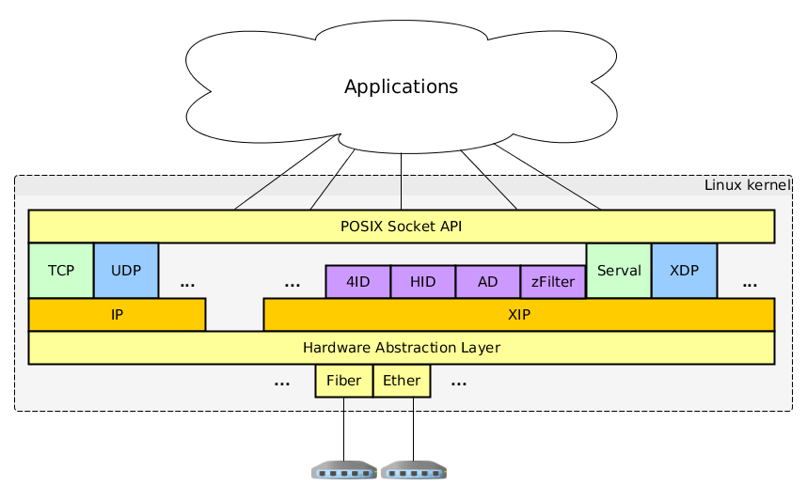
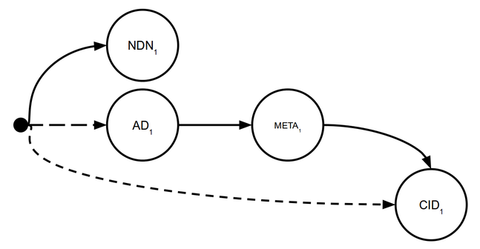
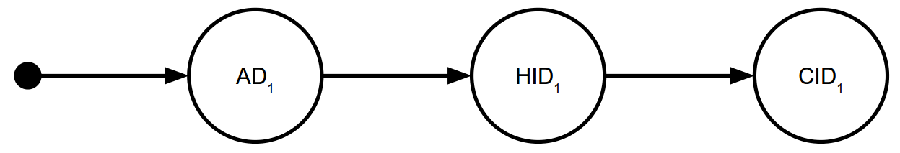
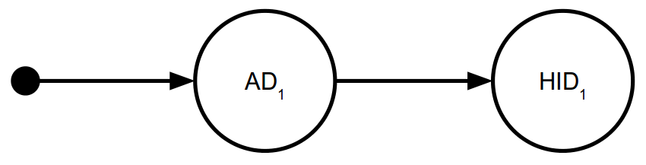
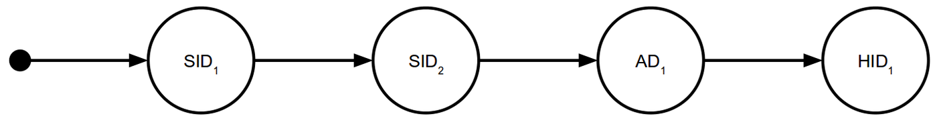




Exploring New Principals and Use-Cases in Linux XIA
Cody Doucette
Michel Machado John W. Byers
Motivation
Discover new XIA functionality and a killer XIA application
Expose interesting new principals, use cases, and DAG addressing techniques
Information-Centric Networking
XIA can allow more choice in ICN:
Network core: NDN-style, CID-style, ...
Network core and edge: meta-information [3]
Network edge: content selectors (version, pub.)
DAG fallbacks can flexibly, evolvably mix and match these various choices:
[3]: “Economic Incentives in Content-Centric Networking: Implications for Protocol Design and Public Policy.”
P. Agyapong, CMU. (XIA-related PhD dissertation.)
Fast Packet Processing
Recent work (netmap [1], DPDK [2], …) moves packet I/O to user space
Advantage: better performance
Disadvantage: kernel bypass limits routing, filtering, flow reconstruction, ...
Balanced solution: an XIA principal could enable kernel processing and more performant delivery to user space using techniques in literature (mmap'd buffers)
Improving communication between the XIA stack in the kernel and applications could reduce latency and increase throughput
[1]: “netmap: a novel framework for fast packet I/O.” L. Rizzo, ATC'12.
[2]: Data Plane Development Kit. http://www.dpdk.org.
Random Intermediate Forwarding
Idea for principal type: before forwarding to the intended destination, packets visit a random intermediate node
Using a “random intermediate” could:
Anonymize the source of a packet
Load balance traffic in the network
Help identify/stop DoS attacks
Centralized DAG Generation
Potential solution to “where do DAGs come from?” problem; makes XIA more application friendly
Is SDN applicable here?
Could provide a centralized way to:
Map user choices to DAGs
“facebook.com” →
Insert network policies into DAGs
→
Enhanced Service Chaining
Recent work [4] has explored the benefits of using service identifiers in service chaining
XIA uses service identifiers (SIDs and others) and generalizes service chaining to more flexible combinations using DAGs
XIA service chaining could be scalable, generalizable, dynamic
[4]: “Exploiting ICN for Flexible Management of Software-Defined Networks.” M. Arumaithurai et al, ICN'14.
Linux XIA is funded by NSF under awards
CNS-1040800, CNS-1345307, and CNS-1347525

