Slide 1
NoSQL
Based on slides by
Mike Franklin and Jimmy Lin

Slide 2
Big Data (some old numbers)
Facebook:
  130TB/day: user logs
  200-400TB/day: 83 million pictures
Google: > 25 PB/day processed data
Gene sequencing: 100M kilobases
per day per machine
  Sequence 1 human cell costs Illumina $1k
  Sequence 1 cell for every infant by 2015?
  10 trillion cells / human body
Total data created in 2010: 1.ZettaByte (1,000,000 PB)/year
  ~60% increase every year

Slide 3
Big data is not only databases
Big data is more about data analytics and on-line querying
Many components:
Storage systems
Database systems
Data mining and statistical algorithms
Visualization

Slide 4
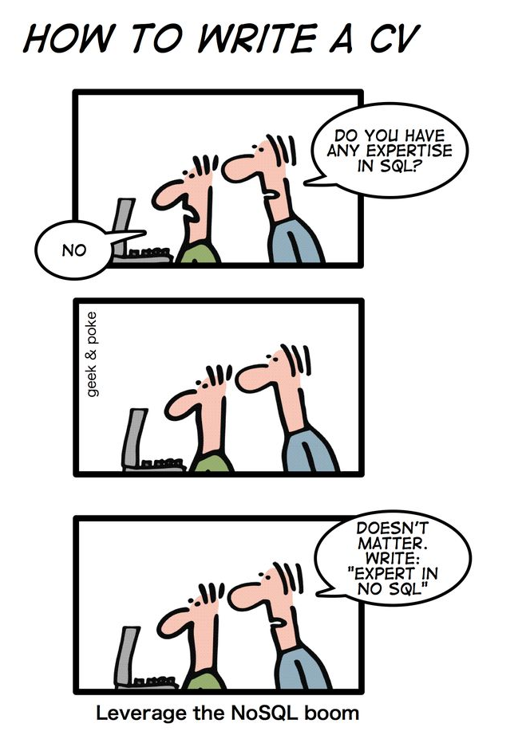
What is NoSQL?
from “Geek and Poke”

Slide 5
What is NoSQL?
An emerging “movement” around non-relational software for Big Data
Roots are in the Google and Amazon homegrown software stacks
Wikipedia: “A NoSQL database provides a mechanism for storage and retrieval of data that use looser consistency models than traditional relational databases in order to achieve horizontal scaling and higher availability. Some authors refer to them as "Not only SQL" to emphasize that some NoSQL systems do allow SQL-like query language to be used.”

Slide 6
Some NoSQL Components
Query Optimization
and Execution
Relational Operators
Access Methods
Buffer Management
Analytics Interface
(Pig, Hive, …)
Imperative Lang
(RoR, Java,Scala, …)
Disk Space Management
Data Parallel Processing
(MapReduce/Hadoop)
Distributed Key/Value or Column Store
(Cassandra, Hbase, Redis, …)
Scalable File System
(GFS, HDFS, …)

Slide 7
NoSQL features
Scalability is crucial!
  load increased rapidly for many applications
Large servers are expensive
Solution: use clusters of small commodity machines
  need to partition the data and use replication (sharding)
  cheap (usually open source!)
  cloud-based storage

Slide 8
NoSQL features
Sometimes not a well defined schema
Allow for semi-structured data
  still need to provide ways to query efficiently
  (use of index methods)
  need to express specific types of queries easily

Slide 9
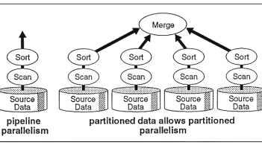
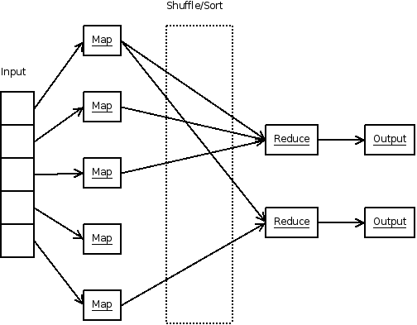
Scalability
Parallel Database
(circa 1990)
Map Reduce
(circa 2005)

Slide 10
Scalability (continued)
Often cited as the main reason for moving from DB technology to NoSQL
DB Position: there is no reason a parallel DBMS cannot scale to 1000’s of nodes
NoSQL Position: a) Prove it; b) it will cost too much anyway

Slide 11
Flavors of NoSQL
Four main types:
• key-value stores
• document databases
• column-family (aka big-table) stores
• graph databases
=>Here we will talk more about “Document” databases (MongoDB)

Slide 12
Key-Value Stores
There are many systems like that: Redis, MemcacheDB, Amazon's DynamoDB, Voldemort
• Simple data model: key/value pairs
• the DBMS does not attempt to interpret the value
• Queries are limited to query by key
• get/put/update/delete a key/value pair
• iterate over key/value pairs

Slide 13
Document Databases
Examples include: MongoDB, CouchDB, Terrastore
Also store key/value pairs
- However, the value is a document.
• expressed using some sort of semi-structured data model
• XML
• more often: JSON or BSON (JSON's binary counterpart)
• the value can be examined and used by the DBMS (unlike in key/ data stores)
• Queries can be based on the key (as in key/value stores), but more often they are based on the contents of the document.
• Here again, there is support for sharding and replication.
• the sharding can be based on values within the document

Slide 14
The Structure Spectrum
Structured (schema-first)
Semi-Structured (schema-later)
Unstructured (schema-never)
Relational Database
DocumentsXML
Plain Text
Media
Formatted Messages
Tagged Text/Media

Slide 15
MongoDB (An example of a Document Database)
-Data are organized in collections. A collection stores a set of documents.
Collection like table and document like record
  but: each document can have a different set of attributes even in the same collection
  Semi-structured schema!
Only requirement: every document should have an “_id” field
  humongous => Mongo

Slide 16
Example mongodb
{ "_id”:ObjectId("4efa8d2b7d284dad101e4bc9"),
"Last Name": ” Cousteau",
"First Name": ” Jacques-Yves",
"Date of Birth": ”06-1-1910" },
{ "_id": ObjectId("4efa8d2b7d284dad101e4bc7"),
"Last Name": "PELLERIN",
"First Name": "Franck",
"Date of Birth": "09-19-1983",
"Address": "1 chemin des Loges",
"City": "VERSAILLES" }

Slide 17
Example Document Database: MongoDB
Key features include:
• JSON-style documents
• actually uses BSON (JSON's binary format)
• replication for high availability
• auto-sharding for scalability
• document-based queries
• can create an index on any attribute
• for faster reads

Slide 18
MongoDB Terminology
relational term <== >MongoDB equivalent
----------------------------------------------------------
database <== > database
table <== > collection
row <== > document
attributes <== > fields (field-name:value pairs)
primary key <== > the _id field, which is the key associated with the document

Slide 19
JSON
JSON is an alternative data model for
semi-structured data.
  • JavaScript Object Notation
• Built on two key structures:
• an object, which is a sequence of name/value pairs
{ ”_id": "1000",
"name": "Sanders Theatre",
"capacity": 1000 }
• an array of values [ "123", "222", "333" ]
• A value can be:
• an atomic value: string, number, true, false, null
• an object
• an array

Slide 20
The _id Field
Every MongoDB document must have an _id field.
• its value must be unique within the collection
• acts as the primary key of the collection
• it is the key in the key/value pair
• If you create a document without an _id field:
• MongoDB adds the field for you
• assigns it a unique BSON ObjectID
• example from the MongoDB shell:
> db.test.save({ rating: "PG-13" })
> db.test.find() { "_id" :ObjectId("528bf38ce6d3df97b49a0569"), "rating" : "PG-13" }
• Note: quoting field names is optional (see rating above)

Slide 21
Data Modeling in MongoDB
Need to determine how to map
entities and relationships => collections of documents
• Could in theory give each type of entity:
• its own (flexibly formatted) type of document
• those documents would be stored in the same collection
• However, it can make sense to group different types of entities together.
• create an aggregate containing data that tends to be accessed together

Slide 22
Capturing Relationships in MongoDB
Two options:
  1. store references to other documents using their _id values
  2. embed documents within other documents

Slide 23
Example relationships
Consider the following documents examples:
{
"_id":ObjectId("52ffc33cd85242f436000001"),
"name": "Tom Hanks",
"contact": "987654321",
"dob": "01-01-1991"
}
{
"_id":ObjectId("52ffc4a5d85242602e000000"),
"building": "22 A, Indiana Apt",
"pincode": 123456,
"city": "Los Angeles",
"state": "California"
}
Here is an example of embedded relationship:
{
"_id":ObjectId("52ffc33cd85242f436000001"),
"contact": "987654321",
"dob": "01-01-1991",
"name": "Tom Benzamin",
"address": [
{
"building": "22 A, Indiana Apt",
"pincode": 123456,
"city": "Los Angeles",
"state": "California"
},
{
"building": "170 A, Acropolis Apt",
"pincode": 456789,
"city": "Chicago",
"state": "Illinois"
}
]
}
And here an example of reference based
{
"_id":ObjectId("52ffc33cd85242f436000001"),
"contact": "987654321",
"dob": "01-01-1991",
"name": "Tom Benzamin",
"address_ids": [
ObjectId("52ffc4a5d85242602e000000"),
ObjectId("52ffc4a5d85242602e000001")
]
}

Slide 24
Queries in MongoDB
Each query can only access a single collection of documents.
• Use a method called
db.collection.find(<selection>, <projection>)
• Example: find the names of all R-rated movies:
> db.movies.find({ rating: 'R' }, { name: 1 })

Slide 25
Projection
Specify the name of the fields that you want in the output with 1 ( 0 hides the value)
Example:
  >db.movies.find({},{"title":1,_id:0})
  (will report the title but not the id)

Slide 26
Selection
You can specify the condition on the corresponding attributes using the find:
>db.movies.find({ rating: "R", year: 2000 }, { name: 1, runtime: 1 })
Operators for other types of comparisons:
MongoDB SQL equivalent
$gt, $gte >, >=
$lt, $lte <, <=
$ne !=
Example: find the names of movies with an earnings <= 200000
> db.movies.find({ earnings: { $lte: 200000 }})
For logical operators $and, $or, $nor
  use an array of conditions and apply the logical operator among the array conditions:
> db.movies.find({ $or: [ { rating: "R" }, { rating: "PG-13" } ] })

Slide 27
Aggregation
Recall the aggregate operators in SQL: AVG(), SUM(), etc.
More generally, aggregation involves computing a result
from a collection of data.
• MongoDB supports several approaches to aggregation:
- single-purpose aggregation methods
- an aggregation pipeline
- map-reduce
Aggregation pipelines are more flexible and useful (see next):
https://docs.mongodb.com/manual/core/aggregation-pipeline/

Slide 28
Simple Aggregations
• db.collection.count(<selection>)
returns the number of documents in the collection
that satisfy the specified selection document
Example: how may R-rated movies are shorter than 90 minutes?
>db.movies.count({ rating: "R”, runtime: { $lt: 90 }})
db.collection.distinct(<field>, <selection>)
returns an array with the distinct values of the specified field
in documents that satisfy the specified selection document
if omit the query, get all distinct values of that field
- which actors have been in one or more of the top 10 grossing movies?
>db.movies.distinct("actors.name”, { earnings_rank: { $lte: 10 }})

Slide 29
Aggregation Pipeline
A very powerful approach to write queries in MongoDB is to use pipelines.
We execute the query in stages. Every stage gets as input some documents, applies filters/aggregations/projections and outputs some new documents. These documents are the input to the next stage (next operator) and so on

Slide 30
Aggregation Pipeline example
{
"_id": "10280",
"city": "NEW YORK",
"state": "NY",
"pop": 5574,
"loc": [
-74.016323,
40.710537
]
}
Example for the zipcodes database:
> db.zipcodes.aggregate( [
{ $group: { _id: "$state", totalPop: { $sum: "$pop" } } },
{ $match: { totalPop: { $gte: 10*1000*1000 } } }
] )
Here we use group_by to group documents per state, compute sum of population and output documents with _id, totalPop (_id has the name of the state). The next stage finds a match for all states the have more than 10M population and outputs the state and total population.
More here: https://docs.mongodb.com/v3.0/tutorial/aggregation-zip-code-data-set/

Slide 31
continued:
In SQL:
SELECT state, SUM(pop) AS totalPop
FROM zipcodes
GROUP BY state
HAVING totalPop >= (10*1000*1000)
Output example:
{
"_id" : "AK",
"totalPop" : 550043
}
db.zipcodes.aggregate( [
{ $group: { _id: "$state", totalPop: { $sum: "$pop" } } },
{ $match: { totalPop: { $gte: 10*1000*1000 } } }
] )

Slide 32
more examples:
db.zipcodes.aggregate( [
{ $group: { _id: { state: "$state", city: "$city" }, pop: { $sum: "$pop" } } },
{ $group: { _id: "$_id.state", avgCityPop: { $avg: "$pop" } } }
] )
What we compute here?
First we get groups by city and state and for each group we compute
the population.
Then we get groups by state and compute the average city population
{
"_id" : {
"state" : "CO",
"city" : "EDGEWATER"
},
"pop" : 13154
}
{
"_id" : "MN",
"avgCityPop" : 5335
}

Slide 33
Aggregation Pipeline example
{ c_id:”A123”
amount: 500,
status: “A”
}
{ c_id:”A123”
amount: 50,
status: “A”
}
{ c_id:”B132”
amount: 200,
status: “A”
}
{ c_id:”A123”
amount: 500,
status: “D”
}
{ c_id:”A123”
amount: 500,
status: “A”
}
{ c_id:”A123”
amount: 50,
status: “A”
}
{ c_id:”B132”
amount: 200,
status: “A”
}
{ _id:”A123”
total:
}
{ _id:”B132”
total: 200
}
$group
$match
db.orders.aggregate( [
{ $match: {status: “A”}}
{ $group: {_id:“c_id”, total: {$sum: $amount}}
])

Slide 34
Other Structure Issues
NoSQL: a) Tables are unnatural, b) “joins” are evil, c) need to be able to “grep” my data
DB: a) Tables are a natural/neutral structure, b) data independence lets you precompute joins under the covers, c) this is a price of all the DBMS goodness you get
This is an Old Debate – Object-oriented databases, XML DBs, Hierarchical, …

Slide 35
Fault Tolerance
DBs: coarse-grained FT – if trouble, restart transaction
  Fewer, Better nodes, so failures are rare
  Transactions allow you to kill a job and easily restart it
NoSQL: Massive amounts of cheap HW, failures are the norm and massive data means long running jobs
  So must be able to do mini-recoveries
  This causes some overhead (file writes)

Slide 36
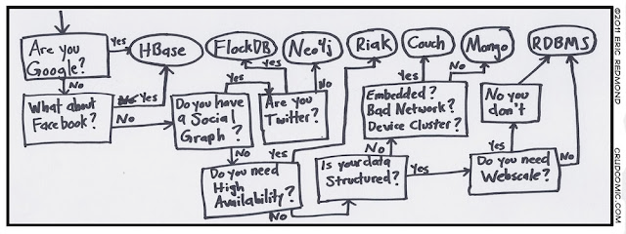

Slide 37
Cloud Computing Computation Models
Similar to SQL!!
Finding the right level of abstraction
  von Neumann architecture vs cloud environment
Hide system-level details from the developers
  No more race conditions, lock contention, etc.
Separating the what from how
  Developer specifies the computation that needs to be performed
  Execution framework (“runtime”) handles actual execution
Notes:
37

Slide 38
Typical Large-Data Problem
Map
Reduce
Key idea: provide a functional abstraction for these two operations – MapReduce
(Dean and Ghemawat, OSDI 2004)
Iterate over a large number of records
Extract something of interest from each
Shuffle and sort intermediate results
Aggregate intermediate results
Generate final output
Notes:
38

Slide 39
Roots in Functional Programming
Map
f
f
f
f
f
Fold
g
g
g
g
g
Notes:
39

Slide 40
MapReduce
Programmers specify two functions:
  map (k, v) → <k’, v’>*
  reduce (k’, v’) → <k’, v’’>*
  All values with the same key are sent to the same reducer
The execution framework handles everything else…
Notes:
40

Slide 41
MapReduce
k₁
v₁
k₂
v₂
k₃
v₃
k₄
v₄
k₅
v₅
k₆
v₆
map
map
map
map
a
1
b
2
c
3
c
6
a
5
c
2
b
7
c
8
Shuffle and Sort: aggregate values by keys
a
1
5
b
2
7
c
2
3
6
8
reduce
reduce
reduce
r₁
s₁
r₂
s₂
r₃
s₃
Notes:
41

Slide 42
MapReduce
What’s “everything else”?
Programmers specify two functions:
  map (k, v) → <k’, v’>*
  reduce (k’, v’) → <k’, v’>*
  All values with the same key are sent to the same reducer
The execution framework handles everything else…
Notes:
42

Slide 43
MapReduce “Runtime”
Handles scheduling
  Assigns workers to map and reduce tasks
Handles “data distribution”
  Moves processes to data
Handles synchronization
  Gathers, sorts, and shuffles intermediate data
Handles errors and faults
  Detects worker failures and automatically restarts
Handles speculative execution
  Detects “slow” workers and re-executes work
Everything happens on top of a distributed FS (later)
Sounds simple, but many challenges!
Notes:
43

Slide 44
MapReduce
Programmers specify two functions:
  map (k, v) → <k’, v’>*
  reduce (k’, v’) → <k’, v’>*
  All values with the same key are reduced together
The execution framework handles everything else…
Not quite…usually, programmers also specify:
  partition (k’, number of partitions) → partition for k’
  Often a simple hash of the key, e.g., hash(k’) mod R
  Divides up key space for parallel reduce operations
  combine (k’, v’) → <k’, v’>*
  Mini-reducers that run in memory after the map phase
  Used as an optimization to reduce network traffic
Notes:
44

Slide 45
k₁
v₁
k₂
v₂
k₃
v₃
k₄
v₄
k₅
v₅
k₆
v₆
map
map
map
map
a
1
b
2
c
3
c
6
a
5
c
2
b
7
c
8
combine
combine
combine
combine
a
1
b
2
c
9
a
5
c
2
b
7
c
8
partition
partition
partition
partition
Shuffle and Sort: aggregate values by keys
a
1
5
b
2
7
c
c
2
2
3
9
6
8
8
reduce
reduce
reduce
r₁
s₁
r₂
s₂
r₃
s₃
Notes:
45

Slide 46
Two more details…
Barrier between map and reduce phases
  But we can begin copying intermediate data earlier
Keys arrive at each reducer in sorted order
  No enforced ordering across reducers
Notes:
46

Slide 47
MapReduce Overall Architecture
User
Program
(1) submit
Master
(2) schedule map
(2) schedule reduce
worker
split 0
(5) remote read
(6) write
output
file 0
split 1
(3) read
worker
split 2
(4) local write
split 3
worker
split 4
output
file 1
worker
worker
Input
files
Map
phase
Intermediate files
(on local disk)
Reduce
phase
Output
files
Adapted from (Dean and Ghemawat, OSDI 2004)
Notes:
47

Slide 48
“Hello World” Example: Word Count
Map(String docid, String text):
for each word w in text:
Emit(w, 1);
Reduce(String term, Iterator<Int> values):
int sum = 0;
for each v in values:
sum += v;
Emit(term, value);
Notes:
48

Slide 49
MapReduce can refer to…
Usage is usually clear from context!
The programming model
The execution framework (aka “runtime”)
The specific implementation
Notes:
49

Slide 50
MapReduce Implementations
Google has a proprietary implementation in C++
  Bindings in Java, Python
Hadoop is an open-source implementation in Java
  Development led by Yahoo, used in production
  Now an Apache project
  Rapidly expanding software ecosystem, but still lots of room for improvement
Lots of custom research implementations
  For GPUs, cell processors, etc.
Notes:
50

Slide 51

Cloud Computing Storage, or how do we get data to the workers?
NAS
SAN
Compute Nodes
What’s the problem here?
Notes:
51

Slide 52
Distributed File System
Don’t move data to workers… move workers to the data!
  Store data on the local disks of nodes in the cluster
  Start up the workers on the node that has the data local
Why?
  Network bisection bandwidth is limited
  Not enough RAM to hold all the data in memory
  Disk access is slow, but disk throughput is reasonable
A distributed file system is the answer
  GFS (Google File System) for Google’s MapReduce
  HDFS (Hadoop Distributed File System) for Hadoop
Notes:
52

Slide 53
GFS: Assumptions
GFS slides adapted from material by (Ghemawat et al., SOSP 2003)
Choose commodity hardware over “exotic” hardware
  Scale “out”, not “up”
High component failure rates
  Inexpensive commodity components fail all the time
“Modest” number of huge files
  Multi-gigabyte files are common, if not encouraged
Files are write-once, mostly appended to
  Perhaps concurrently
Large streaming reads over random access
  High sustained throughput over low latency
Notes:
53

Slide 54
GFS: Design Decisions
HDFS = GFS clone (same basic ideas implemented in Java)
Files stored as chunks
  Fixed size (64MB)
Reliability through replication
  Each chunk replicated across 3+ chunkservers
Single master to coordinate access, keep metadata
  Simple centralized management
No data caching
  Little benefit due to large datasets, streaming reads
Simplify the API
  Push some of the issues onto the client (e.g., data layout)
Notes:
54

Slide 55
From GFS to HDFS
Terminology differences:
  GFS master = Hadoop namenode
  GFS chunkservers = Hadoop datanodes
Functional differences:
  No file appends in HDFS (was planned)
  HDFS performance is (likely) slower
Notes:
55

Slide 56
HDFS Architecture
HDFS namenode
Application
/foo/bar
(file name, block id)
File namespace
HDFS Client
block 3df2
(block id, block location)
instructions to datanode
(block id, byte range)
datanode state
HDFS datanode
HDFS datanode
block data
Linux file system
Linux file system
…
…
Adapted from (Ghemawat et al., SOSP 2003)
Notes:
56

Slide 57
Namenode Responsibilities
Managing the file system namespace:
  Holds file/directory structure, metadata, file-to-block mapping, access permissions, etc.
Coordinating file operations:
  Directs clients to datanodes for reads and writes
  No data is moved through the namenode
Maintaining overall health:
  Periodic communication with the datanodes
  Block re-replication and rebalancing
  Garbage collection
Notes:
57

Slide 58
Putting everything together…
namenode
job submission node
namenode daemon
jobtracker
tasktracker
tasktracker
tasktracker
datanode daemon
datanode daemon
datanode daemon
Linux file system
Linux file system
Linux file system
…
…
…
slave node
slave node
slave node
Notes:
58

Slide 59
MapReduce/GFS Summary
Simple, but powerful programming model
Scales to handle petabyte+ workloads
  Google: six hours and two minutes to sort 1PB (10 trillion 100-byte records) on 4,000 computers
  Yahoo!: 16.25 hours to sort 1PB on 3,800 computers
Incremental performance improvement with more nodes
Seamlessly handles failures, but possibly with performance penalties
Notes:
59

