Slide 1

Wyner’s Wire-Tap Channel, Forty Years Later
Leonid Reyzin
These slides are a superset of the talks given at: - Theory of Cryptography Conference on March 24, 2015 (parts I and II) - École Normale Supérieure Crypto Seminar on March 26, 2015 (parts I and II)
- Charles River Crypto Day on April 17, 2015 (parts I and most of III)
Notes:
1
1

Slide 2
Part I
History and Context

Slide 3

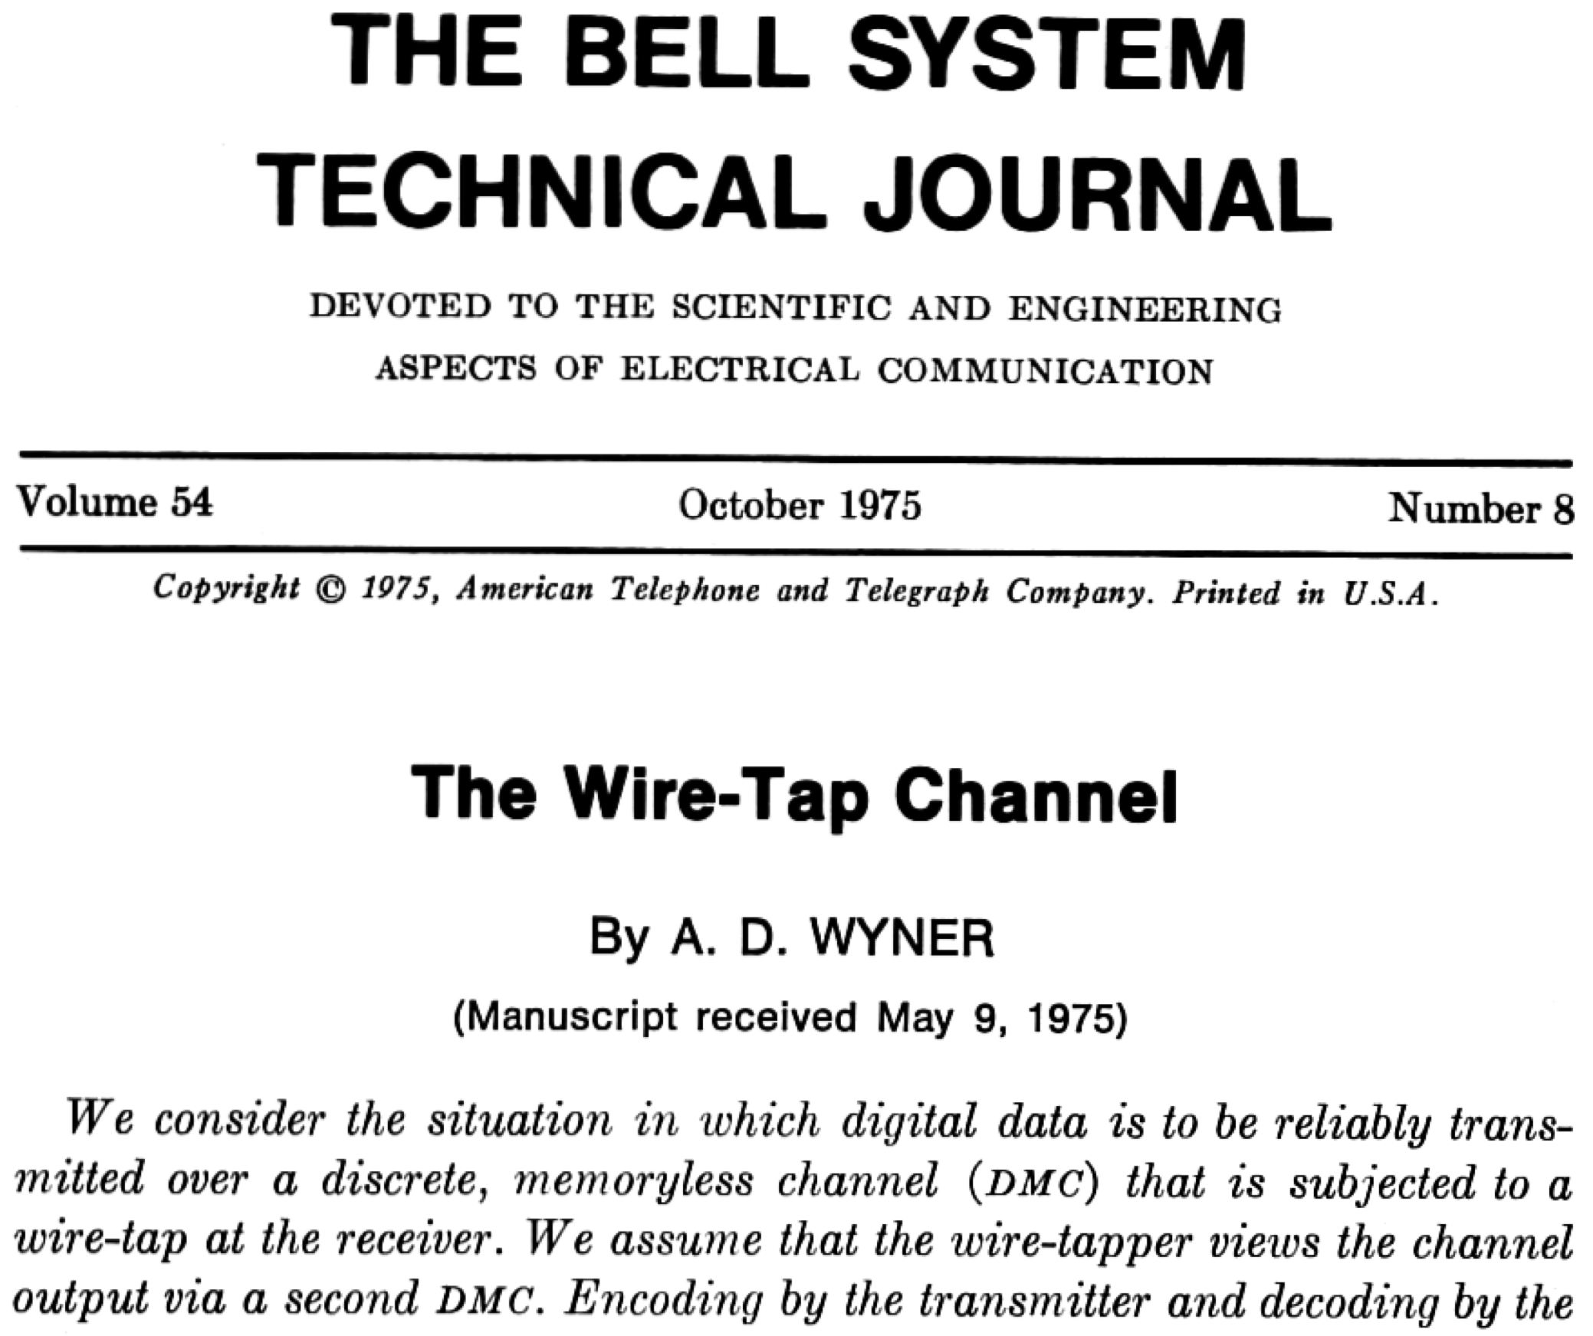
Two Events in October 1975 Enabled This Talk
I was born
Aaron D. Wyner published “The Wire-Tap Channel”
Aaron Wyner c. 1975 (courtesy of Adi Wyner)

Slide 4
Premise of “The Wire-Tap Channel”
Alice
noisy channel
Bob
additional noise
Eve (wire-tapper)
Goal: transfer information from Alice to Bob reliably while hiding it from Eve
Results: Upper/lower bounds on information rate (“secrecy capacity”)
Constructive for a special case (in a few slides)

Slide 5
Context: mid-1970s surge of interest in crypto
Alice
noisy channel
Bob
additional noise
Eve (wire-tapper)
Q: Where Does Secrecy Come From?
Public Keys [Diffie-Hellman 1976, Merkle 1978]
Secret Keys [Shannon 1949] … [Hellman 1974-77]
Nature [Wyner 1975]
Only 5 references: 3 for basic info-theory background +

Slide 6
Simple Special Case
Alice
noisy channel
Bob
additional noise
Eve (wire-tapper)

Slide 7
Simple Special Case
Alice
no noise
Bob
additional noise
Eve (wire-tapper)

Slide 8
Simple Special Case
Alice
no noise
Bob
bits flipped with small probability
Eve (wire-tapper)

Slide 9
Simple Special Case
p₁ p₂ p₃…
Alice
no noise
Bob
bits flipped with small probability
Securely conveys b = ⊕ p_{i}
q₁ q₂ q₃…
Eve (wire-tapper)
Wyner: XOR amplifies information-theoretic uncertainty
Alice sends a string p = p₁ p₂ p₃…
Eve will see q_{i} =p_{i} ⊕ noise; most, but not all, q_{i} =p_{i}
Given enough bits, parity of p looks uniform

Slide 10
Yao 1982: “Theory and Applications of Trapdoor Functions”
PK
SK
Alice
f (x₁), f (x₂), …
Bob
Securely conveys b = ⊕ P(x_{i})
Perfect knowledge of f (x_{i}), but “noisy” knowledge of P(x_{i})
Eve (noiseless but bounded wire-tapper)
Yao: XOR amplifies computational uncertainty
Setup: Weak TDP f (x) with somewhat hardcore predicate P(x) Alice has PK and Bob has SK

Slide 11
Yao 1982: “Theory and Applications of Trapdoor Functions”
PK
SK
Alice
f (x₁), f (x₂), …
Bob
Securely conveys b = ⊕ P(x_{i})
Perfect knowledge of f (x_{i}), but “noisy” knowledge of P(x_{i})
Eve (noiseless but bounded wire-tapper)
“this situation has an exact analogue in the classical information theory, known as the Wyner wiretap channel [25]. Wyner showed that even when the noise in [Eve’s] channel is small, [Alice] can magnify the noise by properly encoding [her] messages.”

Slide 12
Levin 1985,87 “One-Way Functions and Pseudorandom Generators” (proof of Yao’s XOR Lemma)
“One of the important ideas of [Yao 82] is that the methods of [Wyner 75] can be applied for computational as well as for purely probabilistic unpredictability.”

Slide 13
Back to Wyner
Alice
p = p₁p₂…, no noise
Bob
Conveys b = ⊕ p_{i}
bits flipped with small probability
Eve (wire-tapper)
Consider the conditional distribution p | Eve’s knowledge (= U | U ⊕ binary symmetric noise)
Wyner’s observation (reformulated): parity is a deterministic extractor from this distribution
Q: Can we do better? (i.e., extract more bits = increase rate)
A [Wyner]: Yes!

Slide 14
Back to Wyner
Alice
p = p₁p₂…, no noise
Bob
Conveys s = Hp
(H = parity-check matrix for a linear error-correcting code)
bits flipped with small probability
Eve (wire-tapper)
Consider the conditional distribution p | Eve’s knowledge (= U | U ⊕ binary symmetric noise)
Wyner’s observation (reformulated): parity is a deterministic extractor from this distribution
Q: Can we do better? (i.e., extract more bits = increase rate)
A [Wyner]: Yes!
“the coding scheme [above] is based on an idea of Mr. [Colin] Mallows”

Slide 15
Santha-Vazirani 1986 “Generating quasi-random sequences from semi-random sources”
“Wyner shows how to achieve optimal rate of communication, using parity-check codes. We show how to use the same method to extract quasi-random sequences at a higher rate.”
Thm: Hp is an extractor from any distribution where each bit has pre-selected bounded bias (under stronger demands on quality of output than Wyner)

Slide 16
Note the two views of extractors
[Santha-Vazirani]:
poor quality randomness
indistinguishable from uniform
Ext
[Wyner]:
randomness (maybe uniform)
Ext
indistinguishable from uniform given leakage
leakage
Eve

Slide 17
Summary of Wyner’s paper
Alice
noisy channel
Bob
additional noise
Eve (wire-tapper)
Goal: transfer information from Alice to Bob reliably while hiding it from Eve
Results: - Derive best achievable “secrecy capacity” - Achieve it constructively for the case above (assuming good linear codes) - Achieve it nonconstructively in all other cases
Drawback: Weak notion of security (“low rate of leakage”)

Slide 18
Lessons
Alice
noisy channel
Bob
additional noise
Eve (wire-tapper)
There is interesting work to do in provable information-theoretic security
Noise can be your friend
Secrets can come from nature

Slide 19
Early Generalization
Alice
noisy channel
Bob
additional noise
Eve (wire-tapper)
[Csiszár-Körner 1978]:

Slide 20
Early Generalization
Alice
noisy channel
Bob
noisier channel
Eve (wire-tapper)
[Csiszár-Körner 1978]:
no reason Eve’s channel should be a degraded version of Bob’s: it just needs to be worse

Slide 21
A Different Model for Eve’s Knowledge
Alice
noisy channel
Bob
a few chosen bit positions
Eve (wire-tapper)
wire-tapper gets to choose specific symbols to see
Result: Hp is still a good deterministic extractor
[Ozarow-Wyner 1985]:

Slide 22
Adding a Feedback Channel
authentic public channel
Alice
Bob
noisy channel
possibly less noisy channel
Eve (wire-tapper)
[Leung-Yan-Cheong 1976] (Ph.D. Thesis under Hellman), [Maurer 1993], [Ahlswede-Csiszár 1993]: Eve’s channel need not be noisier if Bob has a feedback channel

Slide 23
Generalizing
authentic public channel
Alice
Bob
noisy channel
possibly less noisy channel
Eve (wire-tapper)
[Bennett,Brassard,Robert 1985,88] (motivated by quantum): - errors can be adversarial - leakage can be arbitrary

Slide 24
Generalizing
authentic public channel
Alice
Bob
arbitrary bounded
tampering
possibly less noisy channel
Eve (wire-tapper)
[Bennett,Brassard,Robert 1985,88] (motivated by quantum): - errors can be adversarial - leakage can be arbitrary

Slide 25
Generalizing
authentic public channel
Alice
Bob
arbitrary bounded
tampering
arbitrary bounded leakage
Eve (wire-tapper)
[Bennett,Brassard,Robert 1985,88] (motivated by quantum): - errors can be adversarial - leakage can be arbitrary
Better security notion
Generalized further, better notions of entropy in [Bennett,Brassard,Crépeau,Maurer 1995]
information reconciliation
privacy amplification

Slide 26
Privacy Amplification
authentic public channel
Alice
Bob
no tampering (for now)
arbitrary bounded leakage
Eve (wire-tapper)
Bennett-Brassard-Robert: no fixed function will work (as opposed to Wyner’s specific kind of leakage)
But: a random universal hash function is an extractor (“leftover hash lemma”)
Just send the choice of the function (“extractor seed”) over the public channel

Slide 27
Privacy Amplification = Strong Extractor
Alice
Bob
w
w
leakage
Eve
In [Wyner], these are outcomes of his channel.
But can be obtained in other ways.
We will speak of w instead of a channel from now on

Slide 28
Privacy Amplification = Strong Extractor
seed over authentic public channel
Alice
Bob
w
w
leakage
Eve
seed
Ext
r
w
uniform given leakage+ seed
Note the power of the public channel: fewer assumptions on adversarial knowledge
Modified goal: derive a good key (can use public channel once the key is derived)

Slide 29
Privacy Amplification and Extractors
Hardness
Håstad-Impagliazzo-Levin-Luby 1989,99 (OWF⇒PRG)
another version of the same result: universal hash function is an extractor
(thus, three chain from Wyner to extractors: Wyner 75 → Yao 82 → Levin 87 → HILL
Wyner 75 → Santha-Vazirani Wyner 75 → Bennett-Brassard-Robert)

Slide 30
New Model: no authentic channels (besides w)
[Maurer, Maurer-Wolf 1997, 2003]
Alice
unauthenticated public channel
Bob
w
Bob’s last protocol message
w
last protocol message, r ⊕ m
r
Eve
Can no longer simply send the extractor seed: adversary may tamper
Single-message protocols still possible: “robust” extractors [Maurer-Wolf 97, Boyen-Dodis-Katz-Ostrovsky-Smith 05] but they exist only if w at least ½-entropic [Dodis-Wichs 09]
Lots of work on multi-message protocols [RW03,KR09,DW09,CKOR10,DLWZ11,CRS12,Li12,Li15…]; important tool: “non-malleable” extractors [Dodis-Wichs 09]
Two kinds of robustness: tampering before/after r is used (pre/post- application) [Dodis-Kanukurthi-Katz-Reyzin-Smith]

Slide 31
New Requirement: Source Privacy
Alice
unauthenticated public channel
Bob
w
w
Risk: tampering Eve may learn something about w by observing how the parties behave after she tampers
Standalone security guarantees it won’t be enough to cause problems
But what about sequential security? Imagine w is obtained using a secret process; the next one uses the same process
Need: “source private” extractors [Bouman,Fehr 2011] (Def’n: an active attack won’t tell Eve anything about w)
Relevant in, e.g., bounded storage model [Maurer 1990] and quantum key distribution

Slide 32
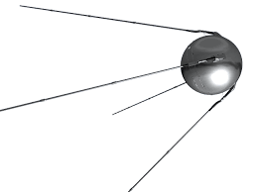
Bounded Storage Model
W
k
k
Alice
Bob
w
w
[Maurer 1990, 92]: W is a HUGE (perhaps streaming) string no one can store
Alice and Bob have a short shared secret k for probing W to get w
Eve stores arbitrary information about W
Need “locally computable” extractors [Lu 2002, 04]
Also used in “bounded retrieval model” [Dziembowski 06] [Di Crescenzo,Lipton,Walfish 06]
k is the secret used to obtain w and needs to be reusable: hence need source privacy

Slide 33
Dealing With Errors
Alice
information reconciliation
Bob
w₀
w₁
Eve
Recall that Wyner’s original paper had noise on the main channel, but no constructions for this case
Common approach: reduce to the no-tampering case by performing information reconciliation over public channel
Add whatever leaks during that process to Eve’s knowledge
Solve the no-tampering case using appropriate extractors
Information reconciliation + extractors = “fuzzy extractors” [Dodis-Ostrovsky-Reyzin-Smith 2004, 08]

Slide 34
Applying to Biometrics
Alice
information reconciliation
Bob
w₀
w₁
Eve
Most of us have ≤10 fingers and ≤2 eyes
Variants of w₀ derived from same iris scan may be used in different systems without coordination
A single-protocol security guarantee doesn’t extend: information reconciliation leakage may be additive
Can we prevent multiple protocols from revealing w₀?
Need: “reusable” extractors [Boyen 2004]

Slide 35
Many Kinds of Extractors
[robust/n-m] [local] [source-private] [fuzzy] [reusable]
Most combinations are interesting and valid as models

Slide 36
Many Kinds of Extractors
[robust/n-m] [local] [source-private] [fuzzy] [reusable]
Interaction: Deterministic / Single-Message / Interactive Input constraints: what’s minimum required entropy Protocol quality: entropy loss, number of rounds if interactive
Ex 1: active adversary, need to handle errors: robust + fuzzy [RW04,BDKOS05,DKKRS06,KR09,DW09,CKOR10, …]
Ex 2: bounded storage model with errors local + fuzzy + source-private [Dodis-Smith 2005]
Ex 3: active adversary, large secret, need to protect source post-app robust + source-private + local [Aggarwal-Dodis-Jafargholi-Miles-Reyzin 2014]

Slide 37
Information-Theoretic Protocols Beyond Key Agreement
[Crépeau,Kilian 1988] [Benett,Brassard,Crépeau,Skubiszweska 1991] [Damgard, Kilian, Salvail 1999] oblivious transfer and variations using noise/quantum
[Crépeau 1997] bit commitment using noise
Other works I probably don’t know about, including many in quantum cryptography

Slide 38
Given all this follow-up, what about Wyner’s paper?
22
36
128
2440
1975
1985
1995
2005
2015
Google Scholar Citation Counts by Decade
Half the total citations are from the 2012-2015
Most (?) are in the info-theory community, nonconstructive, with security definitions that won’t make us happy
Many are due to recent interest in physical-layer security

Slide 39
Given all this follow-up, what about Wyner’s paper?
Alice
noisy channel
Bob
noisier channel
Eve
Wyner’s model is artificial for crypto community: we assume a free public channel and thus focus on key derivation
Question: what can you do without a free channel (every bit counts – so “derive key + encrypt” loses half the rate)
[Bellare Tessaro Vardy 2012]: first cryptographic treatment (“semantic security”) and first optimal construction

Slide 40
Lessons
Alice
noisy channel
Bob
noisier channel
Eve

Slide 41
Lessons
Alice
public channel
Bob
w₀
w₁
Eve (passive or active)
Secrets can come from nature, but we need to tame them
Research Directions:
Finding the right notion of security
Minimizing assumptions about adversarial knowledge
Broadening sources of secrets
Understanding fundamental bounds on what’s feasible
Finding the right notion of input entropy
Making it all efficient

Slide 42
Lessons
Alice
public channel
Bob
w₀
w₁
Eve (passive or active)
Secrets can come from nature, but we need to tame them
Research Directions:
Finding the right notion of security
Minimizing assumptions about adversarial knowledge
Broadening sources of secrets
Understanding fundamental bounds on what’s feasible
Finding the right notion of input entropy
Making it all efficient

Slide 43
Part II
Fuzzy Extractors for Noisy Sources with More Errors than Entropy
Ran Canetti, Benjamin Fuller, Omer Paneth, Leonid Reyzin, and Adam Smith
http://eprint.iacr.org/2014/243

Slide 44
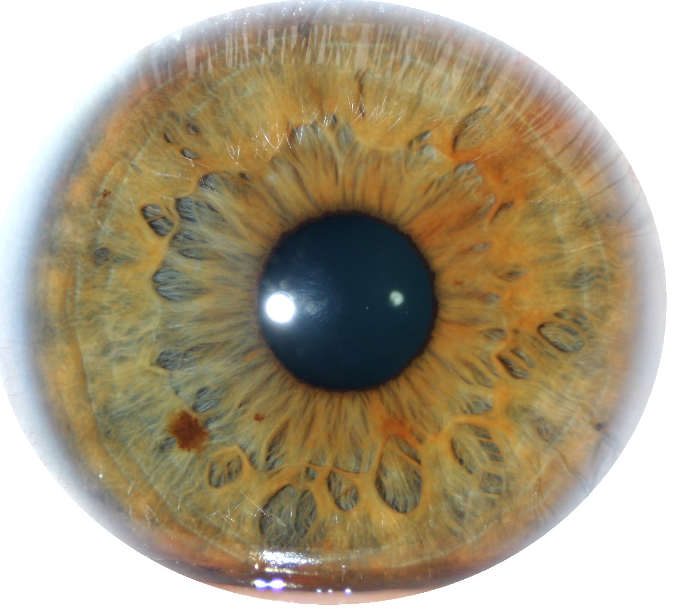
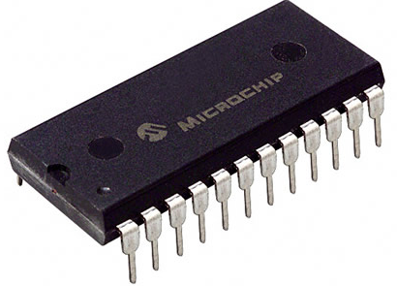
Our Setting
Alice
information reconciliation + privacy amplification
Bob
w₀
w₁
Non-Tampering Eve
Single message: Alice and Bob can be the same person at different times
Target application: key extraction from unique physical features
Physically Unclonable Functions (PUFs)
Biometrics

Slide 45
Notation
Enrollment algorithm Gen (Alice): Take a measurement w₀ from the source. Use it to “lock up” a random output in a nonsecret value p.
Subsequent algorithm Rep (Bob): give same output if d(w₀, w₁) < t
Security: r looks uniform even given p, whenever the source is good enough
Gen
r
w₀
Rep
p
r
< t
w₁

Slide 46
Fuzzy Extractors: Goals
Goal 1: handle as many sources as possible (typically, any source in which w₀ is 2^{k} hard to guess)
Goal 2: handle as much error as possible (typically, any w₁ within distance t)
Most previous approaches are analyzed in terms of t and k
This work: handle t > k
Gen
r
entropy k
w₀
Rep
p
r
< t
w₁

Slide 47
Fuzzy Extractors: Typical Construction
- derive r using a randomness extractor
(converts high-entropy sources to uniform, e.g., via universal hashing)
- correct errors using a secure sketch
(gives recovery of the original from a noisy signal e.g., via the “checksum” bits of an error-correcting code)
Gen
r
entropy k
w₀
Ext
Rep
p
r
< t
Ext
w₁

Slide 48
Fuzzy Extractors: Typical Construction
- derive r using a randomness extractor
(converts high-entropy sources to uniform, e.g., via universal hashing)
- correct errors using a secure sketch
(gives recovery of the original from a noisy signal e.g., via the “checksum” bits of an error-correcting code)
Gen
r
entropy k
w₀
Ext
Rep
p
r
w₀
< t
Sketch
Ext
Rec
w₁

Slide 49
Problem with Secure Sketches
p must store enough information to let you recover w₀
How much information is that?
Gen
r
entropy k
w₀
Ext
Rep
p
r
w₀
< t
Sketch
Ext
Rec
w₁

Slide 50
Problem with Secure Sketches
p must store enough information to let you recover w₀
How much information is that?
w₀ could be anywhere within distance t, so log|B_{t} | > t bits
No security left if t > k (can be made rigorous for large classes of sources)
Observation: not necessary to recover w₀
stores t bits about w₀
has k < t bits of entropy
Rep
w₀
p
r
B_{t}
w₀
< t
Ext
Rec
w₁

Slide 51
Is it possible to handle “more errors than entropy” (t > k)?
Consider some distribution for w₀ with entropy k
Suppose t > k
Then B_{t} > 2^{k}
Possibly |B_{t}| > # of possibilities for w₀
Possibly all w₀ lie in a single ball
No matter what we do, adversary can get the output by running Rep on w₁ = center of that ball
t
r
w₁
Rep

Slide 52
Is it possible to handle “more errors than entropy” (t > k)?
t
r
w₁
Rep
w₁
But if all the points are far apart, the problem is trivial! (at least information-theoretically)

Slide 53
Is it possible to handle “more errors than entropy” (t > k)?
t
r
w₁
Rep
w₁
No construction that is analyzed only in terms of t and k can distinguish the two cases

Slide 54
Is it possible to handle “more errors than entropy” (t > k)?
t
r
w₁
Rep
w₁
Moral: our constructions will exploit structure in the source (not “any source of a given k” like prior work)

Slide 55
What Sources Can We Handle?
Sources with high-entropy samples
w₀ = a₁ a₂ a₃ a₄ a₅ a₆ a₇ a₈ a₉
sample: a₂ a₅ a₇
We need: for some superlog sample size you are guaranteed to get superlog entropy
Sufficient assumption: somewhat q-wise independence for superlogarithmic q
E.g., IrisCode [Daugman] is redundant and noisy (t>>k): log |B_{t}| ≈ 900 but k ≈ 250 Yet this assumption is plausible

Slide 56
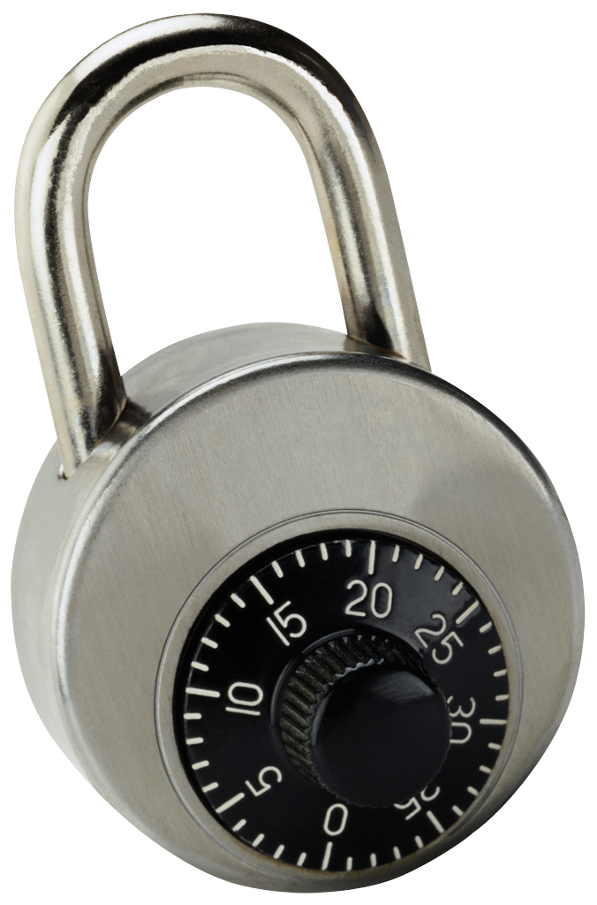
Idea: “encrypt” r using parts of w₀
Source: a string of symbols, arbitrary alphabet
Errors: Hamming
Gen: - get random combinations of symbols in w₀
r
- “lock” r using these combinations
r
w₀ = a₁ a₂ a₃ a₄ a₅ a₆ a₇ a₈ a₉
Gen
p
r
r
r
r
r
r
r
r
r
r
r
r
a₁ a₉ a₂
a₃ a₉ a₅
a₃ a₄ a₅
a₇ a₅ a₆
a₂ a₈ a₇
a₃ a₅ a₂

Slide 57
Idea: “encrypt” r using parts of w₀
Source: a string of symbols, arbitrary alphabet
Errors: Hamming
Gen: - get random combinations of symbols in w₀
r
- “lock” r using these combinations
r
w₀ = a₁ a₂ a₃ a₄ a₅ a₆ a₇ a₈ a₉
Gen
p
r
r
r
r
r
r
r
r
r
r
r
r
a₁ a₉ a₂
a₃ a₉ a₅
a₃ a₄ a₅
a₇ a₅ a₆
a₂ a₈ a₇
a₃ a₅ a₂

Slide 58
Idea: “encrypt” r using parts of w₀
Source: a string of symbols, arbitrary alphabet
Errors: Hamming
Gen: - get random combinations of symbols in w₀
r
- “lock” r using these combinations
r
w₀ = a₁ a₂ a₃ a₄ a₅ a₆ a₇ a₈ a₉
Gen
p
r
r
r
r
r
r
r
r
r
r
r
r
a₁ a₉ a₂
a₃ a₉ a₅
a₃ a₄ a₅
a₇ a₅ a₆
a₂ a₈ a₇
a₃ a₅ a₂

Slide 59
Idea: “encrypt” r using parts of w₀
Source: a string of symbols, arbitrary alphabet
Errors: Hamming
Gen: - get random combinations of symbols in w₀
r
- “lock” r using these combinations
- = locks + positions of symbols needed to unlock
p
r
w₀ = a₁ a₂ a₃ a₄ a₅ a₆ a₇ a₈ a₉
Gen
p
r
r
r
r
r
r
a₁ a₉ a₂
a₃ a₉ a₅
a₃ a₄ a₅
a₇ a₅ a₆
a₂ a₈ a₇
a₃ a₅ a₂

Slide 60
Idea: “encrypt” r using parts of w₀
Source: a string of symbols, arbitrary alphabet
Errors: Hamming
Gen: - get random combinations of symbols in w₀
r
- “lock” r using these combinations
- = locks + positions of symbols needed to unlock
p
r
w₀ = a₁ a₂ a₃ a₄ a₅ a₆ a₇ a₈ a₉
Gen
p
r
r
r
r
r
r
a₁ a₉ a₂
a₃ a₉ a₅
a₃ a₄ a₅
a₇ a₅ a₆
a₂ a₈ a₇
a₃ a₅ a₂

Slide 61
Idea: “encrypt” r using parts of w₀
Source: a string of symbols, arbitrary alphabet
Errors: Hamming
Gen: - get random combinations of symbols in w₀
r
- “lock” r using these combinations
- = locks + positions of symbols needed to unlock
p
p
r
r
r
r
r
r
a₁ a₉ a₂
a₃ a₉ a₅
a₃ a₄ a₅
a₇ a₅ a₆
a₂ a₈ a₇
a₃ a₅ a₂

Slide 62
Idea: “encrypt” r using parts of w₀
Source: a string of symbols, arbitrary alphabet
Errors: Hamming
Gen: - get random combinations of symbols in w₀
r
- “lock” r using these combinations
- = locks + positions of symbols needed to unlock
p
Rep:
w₁ = a₁ a₂ a₃ a₄ a₅ a₆ a₇ a₈ a₉
r
Rep
p
r
r
r
r
r
r
a₁ a₉ a₂
a₃ a₉ a₅
a₃ a₄ a₅
a₇ a₅ a₆
a₂ a₈ a₇
a₃ a₅ a₂

Slide 63
Idea: “encrypt” r using parts of w₀
Source: a string of symbols, arbitrary alphabet
Errors: Hamming
Gen: - get random combinations of symbols in w₀
r
- “lock” r using these combinations
- = locks + positions of symbols needed to unlock
p
Rep:
w₁ = a₁ a₂ a₃ a₄ a₅ a₆ a₇ a₈ a₉
r
Rep
p
r
r
r
r
r
r
a₁ a₉ a₂
a₃ a₉ a₅
a₃ a₄ a₅
a₇ a₅ a₆
a₂ a₈ a₇
a₃ a₅ a₂

Slide 64
Idea: “encrypt” r using parts of w₀
Source: a string of symbols, arbitrary alphabet
Errors: Hamming
Gen: - get random combinations of symbols in w₀
r
- “lock” r using these combinations
- = locks + positions of symbols needed to unlock
p
Rep: Use the symbols of w₁ to open at least one lock
w₁ = a₁ a₂ a₃ a₄ a₅ a₆ a₇ a₈ a₉
r
Rep
p
r
r
r
r
r
r
a₁ a₉ a₂
a₃ a₉ a₅
a₃ a₄ a₅
a₇ a₅ a₆
a₂ a₈ a₇
a₃ a₅ a₂

Slide 65
Idea: “encrypt” r using parts of w₀
Source: a string of symbols, arbitrary alphabet
Errors: Hamming
Gen: - get random combinations of symbols in w₀
r
- “lock” r using these combinations
- = locks + positions of symbols needed to unlock
p
Rep: Use the symbols of w₁ to open at least one lock
w₁ = a₁ a₂ a₃ a₄ a₅ a₆ a₇ a₈ a₉
r
Rep
p
r
r
r
r
r
r
r
a₁ a₉ a₂
a₃ a₉ a₅
a₃ a₄ a₅
a₇ a₅ a₆
a₂ a₈ a₇
a₃ a₅ a₂

Slide 66
Idea: “encrypt” r using parts of w₀
Source: a string of symbols, arbitrary alphabet
Errors: Hamming
Gen: - get random combinations of symbols in w₀
r
- “lock” r using these combinations
- = locks + positions of symbols needed to unlock
p
Rep: Use the symbols of w₁ to open at least one lock
Error-tolerance: as long as at least one combination is ok
Security: each combination must have enough entropy
r
r
r
r
r
r
r
a₁ a₉ a₂
a₃ a₉ a₅
a₃ a₄ a₅
a₇ a₅ a₆
a₂ a₈ a₇
a₃ a₅ a₂

Slide 67
How to implement locks?
r
a₁ a₉ a₂
R.O. model [Lynn Prabhakaran Sahai 04]:
lock = nonce, Hash(nonce, a₁ a₉ a₂) ⊕ (r||00…0)

Slide 68
How to implement locks?
A lock is the following program:
If input = a₁ a₉ a₂, output r
Else output ⊥
r
a₁ a₉ a₂
Obfuscate this program!
Obfuscation: preserve functionality, hide the program
Obfuscating this specific program gives a “digital locker”: encryption of r that is secure even multiple times with correlated and weak keys [Canetti Kalai Varia Wichs 10]
For this specific program: obfuscation is practical (R.O. or DL-based) [Canetti Dakdouk 08], [Bitansky Canetti 10]
Hiding r as long as the input can’t be exhaustively searched (superlogarithmic entropy)
Notes:
ADS: Say RO construction first? Then say point obfuscation?

Slide 69
How to implement locks?
A lock is the following program:
If input = a₁ a₉ a₂, output r
Else output ⊥
r
a₁ a₉ a₂
Q: if you are going to use obfuscation, why not this:
Gen
r
Pick random r
p = obfuscate{ if dis(w₀, ⋅ ) ≤ t → r else →⊥ }
w₀
Rep
p
r
Send input to the obfuscated program p
w₁
A: you can do that [Bitansky Canetti Kalai Paneth 14], except it’s very impractical + has a very strong assumption

Slide 70
How good is this construction?
We can correct more errors than entropy!
For correctness: need sublinear error
Note: computational, not information-theoretic, security
r
r
r
r
r
r
a₁ a₉ a₂
a₃ a₉ a₅
a₃ a₄ a₅
a₇ a₅ a₆
a₂ a₈ a₇
a₃ a₅ a₂

Slide 71
How good is this construction?
It is reusable!
Same source can be enrolled multiple times with multiple independent services
r
w₀
Gen
p
Secret even given
p, p’,p’’, r, r’'
r'
w₀'
Gen
p'
r''
w₀''
Gen
p''

Slide 72
How good is this construction?
It is reusable!
Same source can be enrolled multiple times with multiple independent services
Follows from composability of obfuscation
In the past: difficult to achieve, because typically new enrollments leak fresh information
Previous constructions: non-fuzzy [Dodis Kalai Lovett 09] or all readings must differ by fixed constants [Boyen 2004]
Our construction: each reading individually must satisfy our conditions

Slide 73
What Sources Can We Handle?
1. Sources with high-entropy samples (with reusability)!
2. Sources with sparse high-entropy marginals (requires large alphabets)
Constraint: individual symbols have high entropy (but no independence assumed)
w₀ =
a₁
a₂
OR
w₀ =
a₃
a₄
a₅
a₆
r
r
r
r
r
r
a₁
a₂
a₃
a₄
a₅
a₆

Slide 74
Construction for Sparse High-Entropy Marginals
Problem: each low-entropy symbol reveals one bit of r
w₀ =
a₁
a₂
a₃
a₄
a₅
a₆
r
r
r
r
r
r
a₁
a₂
a₃
a₄
a₅
a₆

Slide 75
Construction for Sparse High-Entropy Marginals
Problem: each low-entropy symbol reveals one bit of r
Solution: use a randomness extractor at the end
w₀ =
a₁
a₂
a₃
a₄
a₅
a₆
r
r
r
r
r
r
r
a₁
a₂
a₃
a₄
a₅
a₆

Slide 76
Construction for Sparse High-Entropy Marginals
w₀ =
a₁
a₂
a₃
a₄
a₅
a₆
r
r
r
r
r
r
r
a₁
a₂
a₃
a₄
a₅
a₆

Slide 77
Construction for Sparse High-Entropy Marginals
Problem: differences in w₁ will make us miss some bits
Solution: use an error-correcting code
w₁ =
a₁
a₂
a₃
a₄
a₅
a₆
r
r
r
r
r
r
r
a₁
a₂
a₃
a₄
a₅
a₆

Slide 78
What Sources Can We Handle?
1. Sources with high-entropy samples: with reusability! (subconstant error rate)
2. Sources with sparse high-entropy marginals: with constant error rate! (requires large alphabets)
3. Sparse block sources information theoretically! (stricter entropy condition)
r
r
r
r
r
r
a₁
a₂
a₃
a₄
a₅
a₆

Slide 79
What Sources Can We Handle?
1. Sources with high-entropy samples: with reusability! (subconstant error rate)
2. Sources with sparse high-entropy marginals: with constant error rate! (requires large alphabets)
3. Sparse block sources information theoretically! (stricter entropy condition)
Ideas:
For sources with more errors than entropy:
- avoid information reconciliation
- exploit the source structure
For reusability:
- use computational security

Slide 80
What I Just Showed
Alice
Bob
w₀
w₁
Eve (passive)
Eve
Secrets can come from nature, but we need to tame them
Research Directions:
Finding the right notion of security
Minimizing assumptions about adversarial knowledge
Broadening sources of secrets
Understanding fundamental bounds on what’s feasible
Finding the right notion of input entropy
Making it all efficient

Slide 81
What I will show next
Alice
Bob
w₀
w₁
Eve (passive)
Secrets can come from nature, but we need to tame them
Research Directions:
Finding the right notion of security
Minimizing assumptions about adversarial knowledge
Broadening sources of secrets
Understanding fundamental bounds on what’s feasible
Finding the right notion of input entropy
Making it all efficient
Fir0002/Flagstaffotos

Slide 82
Part III
When are Fuzzy Extractors Possible?
Benjamin Fuller, Leonid Reyzin, and Adam Smith
http://eprint.iacr.org/2014/961

Slide 83
Our Setting (same as Part II)
Alice
information reconciliation + privacy amplification
Bob
w₀
w₁
Non-Tampering Eve
Single message: Alice and Bob can be the same person at different times
Target application: key extraction from unique physical features
Physically Unclonable Functions (PUFs)
Biometrics

Slide 84
Notation (same as Part II)
Enrollment algorithm Gen (Alice): Take a measurement w₀ from the source W. Use it to “lock up” a random output in a nonsecret value p.
Subsequent algorithm Rep (Bob): give same output if d(w₀, w₁) < t
Gen
looks uniform given p if the source is good enough
r
w₀
Rep
p
r
< t
w₁

Slide 85
Notation (same as Part II)
Gen
looks uniform given p if the source is good enough
r
w₀
Rep
p
r
< t
w₁

Slide 86
When are fuzzy extractors possible?
Gen
looks uniform given p if the source is good enough
r
w₀
Rep
p
r
< t
w₁

Slide 87
When are fuzzy extractors possible?
An adversary can always try a guess w₀ in W
p
r
Rep
Source W
Minimum requirement: every w₀ has low probability
Gen
looks uniform given p if the source is good enough
r
w₀
Rep
p
r
= seed

Slide 88
When are fuzzy extractors possible?
Define min-entropy: H∞(W) = min −log Pr[w]
Necessary: H∞(W) > security parameter
And sufficient by Leftover Hash Lemma
Minimum requirement: every w₀ has low probability
Gen
looks uniform given p if the source is good enough
r
w₀
Rep
p
r
= seed

Slide 89
When are fuzzy extractors possible?
An adversary can always try a guess w₁ near many w₀
p
t
w₁
Rep
r
Source W
Minimum requirement: every B_{t} has low probability
Gen
looks uniform given p if the source is good enough
r
w₀
Rep
p
r
< t
w₁

Slide 90
When are fuzzy extractors possible?
Define fuzzy min-entropy: H_{fuzz}(W) = min_{Bt} −log Σ_{w ∈ Bt} Pr[w]
Necessary: H_{fuzz} (W) > security parameter
Sufficient?
Minimum requirement: every B_{t} has low probability
Gen
looks uniform given p if the source is good enough
r
w₀
Rep
p
r
< t
w₁

Slide 91
H_{fuzz}(W) = min_{Bt} −log (mass inside B_{t})
Why bother with this new notion? Can’t we use the old one?
H_{fuzz}(W) ≥ H∞(W) − log |B_{t}|
(since mass inside B_{t} ≤ max Pr[w] ⋅ |B_{t}|)
Because there are distributions
“with more errors than entropy”
( log |B_{t}| > H∞(W) )
But perhaps H_{fuzz}(W) > 0

Slide 92
Why is H_{fuzz} the right notion?
An adversary can always try a guess w₁ near many w₀
p
t
w₁
Rep
r
Q: can we make sure that’s all the adversary can do?
A: yes, using obfuscation! [Bitansky Canetti Kalai Paneth 14]
Gen
r
Pick random r
p = obfuscate{ if dis(w₀, ⋅ ) ≤ t → r else →⊥ }
w₀
Rep
p
r
Send input to the obfuscated program p
w₁

Slide 93
Why is H_{fuzz} the right notion?
An adversary can always try a guess w₁ near many w₀
p
t
w₁
Rep
r
- H_{fuzz} is necessary
- H_{fuzz} is sufficient against computational adversaries
- What about information-theoretic adversaries?

Slide 94
Claim: we can extract ~H_{fuzz} bits
Gen
r
H_{fuzz}(w₀)=k
w₀
Ext

Slide 95
Claim: we can extract ~H_{fuzz} bits
Gen
r
H_{fuzz}(w₀)=k
w₀
Ext
Rep
p
r
w₀
< t
Sketch
Ext
Rec
w₁

Slide 96
Claim: we can extract ~H_{fuzz} bits
H_{fuzz}(w₀)=k
w₀
p
w₀
< t
Sketch
Rec
w₁

Slide 97
Claim: we can extract ~H_{fuzz} bits
p needs to disambiguate the possible points in B_{t}(w₁)
suppose all w₀ are equiprobable
(max mass in B_{t})
l ≈ log (max # w₀ in B_{t})
= log
______________
Pr[w₀]
=H∞ (W)−H_{fuzz}(W)
|r| ≈ H∞ (W) − l = H_{fuzz}(W)
p
=Hash(w₀) of length l
r
w₀
Rec
Ext
t
w₁

Slide 98
Claim: we can extract ~H_{fuzz} bits
p needs to disambiguate the possible points in B_{t}(w₁)
suppose all w₀ are equiprobable
(max mass in B_{t})
l ≈ log (max # w₀ in B_{t})
= log
______________
Pr[w₀]
=H∞ (W)−H_{fuzz}(W)
|r| ≈ H∞ (W) − l = H_{fuzz}(W)
stays
grows
grows
p
=Hash(w₀) of length l
r
w₀
Rec
Ext
t
w₁

Slide 99
Claim: we can extract ~H_{fuzz} bits
p needs to disambiguate the possible points in B_{t}(w₁)
suppose all w₀ are equiprobable
(max mass in B_{t})
l ≈ log (max # w₀ in B_{t})

______________
= log
Pr[w₀]
>
=H∞ (W)−H_{fuzz}(W)
|r| ≈ H∞ (W) − l = H_{fuzz}(W)
p
=Hash(w₀) of length l
r
w₀
Rec
Ext
t
w₁

Slide 100
Claim: we can extract ~H_{fuzz} bits
p needs to disambiguate the possible points in B_{t}(w₁)
suppose all w₀ are equiprobable
l ≈ log (max # w₀ in B_{t})
variable, grows with log 1/Pr[w₀]
reveals log 1/Pr[w₀] ✗, a value between 1 and log |W|
|r| ≈ H∞ (W) − l = H_{fuzz}(W)
p
=Hash(w₀) of length l
r
w₀
Rec
Ext
t
w₁

Slide 101
Claim: we can extract ~H_{fuzz} bits
p needs to disambiguate the possible points in B_{t}(w₁)
suppose all w₀ are equiprobable
l ≈ log (max # w₀ in B_{t})
variable, grows with log 1/Pr[w₀]
reveals log 1/Pr[w₀] ✗, a value between 1 and log |W|
|r| ≈ H∞ (W) − l = H_{fuzz}(W)
− log log |W|
(e.g. log n if W is over {0,1}^{n})
p
=Hash(w₀) of length l
r
w₀
Rec
Ext
t
w₁

Slide 102
Claim: we can extract ~H_{fuzz} bits
Feasibility-only result!
Sketch needs to know log Pr[w₀]
Rec is not efficient in general.
Rec needs to know W (to know candidate w₀ values)
p
=Hash(w₀) of correct length
w₀
Sketch
w₀
t
Rec
w₁

Slide 103
What if we don’t know W ?
Common design goal: one construction for family of sources (e.g., all sources of a given H_{fuzz})
Recall:
Family of sources with
randomness (maybe uniform)
⇔
poor quality randomness
leakage
unknown to Gen, Rep
Eve
(e.g, Eve gets z = Gw for random linear G)

Slide 104
What if we don’t know W ?
Common design goal: one construction for family of sources (e.g., all sources of a given H_{fuzz})
w₁
p
Rec
w₀
w₁

Slide 105
What if we don’t know W ?
Common design goal: one construction for family of sources (e.g., all sources of a given H_{fuzz})
w₁
p
Rec
w₀
w₁

Slide 106
What if we don’t know W ?
Common design goal: one construction for family of sources (e.g., all sources of a given H_{fuzz})
Rec needs to recover from w₁ regardless of which W the original w₀ came from
w₁
p
Rec
w₀
w₁

Slide 107
What if we don’t know W ?
Common design goal: one construction for family of sources (e.g., all sources of a given H_{fuzz})
Rec needs to recover from w₁ regardless of which W the original w₀ came from
⇓
p has a lot of information about w₀
⇓
combined with Eve’s z = Gw₀ it’s too much (because p is generated without knowledge of G)
w₁

Slide 108
What if we don’t know W ?
Common design goal: one construction for family of sources (e.g., all sources of a given H_{fuzz})
Rec needs to recover from w₁ regardless of which W the original w₀ came from
Theorem: ∃ a family {W} with superlog H∞(W) s.t. any Sketch, Rec that corrects 4 Hamming errors with prob. > 1/4 will have H_{fuzz}(W | p) < 2
⇓
p has a lot of information about w₀
⇓
combined with Eve’s z = Gw₀ it’s too much (because p is generated without knowledge of G)

Slide 109
What if we don’t know W ?
Common design goal: one construction for family of sources (e.g., all sources of a given H_{fuzz})
But we don’t have to recover w₀!

Slide 110
What if we don’t know W ?
Common design goal: one construction for family of sources (e.g., all sources of a given H_{fuzz})
But we don’t have to recover w₀!
Gen
r
w₀
Ext
Rep
p
r
w₀
< t
Sketch
Ext
Rec
w₁

Slide 111
What if we don’t know W ?
Common design goal: one construction for family of sources (e.g., all sources of a given H_{fuzz})
But we don’t have to recover w₀!
Gen
r
w₀
something else entirely
Rep
p
r
< t
something else entirely
w₁

Slide 112
What if we don’t know W ?
Common design goal: one construction for family of sources (e.g., all sources of a given H_{fuzz})
Given p, this partition is known
Nothing near the boundary can have been w₀ (else Rep wouldn’t be 100% correct)
w₁ s.t. Rep(w₁, p) = 0
w₀
p
w₁ s.t. Rep(w₁, p) = 1
Rep
r
w₁
(even just one bit)

Slide 113
What if we don’t know W ?
Common design goal: one construction for family of sources (e.g., all sources of a given H_{fuzz})
Given p, this partition is known
Nothing near the boundary can have been w₀ (else Rep wouldn’t be 100% correct)
w₁ s.t. Rep(w₁, p) = 0
Leaves little uncertainty about w₀ (high-dimensions ⇒ everything near boundary)
No w₀ in here!
Combined with Eve’s z = Gw₀ no uncertainty left (because p is generated without knowledge of G)
w₁ s.t. Rep(w₁, p) = 1

Slide 114
What if we don’t know W ?
Common design goal: one construction for family of sources (e.g., all sources of a given H_{fuzz})
Given p, this partition is known
Nothing near the boundary can have been w₀ (else Rep wouldn’t be 100% correct)
Theorem: ∃ a family {W} over {0,1}^{n} with superlog H∞(W) s.t. any Gen, Rep that handles at least n^{1/2}log n errors can’t output even 2 bits (if Rep is 100% correct)
Leaves little uncertainty about w₀ (high-dimensions ⇒ everything near boundary)
Combined with Eve’s z = Gw₀ no uncertainty left (because p is generated without knowledge of G)

Slide 115
Summary
Natural and necessary notion: H_{fuzz}(W) = log (1/max wt(B_{t}))
Sufficient under computational assumptions
Sufficient if the distribution is known
t
w₁
r
Rep
In case of distributional uncertainty:
Insufficient for secure sketches
Insufficient for perfectly correct fuzzy extractors in high dimensions
Open: removing perfect correctness limitation

Slide 116
What I just showed
Alice
public channel
Bob
w₀
w₁
Eve (passive or active)
Secrets can come from nature, but we need to tame them
Research Directions:
Finding the right notion of security
Minimizing assumptions about adversarial knowledge
Broadening sources of secrets
Understanding fundamental bounds on what’s feasible
Finding the right notion of input entropy
Making it all efficient

Slide 117
Lots more to be done!
Alice
Bob
w₀
w₁
Eve (passive or active)
Secrets can come from nature, but we need to tame them
Research Directions:
Finding the right notion of security
Minimizing assumptions about adversarial knowledge
Broadening sources of secrets
Understanding fundamental bounds on what’s feasible
Finding the right notion of input entropy
Making it all efficient

Slide 118
Aaron Wyner c. 1975 (courtesy of Adi Wyner)

