Slide 1

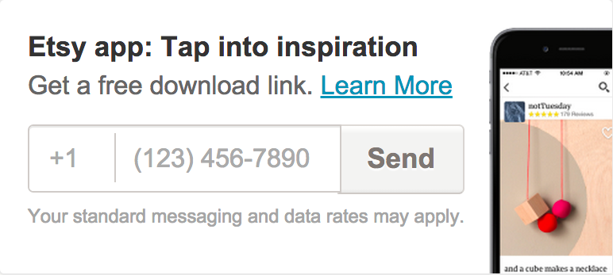

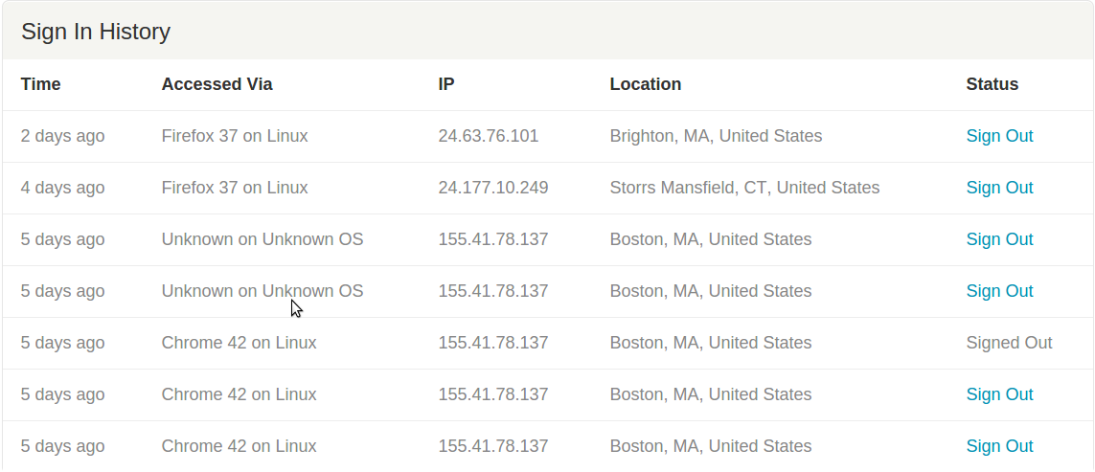
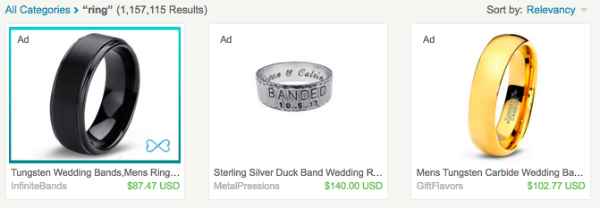

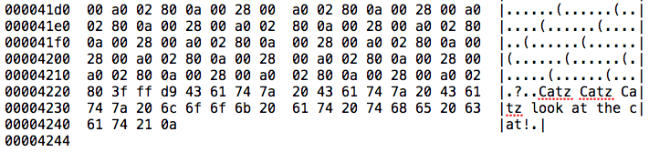
The Security of Etsy
Etsy employs good security practices.
After visiting 50+ Etsy pages, we have found
that Etsy:
1. Always uses HTTPS, never sending any
information in the clear. No mixed content.
2. Offers two-factor authentication.
3. Offers users the option of being notified whenever a login from a new device occurs.
4. Enables users to view a history of past logins, including IP address and user agent.
5. Protects against CSRF attacks using nonces.
(contained in the HTML itself, not in a cookie)
6. Protects against XSS attacks by using HTTP headers.
7. Has no external ads.
8. Images in private messages are accompanied by a MAC.
9. Sanitizes most input data, such as image meta-data. (However, it should be noted that the image content is not sanitized - see potential exploit (A).)
10. Blocks many throwaway emails, preventing some spam.
How Etsy tracks its users:
Cookies: used to store the necessary user personal information.
Clear gifs, web beacons and web plugins: no user personal information stored.
Flash cookies and other locally stored objects: solely for fraud prevention. No user personal information stored.
Potential Vulnerabilities / Exploits
(B) Text Bomb
An automated script could be written to repeatedly send text messages to a given number. This could:
1. Result in potentially high expenses for the victim,
who may have a pay-per-message plan
2. Result in a denial of service attack if the messages arrive at such a frequency that the victim cannot use his phone for other tasks
(C) Click Fraud
A user can have his merchandise advertised in response to a given search query, and must pay per click generated by that store. An automated script could be written to generate large numbers of clicks, resulting in potentially high expenses for the victim.
(D) Side Channels
The “search” field (as well as username registration and zip code fields) issues HTTP requests for every letter typed; an analysis of the frequency of such requests can reveal the search keyword!
Auditing Etsy
Wil Koch,
Nikolaj Volgushev,
Sophia Yakoubov
#1!
Etsy privacy policy:
The Etsy privacy policy states that Etsy will not share user data with external organizations without explicitly getting the user’s permission. However, it appears that an exception to this is complying with legal requirements.
Potential Vulnerabilities / Exploits
(A) Malicious Payloads
While image meta-data is sanitized, image content is not. Since images are public and never deleted, this can be exploited to store malicious payloads.
For instance, consider the following image:
It actually has a message embedded!

