Slide 1
SQL Primer Boston University CS558 Network Security Fall 2015
SQL Examples taken from
http://www.w3schools.com/sql/

Slide 2
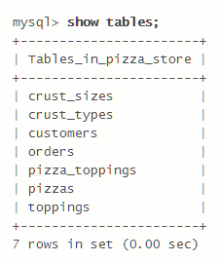
drop, show, create;
drop table myemployees;
CREATE TABLE Persons ( PersonID int, LastName varchar(255), FirstName varchar(255), Address varchar(255), City varchar(255) );

Slide 3
select
ProductID | ProductName | SupplierID | CategoryID | Unit | Price
1 | Chais | 1 | 1 | 10 boxes x 20 bags | 18
2 | Chang | 1 | 1 | 24 - 12 oz bottles | 19
3 | Aniseed Syrup | 1 | 2 | 12 - 550 ml bottles | 10
4 | Chef Anton's Cajun Seasoning | 1 | 2 | 48 - 6 oz jars | 22
5 | Chef Anton's Gumbo Mix | 1 | 2 | 36 boxes | 4
SELECT * FROM Products WHERE ProductName NOT BETWEEN ‘B' AND 'M';
SELECT COUNT(*) FROM Products WHERE ProductName LIKE '%sChef‘ -- returns 2
SELECT ProductName FROM Products WHERE Price BETWEEN 8 AND 21;
wildcard
comment

Slide 4
select
SELECT * FROM Products WHERE ProductName NOT BETWEEN 'C' AND 'M';
SELECT COUNT(*) FROM Products
WHERE (Price BETWEEN 10 AND 20) AND NOT CategoryID IN (1,2,3);
SELECT phoneNumber
FROM userTable
WHERE email= '$EMAIL';
SELECT * FROM Customers WHERE City LIKE '%s';
wildcard

Slide 5
insert, update
INSERT INTO Customers (CustomerName, City, Country) VALUES ('Cardinal', 'Stavanger', 'Norway');
UPDATE Customers SET ContactName='Alfred Schmidt', City='Hamburg' WHERE CustomerName='Alfreds Futterkiste';

Slide 6
SQL Injection Boston University CS558 Network Security
Most Slides taken from
CS155 at Stanford

Slide 7
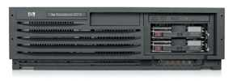
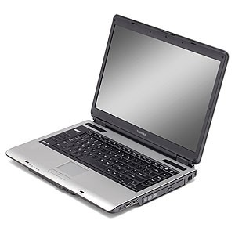
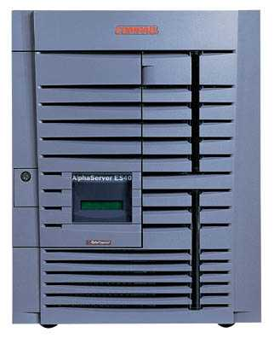
Basic picture: SQL Injection
Victim Server
post malicious form
1
2
unintended SQL query
3
receive valuable data
Attacker
Victim SQL DB

Slide 8
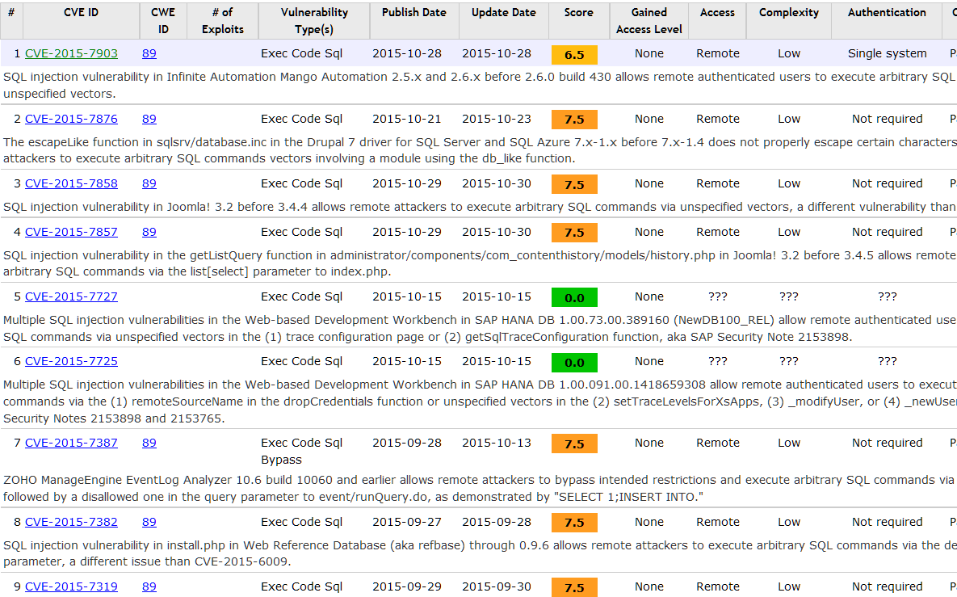
SQL Injection: A classic vulnerability that is still out there…
https://www.cvedetails.com/vulnerability-list/opsqli-1/sql-injection.html

Slide 9
Database queries with PHP
(the wrong way)
Sample PHP
$recipient = $_POST[‘recipient’];
$sql = "SELECT PersonID FROM Person WHERE Username='$recipient'";
$rs = $db->executeQuery($sql);
Problem
What if ‘recipient’ is malicious string that changes the meaning of the query?

Slide 10
Let’s see how the attack described in this cartoon works…

Slide 11
Example: buggy login page (ASP)
set ok = execute( "SELECT * FROM Users
WHERE user=' " & form(“user”) & " ' AND pwd=' " & form(“pwd”) & “ '” );
if not ok.EOF
login success
else fail;
Is this exploitable?
Notes:
This snipet is in VB.

Slide 12
Web
Browser (Client)
Enter
Username
&
Password
Web
Server
DB
SELECT *
FROM Users
WHERE user='me' AND pwd='1234'
Normal Query

Slide 13
Bad input
Suppose user = “ ' or 1=1 -- ” (URL encoded)
Then scripts does:
ok = execute( SELECT …
WHERE user= ' ' or 1=1 -- … )
The “--” causes rest of line to be ignored.
Now ok.EOF is always false and login succeeds.
The bad news: easy login to many sites this way.

Slide 14
Even worse
Suppose user =
“ ′ ; DROP TABLE Users -- ”
Then script does:
ok = execute( SELECT …
WHERE user= ′ ′ ; DROP TABLE Users … )
Deletes user table
Similarly: attacker can add users, reset pwds, etc.

Slide 15
Preventing SQL Injection
Never build SQL commands yourself !
Use parameterized/prepared SQL
Use ORM framework

Slide 16
PHP addslashes()
PHP: addslashes( “ ’ or 1 = 1 -- ”)
outputs: “ \’ or 1=1 -- ”
Unicode attack: (GBK)
$user = 0x bf 27
addslashes ($user) → 0x bf 5c 27 →
Correct implementation: mysql_real_escape_string()
0x 5c → \
0x bf 27 → ¿′
0x bf 5c →
′
Notes:
Escaping is tricky: addslashes() can reintroduce SQL injection vulnerability

Slide 17
Parameterized/prepared SQL
Builds SQL queries by properly escaping args: ′ → \′
Example: Parameterized SQL: (ASP.NET 1.1)
Ensures SQL arguments are properly escaped.
SqlCommand cmd = new SqlCommand( "SELECT * FROM UserTable WHERE username = @User AND password = @Pwd", dbConnection);
cmd.Parameters.Add("@User", Request[“user”] );
cmd.Parameters.Add("@Pwd", Request[“pwd”] );
cmd.ExecuteReader();
In PHP: bound parameters -- similar function
Notes:
Escapes with \. ‘ -> \’ . DB independent --- different DB’s have different rules for escaping.
This snipet is in C#

